Slide 1
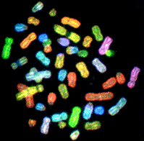
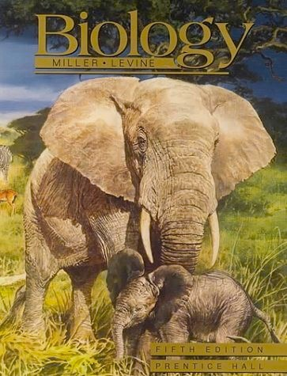
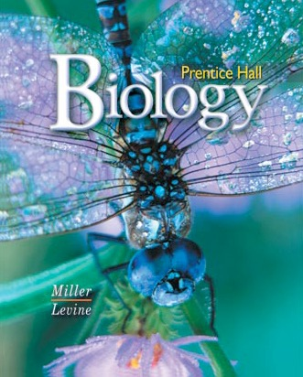
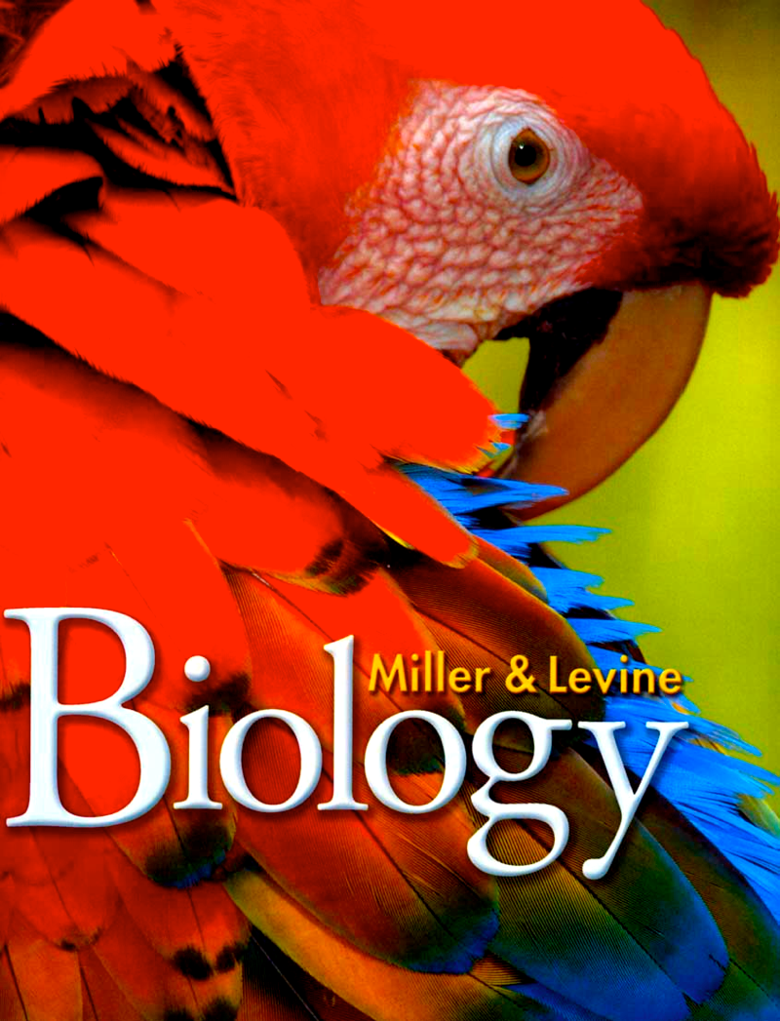
Biology - A New Generation
Ken Miller Brown University
7/19/17

Slide 2
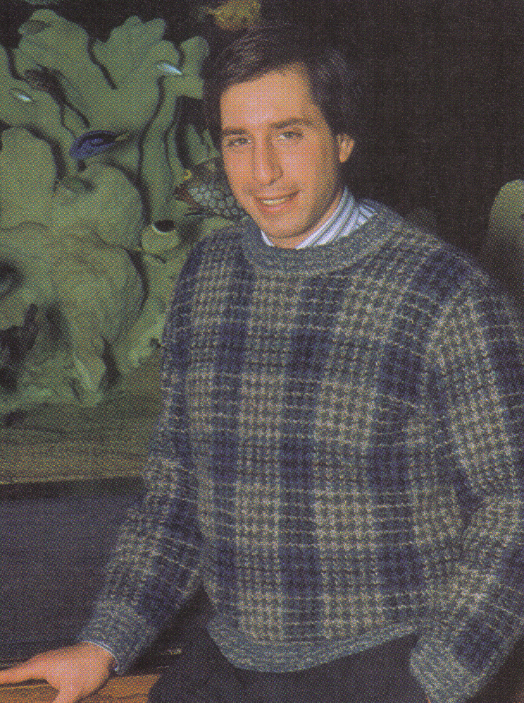
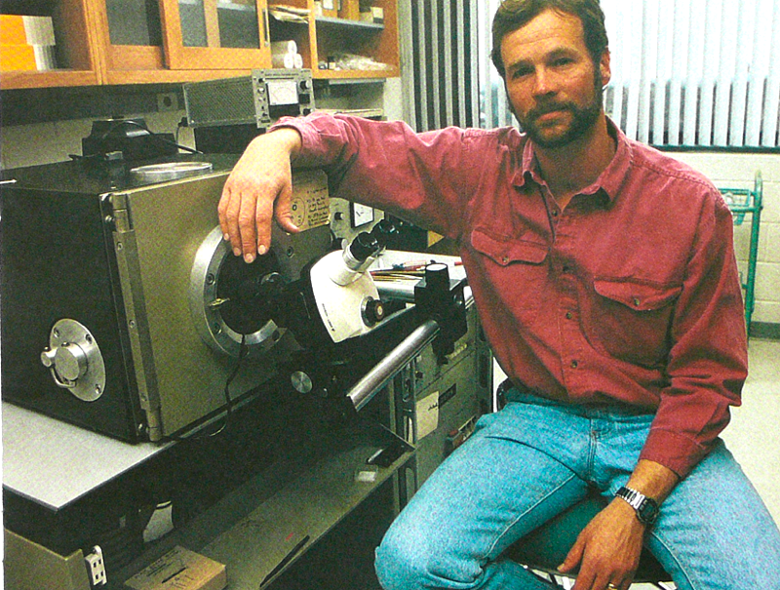
Joe Levine: “Want to write a HS Biology textbook?”
1982: I’m just an innocent Cell Biologist, working in my lab... and the phone rings.
Ken: “Whaddayou, nuts?”
Joe Levine
… a mere 8 years later

Slide 3
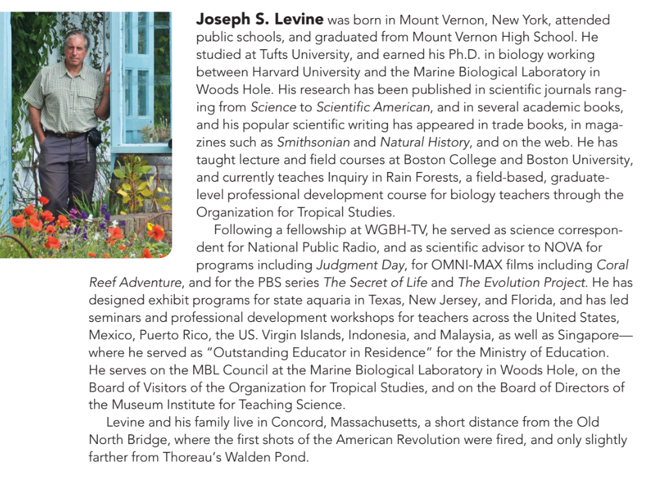
Joe Levine is an expert in scientific communication who has worked extensively in public media (PBS, Discovery Channel, museums, aquarium design, etc…)

Slide 4
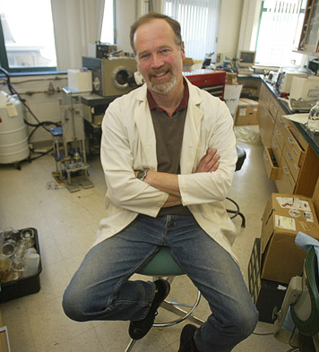
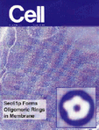
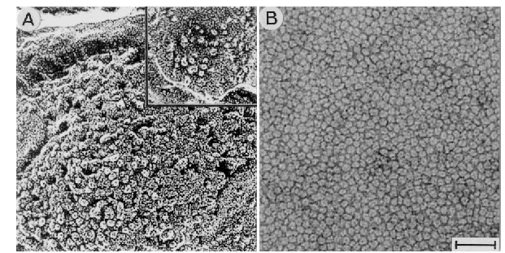
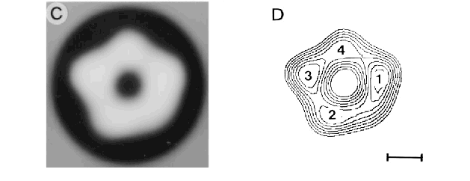
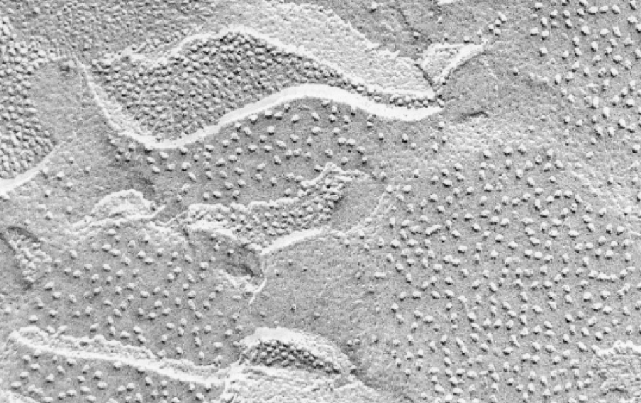
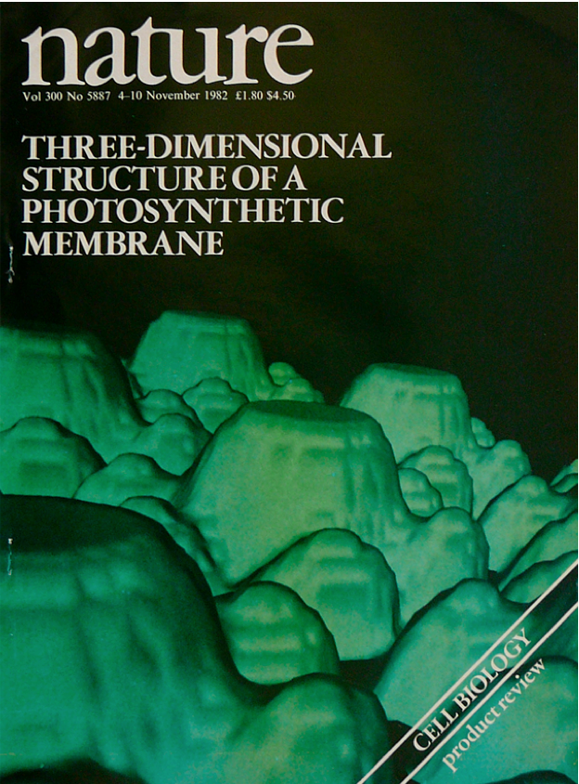

Slide 5
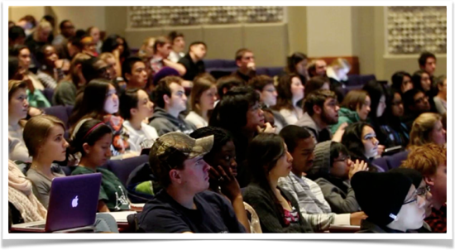
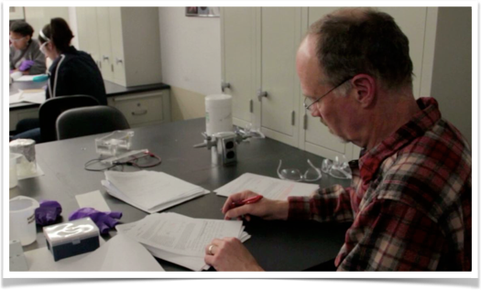
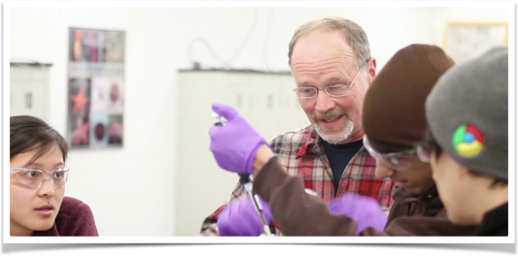

Slide 6
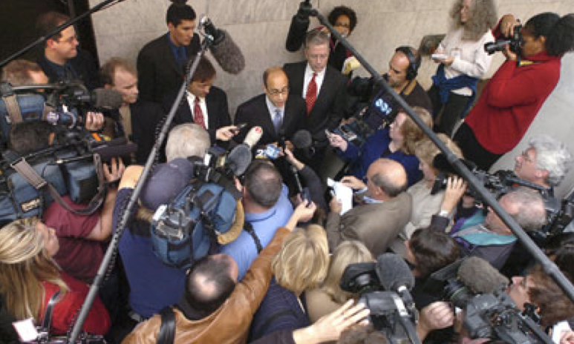
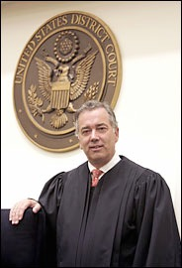
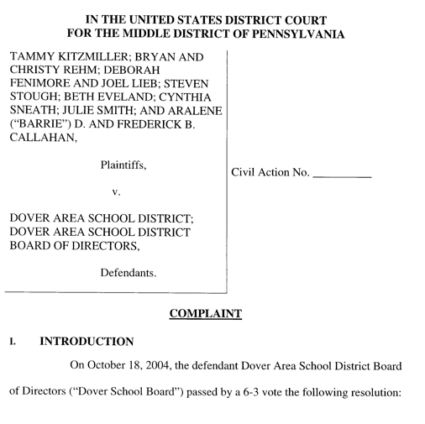
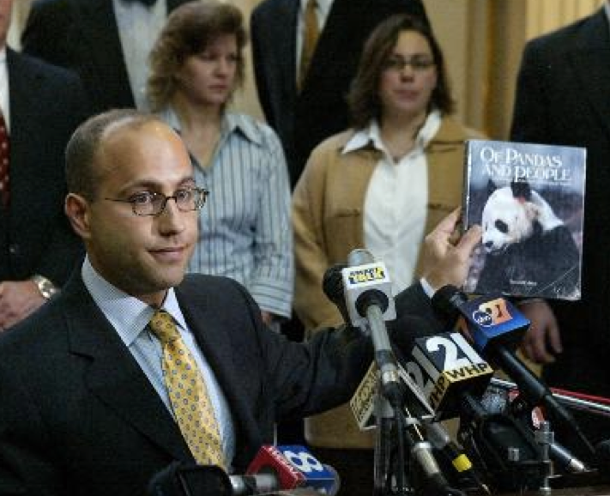
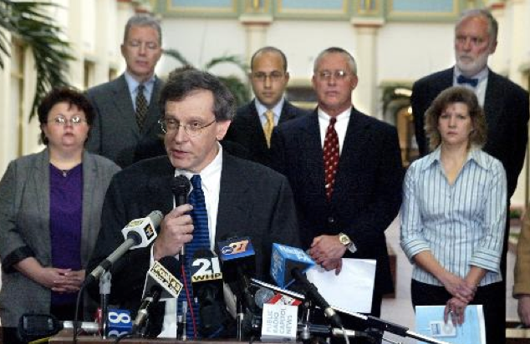
Eleven Parents, objecting to the Board’s ID policy, filed a First Amendment lawsuit against the Board in December, 2004.
Notes:
Current battle — Dover, PA

Slide 7
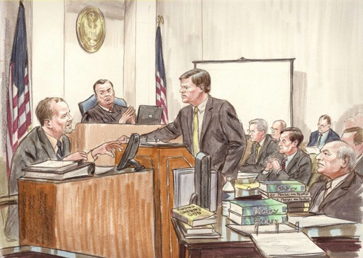
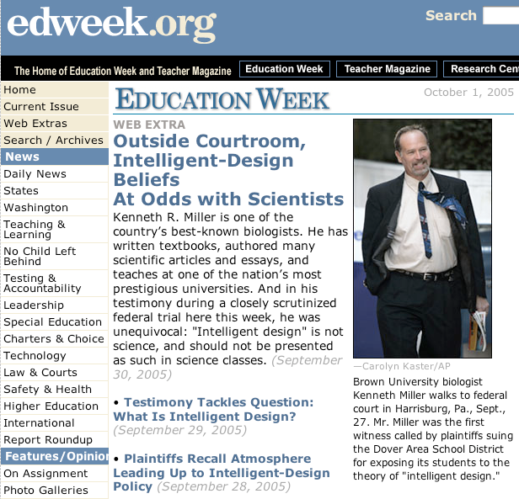

Slide 8
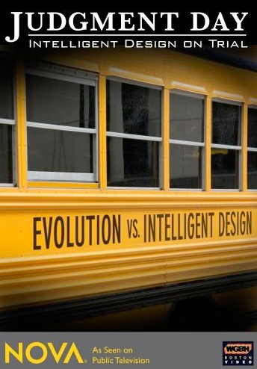
Judgment Day
PBS - November 13, 2007

Slide 9
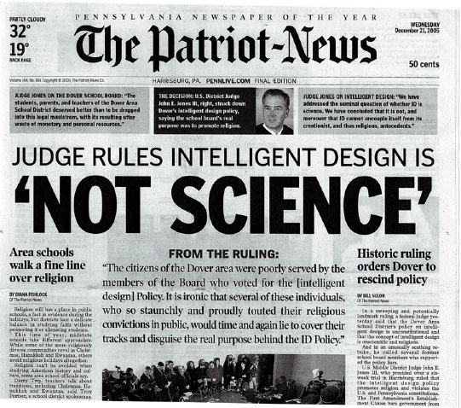

Slide 10
• 27 chapters (instead of 35)
• Case Studies
• Emphasis on Problem- Based Learning
• Student-Friendly Style
• Written specifically to NGSS & Florida standards.
• Increased coverage of Ecology & Biotech
• Completely on-line
• Clear, Accurate, Engaging

Slide 11
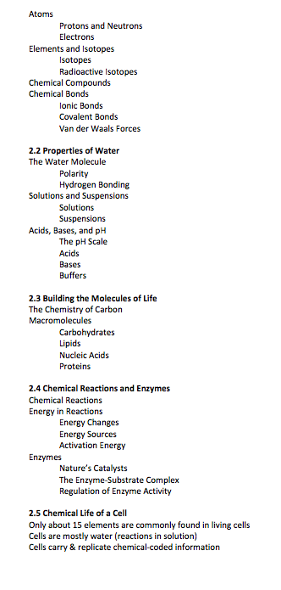
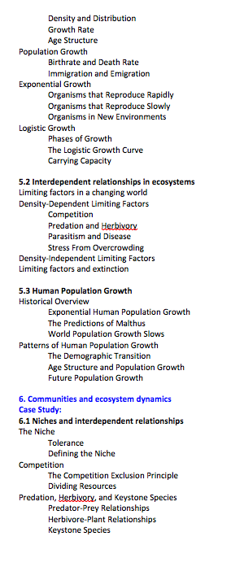
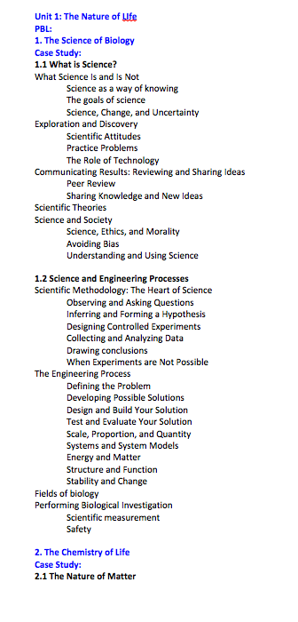
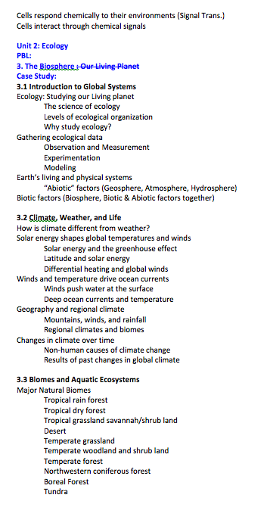
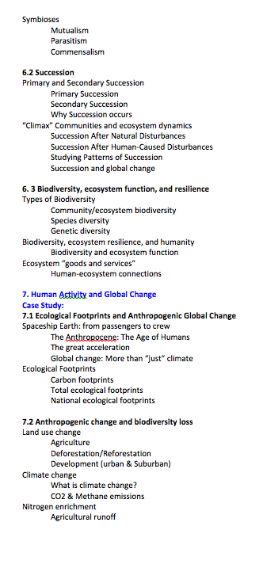
We started with a blank sheet of paper.
This is a completely new book and program!

Slide 12
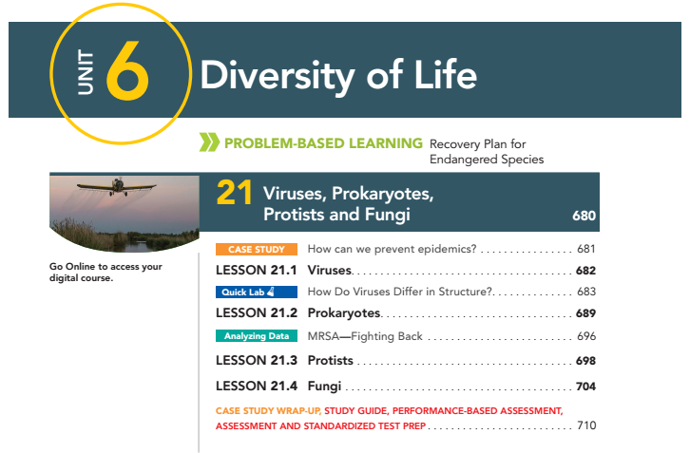
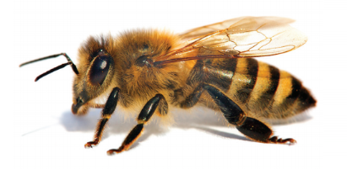
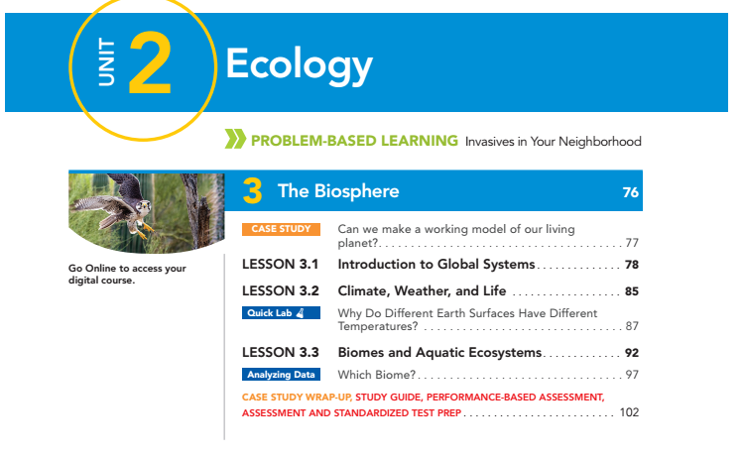

Slide 13
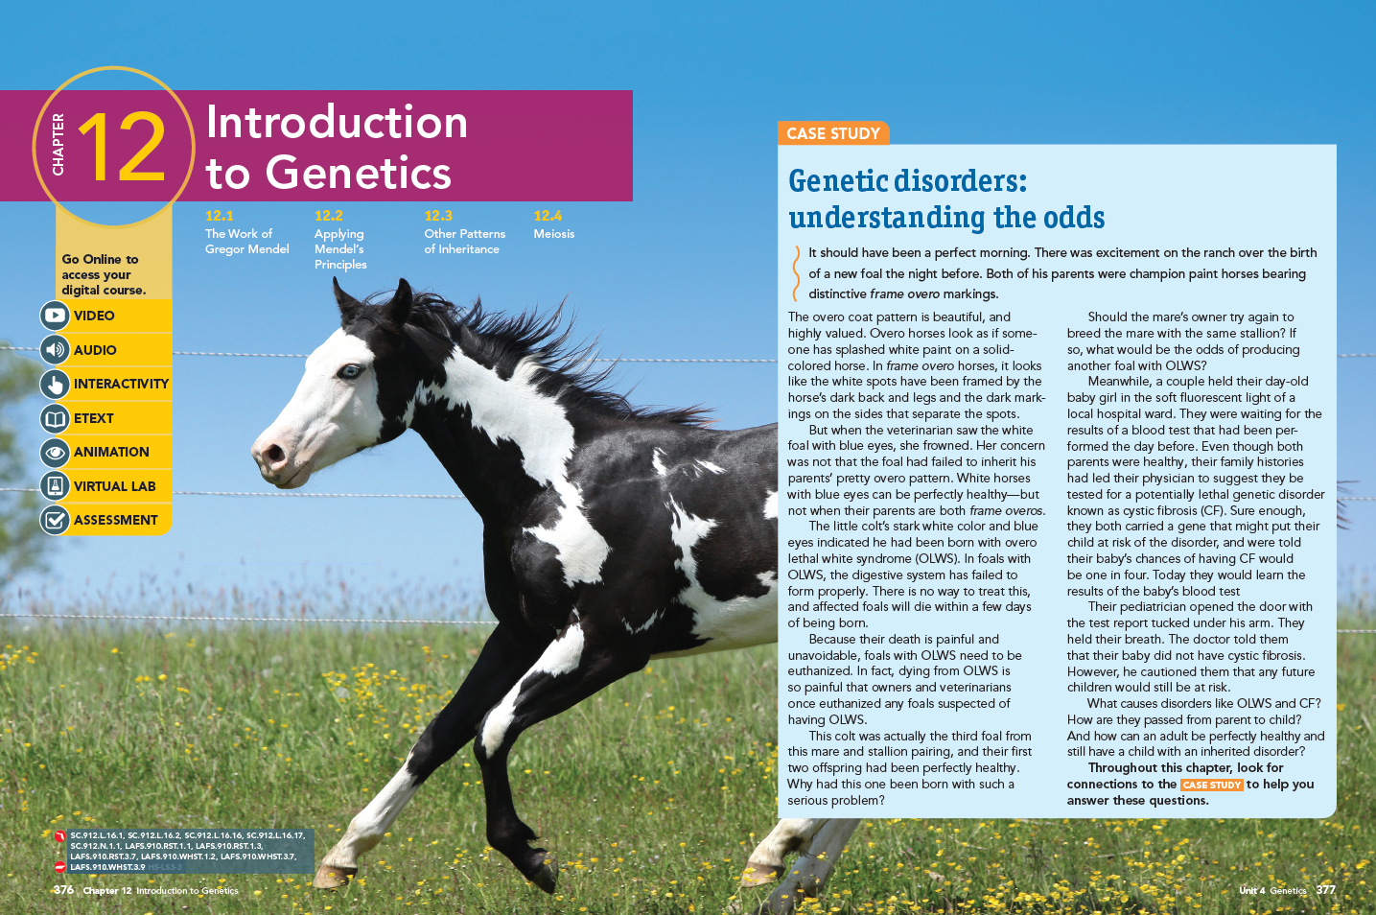
Chapters are built around Case Studies

Slide 14
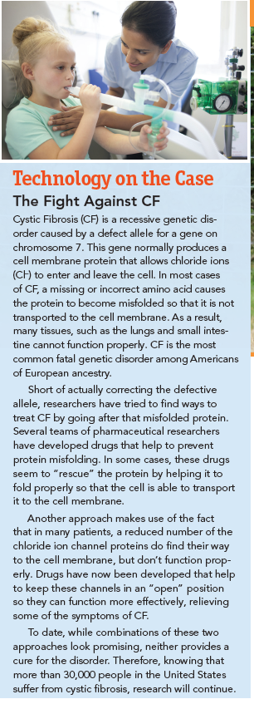
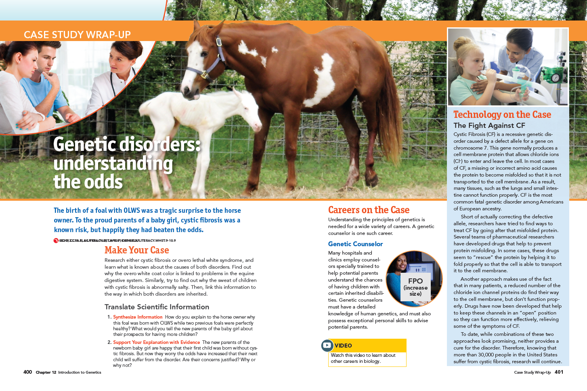
These Explore Biological Principles
Which can be applied to current issues

Slide 15
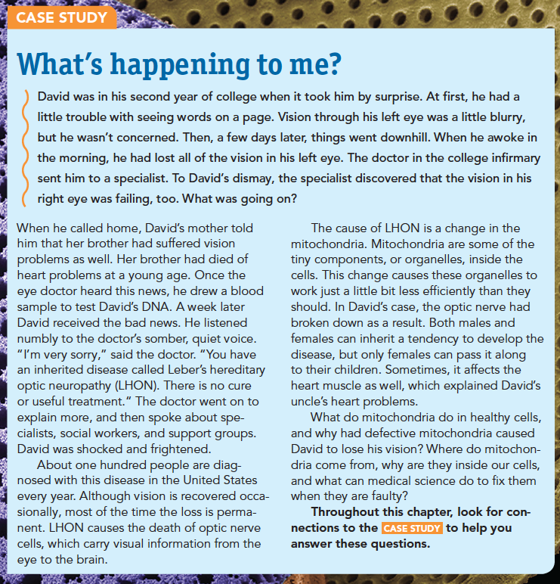
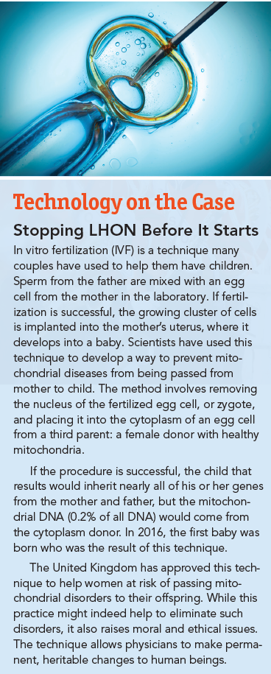
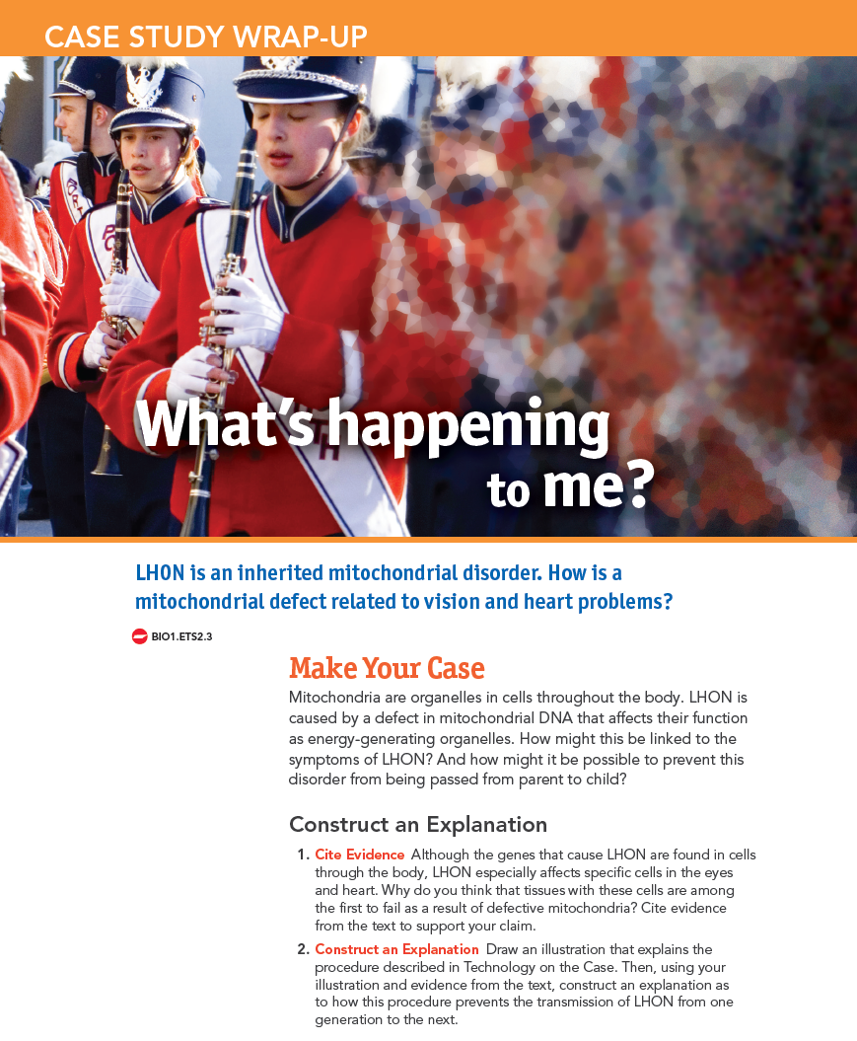

Slide 16
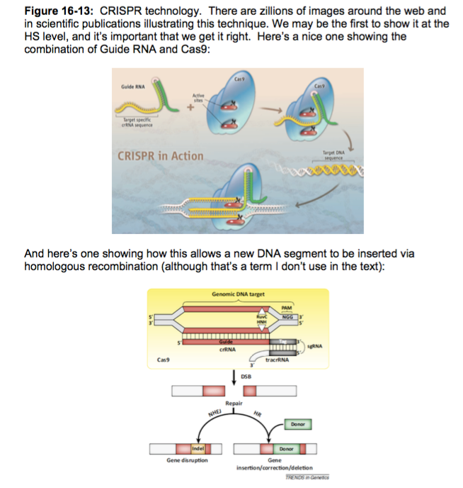
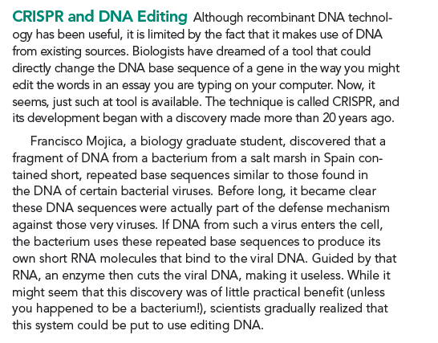
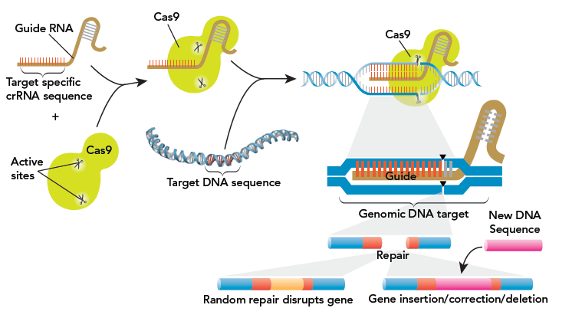
CRISPR is revolutionizing genetic engineering
We are the only text that explains it!
p. 515

Slide 17
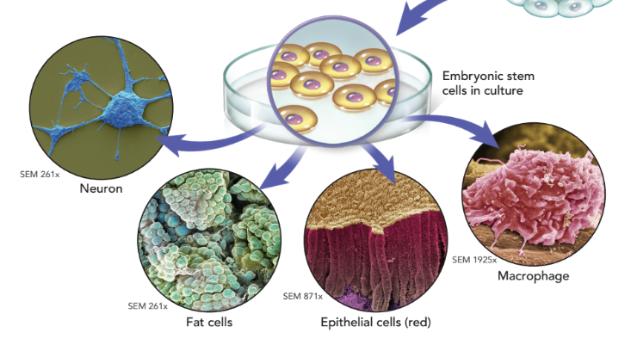

Slide 18
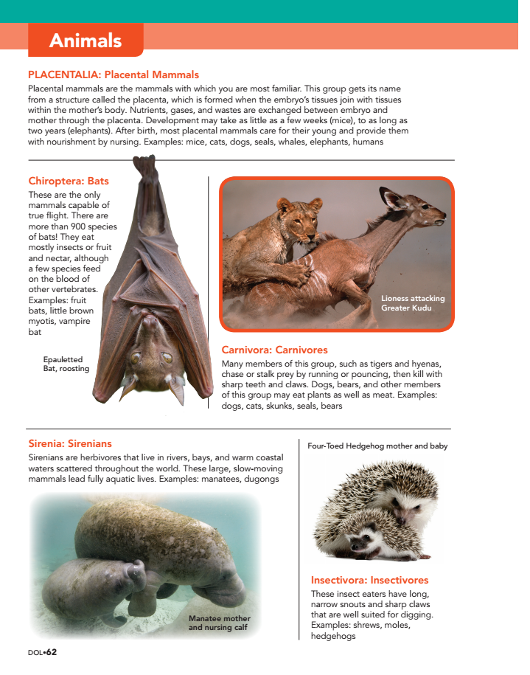
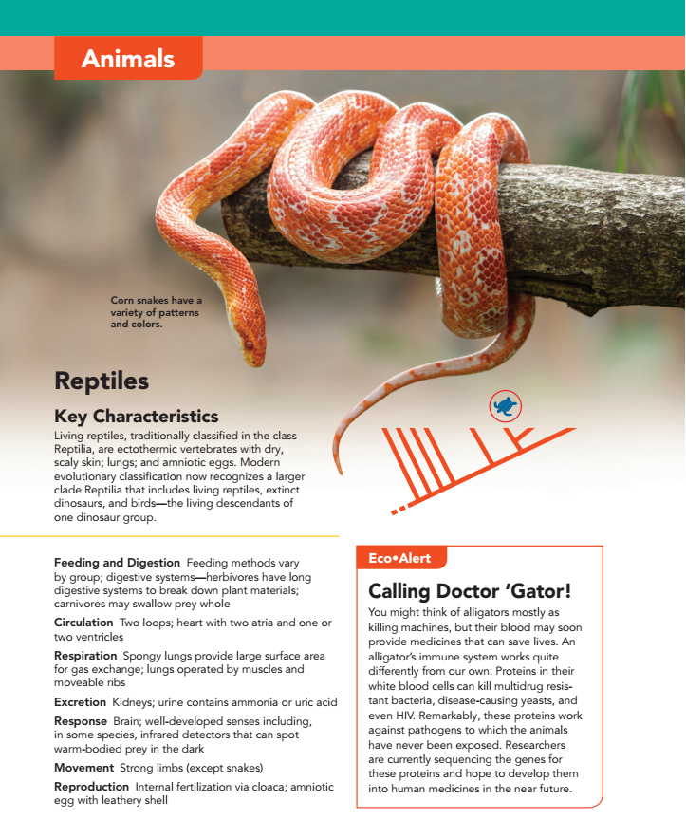
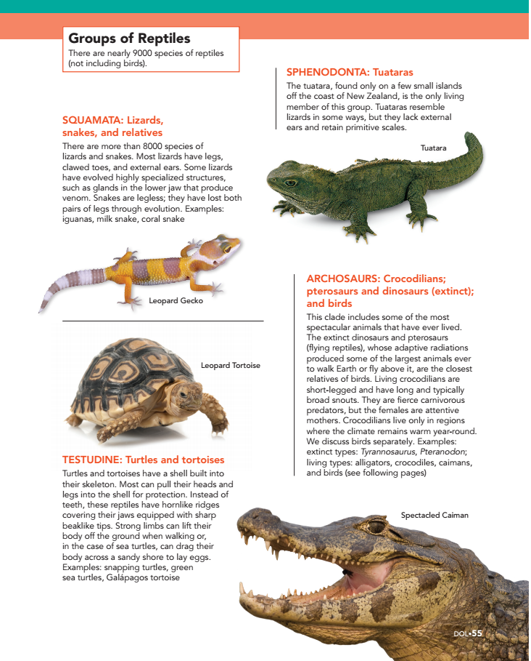
Diversity of Life Handbook

Slide 19
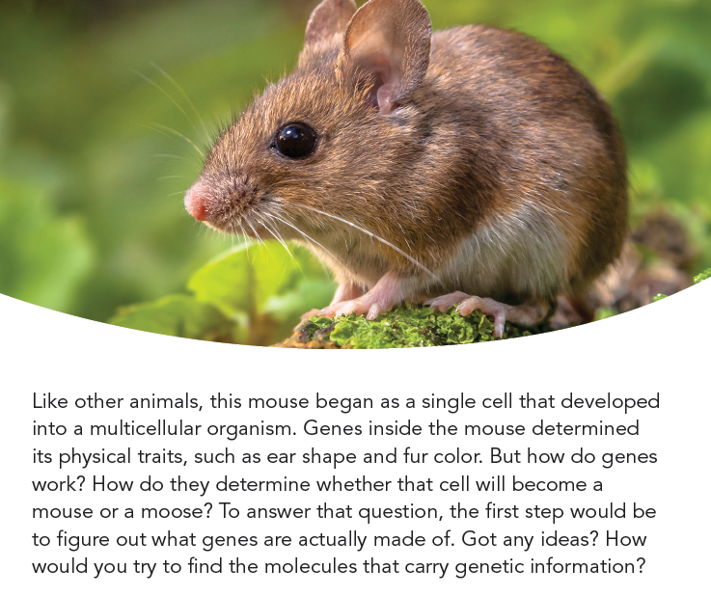
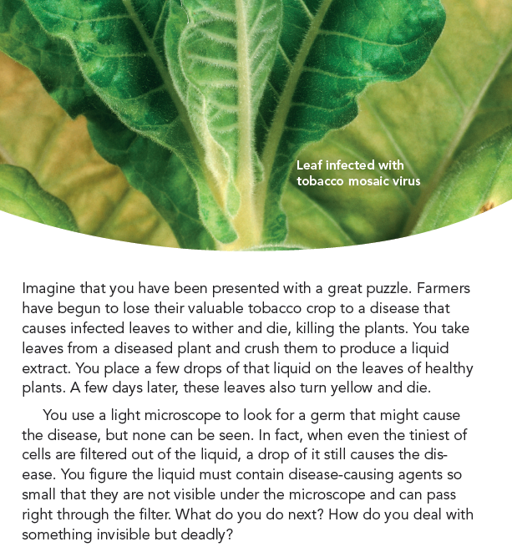
The Narrative: It matters for student interest and understanding!
p. 412
p. 682
Our conversational writing style is unique and student-friendly

Slide 21
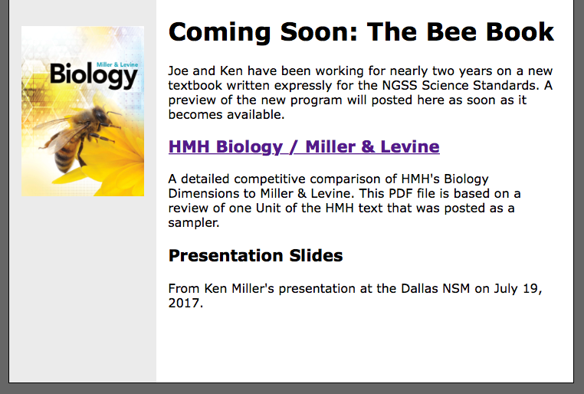
millerandlevine.com/beebook

Slide 22
ken.miller@brown.edu
401-863-3410
levinejs@me.com
millerandlevine.com

Slide 23
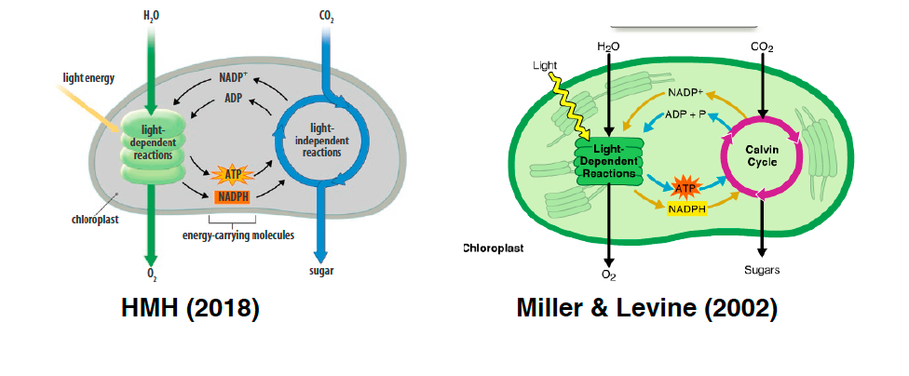
Images
Notes:
Ken analysis – noted several images that are strikingly similar to ours

Slide 24
Images
Notes:
Ken analysis – noted several images that are strikingly similar to ours

