Slide 1
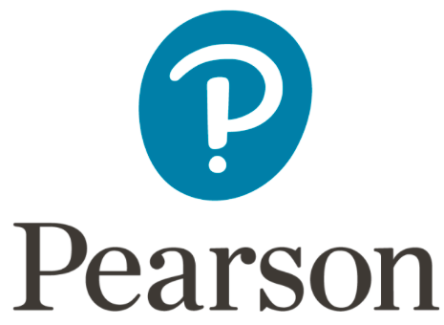
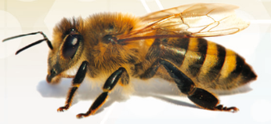
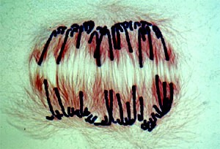
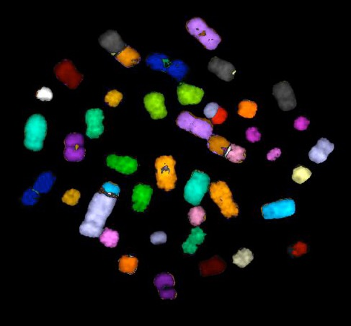
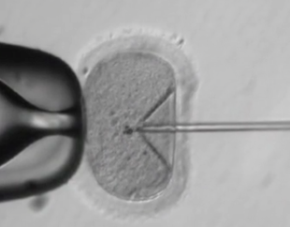
From CRISPR to Three-Parent Babies
What to Tell Our Students about the Coming Revolution in Human Biology
Ken Miller
Brown University
10-19-18

Slide 2
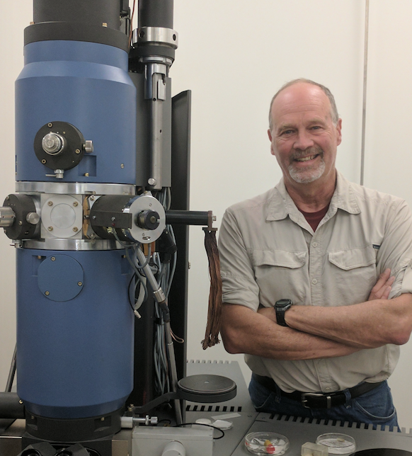
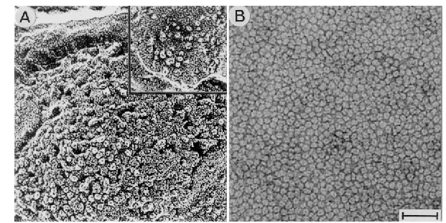
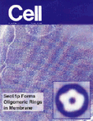
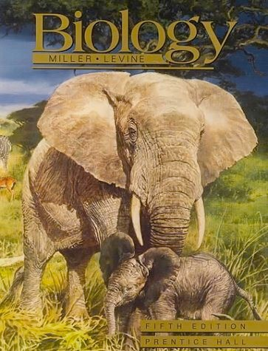
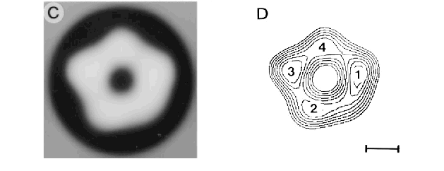
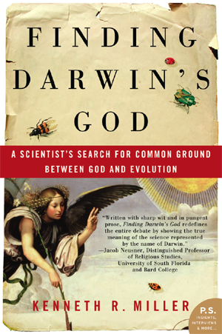
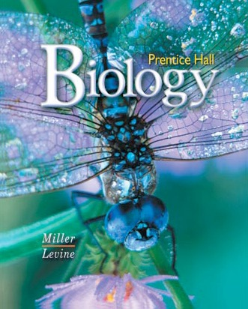
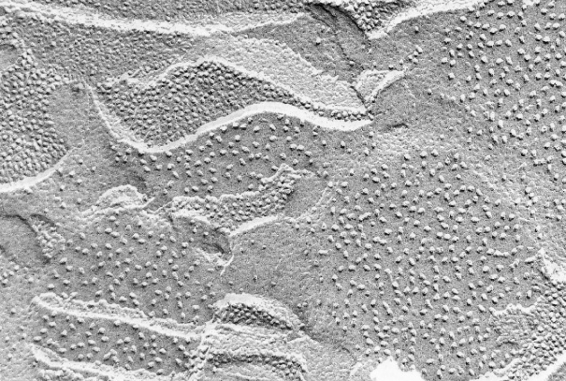
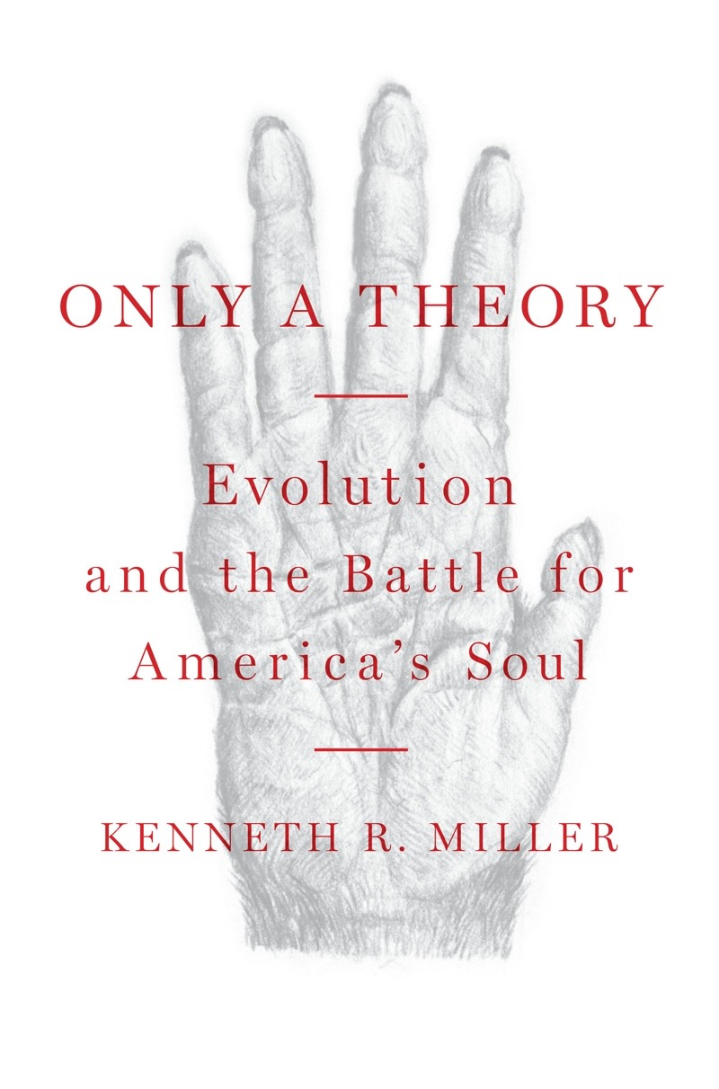
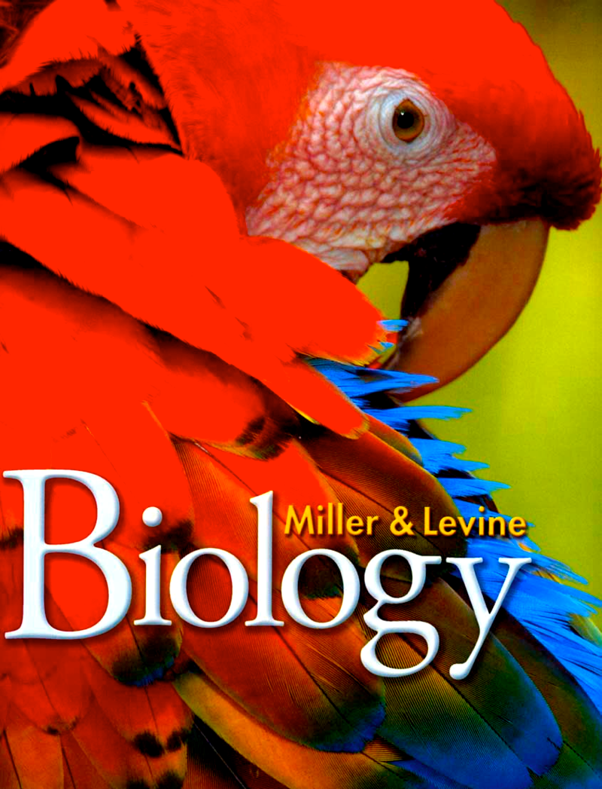
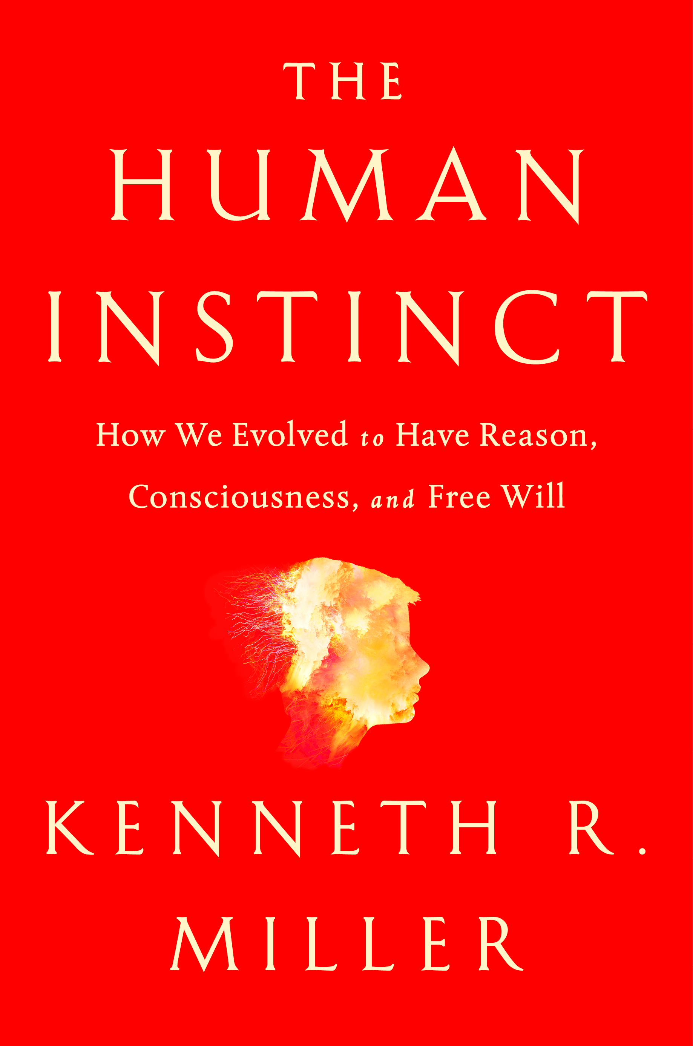
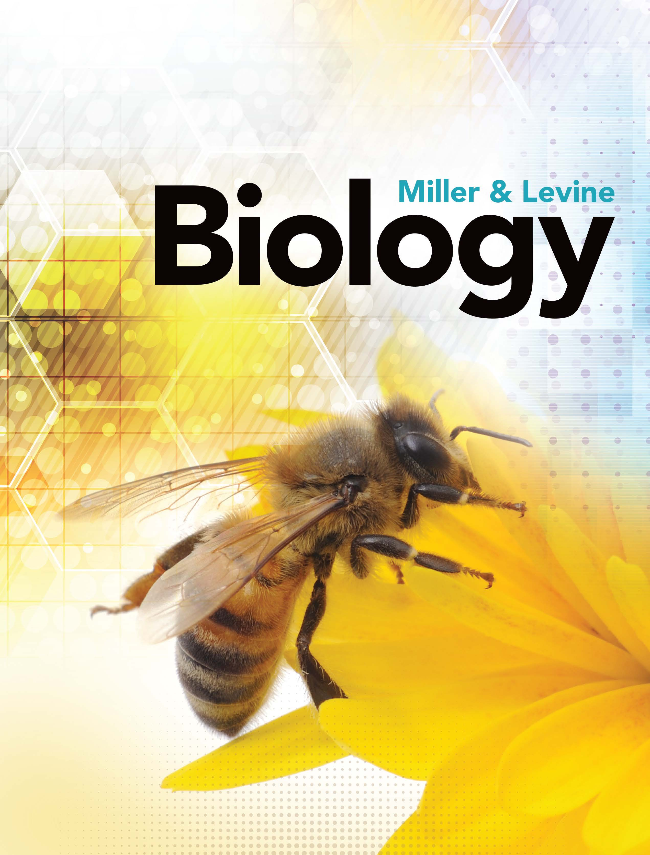
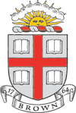

Slide 3
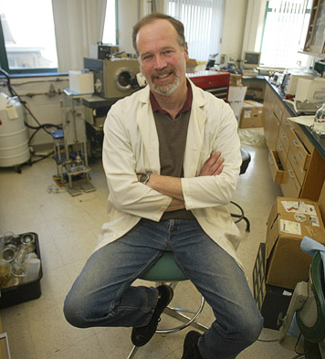
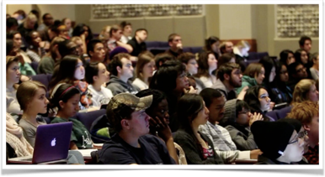
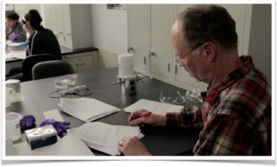
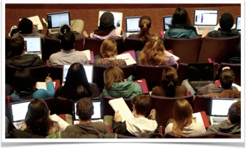
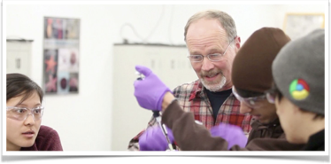

Slide 4
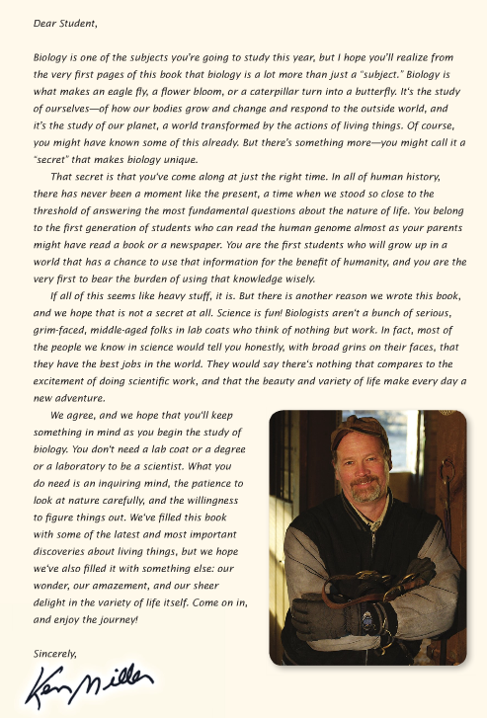
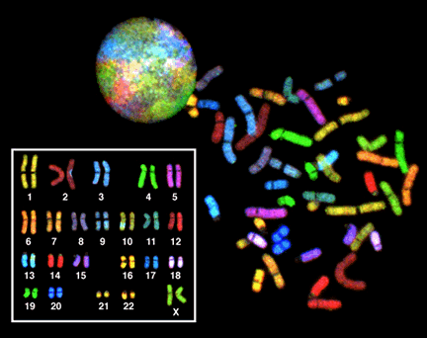
The “secret” is that you’ve come along at just the right time. In all of human history, there has never been a moment like the present, a time when we stood so close to answering the most fundamental questions about the nature of life. You belong to the first generation of students who can read the human genome almost as your parents might have read a book of a newspaper.

Slide 5
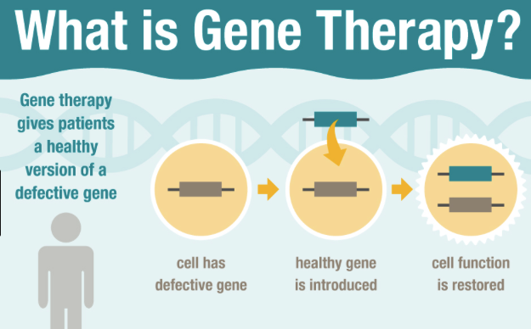
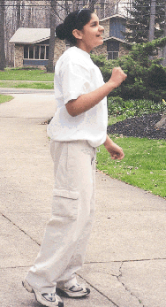
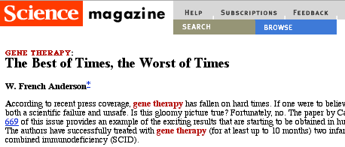
Example? Gene Therapy
Success! A cure for SCID (severe combined immuno-deficiency)
Ashanti de Silva. Now 31, Ashanti was the first patient to be treated with gene therapy. She received infusions of T cells that had been transformed with a gene for ADA (an enzyme that she lacks), resulting in an amelioration
of the symptoms
of her severe
combined
immunodeficiency.

Slide 6
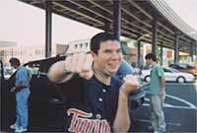
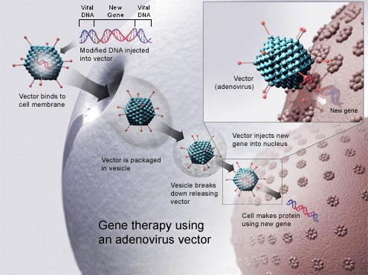
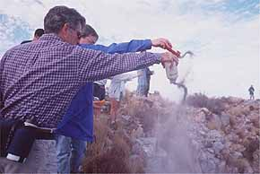
A Signal Success: A cure for SCID (severe combined immuno-deficiency)
Jessie Gelsinger: Ornithine-Transcarbamylase Deficiency

Slide 7
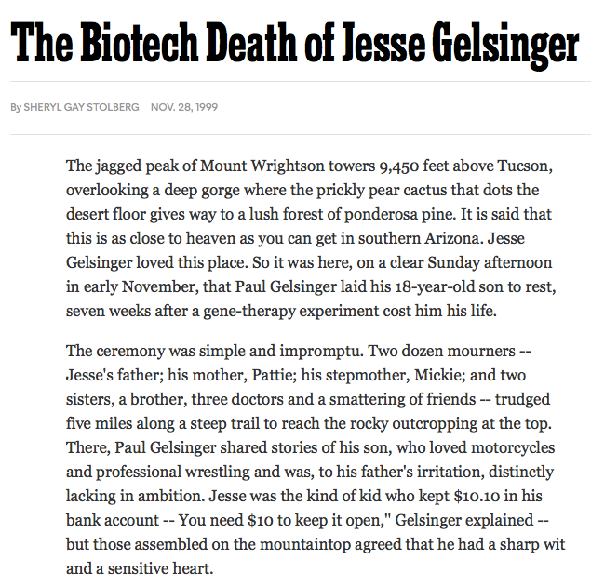
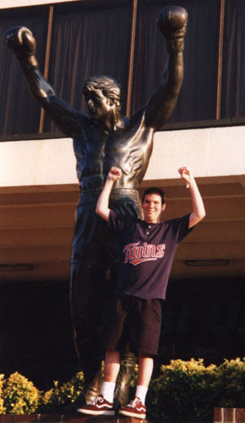
New York Times 11/28/99

Slide 8
For a decade and a half, the dream of Gene Therapy has been on hold.
Attempts at molecular cures have focused instead on Stem Cells

Slide 9
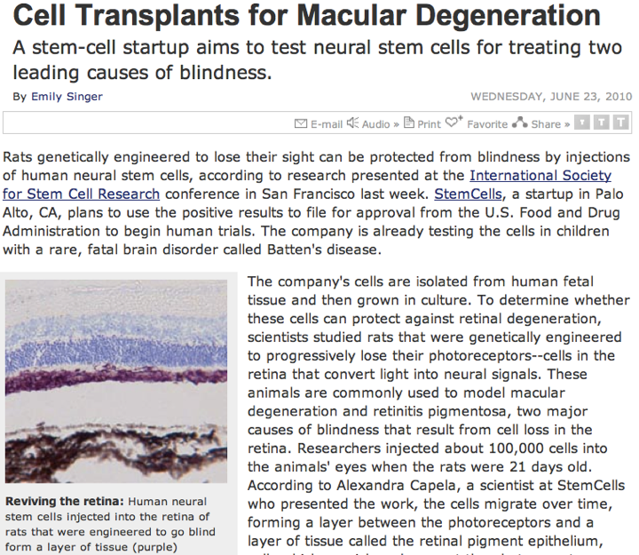
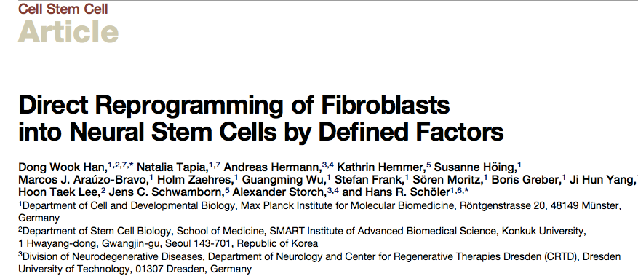
For Cell Biology, this has been where the action is:
But now, Gene Therapy May Be Back

Slide 10
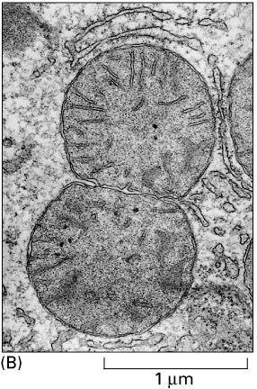
Where do new Mitochondria come from? De novo? From other organelles? Or by division of preexisting mitochondria?

Slide 11
Where do new Mitochondria come from? De novo? From other organelles? Or by division of preexisting mitochondria?
The definitive, classic experiments on this subject were done by David Luck (JCB 24: 461 [1965]). He used a mutant of Neurospora that required choline (need to make phosphatidylcholine, the organism's major phospholipid).
choline restruction - reduced PL content, and this increases the density of the mitochondria.

Slide 12
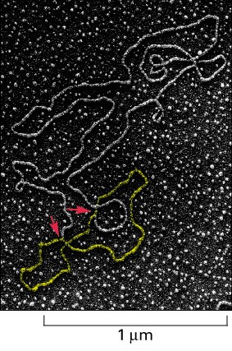
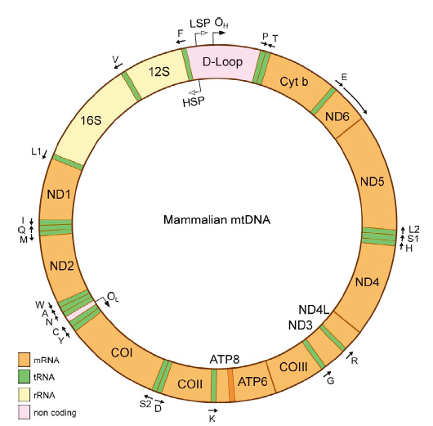

Slide 13
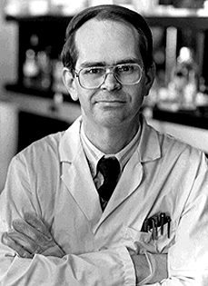
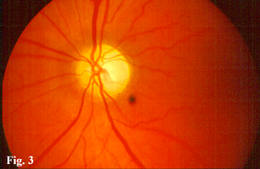
Leber’s Hereditary Optic Neuropathy
Doug Wallace (Emory)
Nature of the mutation: A single base change at nucleotide #11778 (ARG HIS of AA #340 of NADH subunit #4 of complex #1)
• onset in late adolescence • variable severity • maternal inheritance

Slide 14
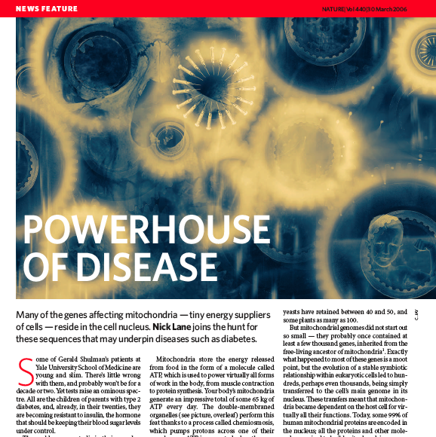
Mitochondrial disease is now understood to be widespread, since disorders in nuclear genes whose products are targeted to mitochondria affect the organelle as well.
Pathologies currently associated with 30 of 37 mtDNA genes.
See: JCB 193: 809-818 (2011)

Slide 15
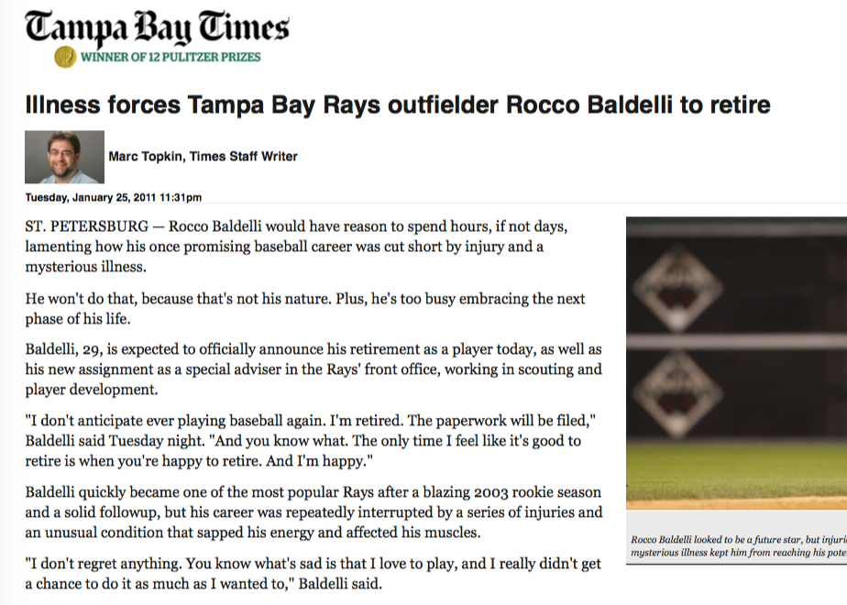
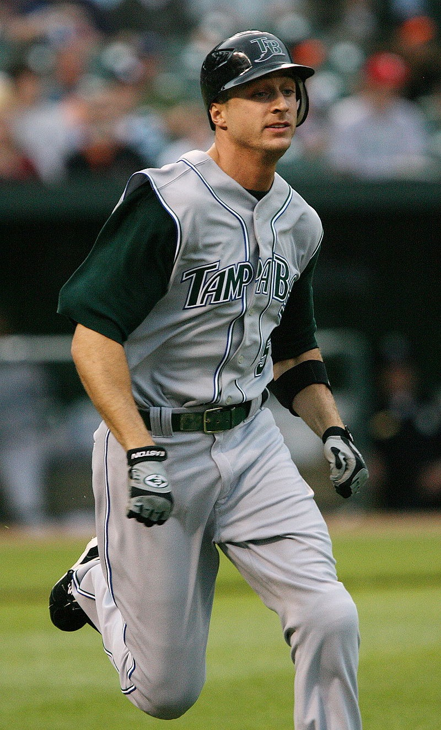
Rocco Baldelli
Woonsocket, RI
Bishop Hendricken HS (Warwick, RI)
Batted .531 senior year
Selected 6th in 2000 MLB Draft
Signed with Tampa for $2.5 million
Minor League Player of the Year 2002
3rd in voting for MLB Rookie of the Year
Retired in 2006
mitochondrial channelopathy

Slide 16
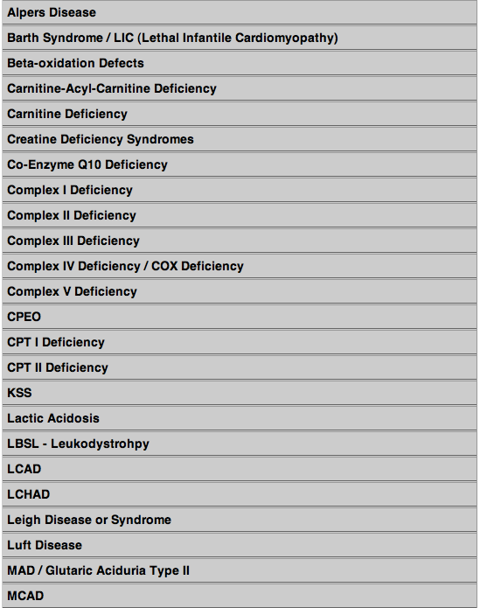
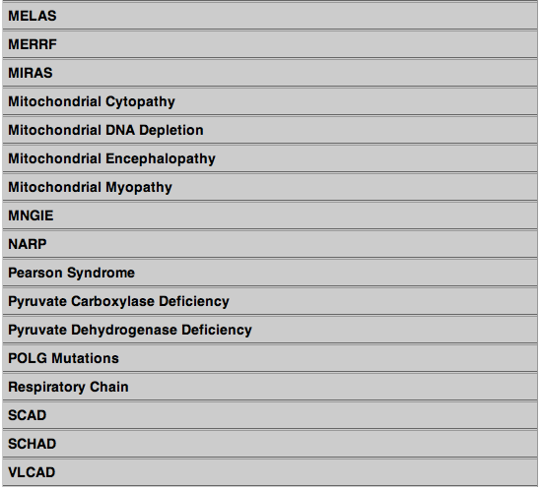

Slide 17
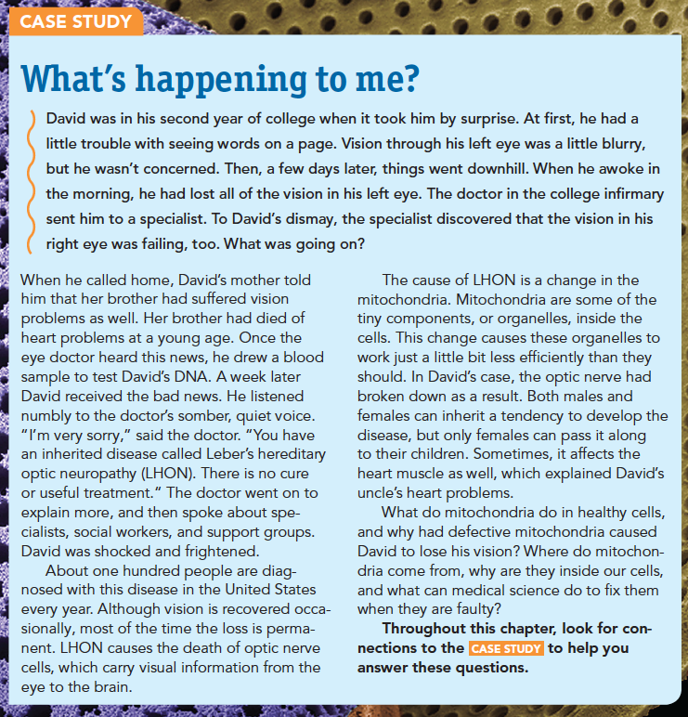
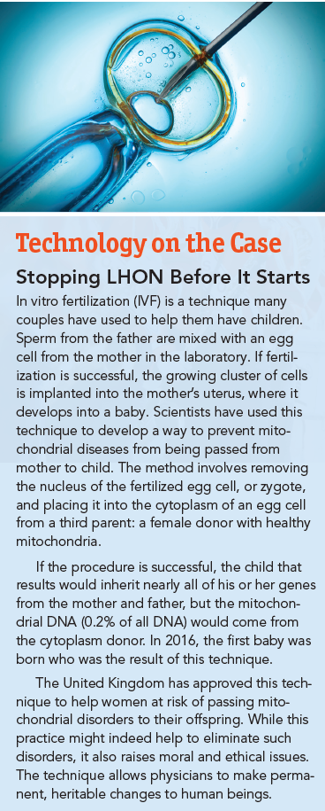
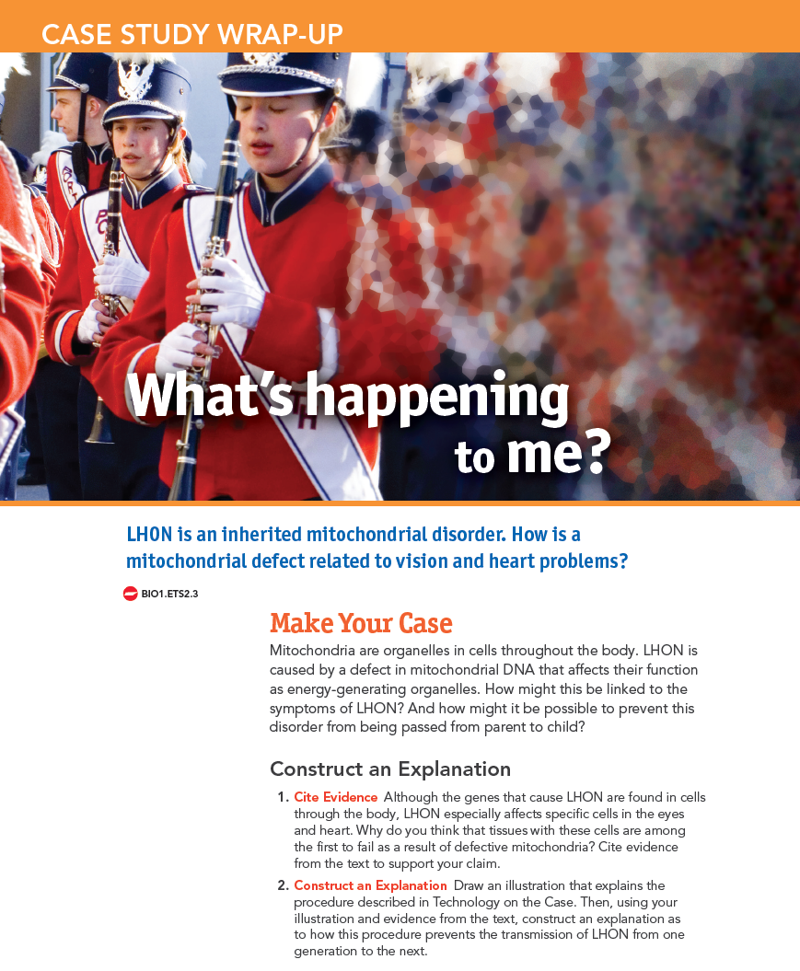
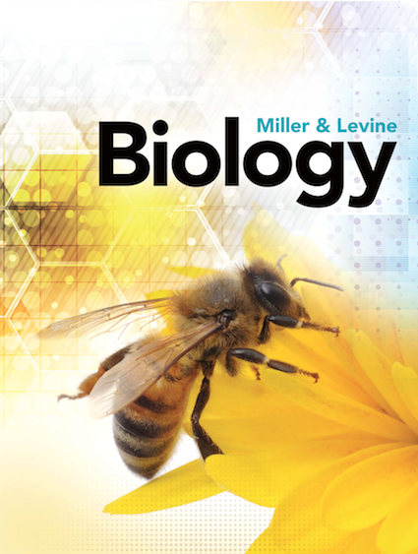

Slide 18
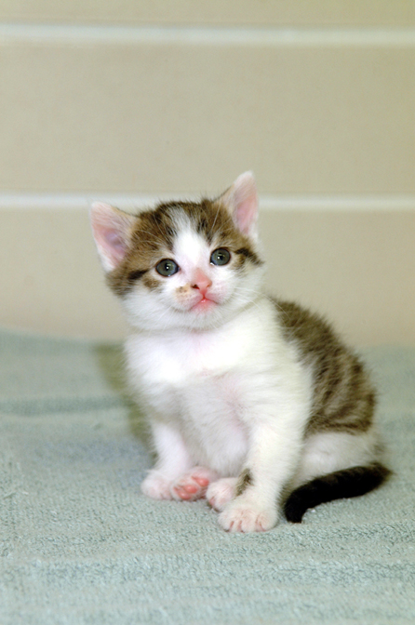
How many “parents” do cloned animals have?
Dolly
Three!
“CC”

Slide 19
The donor of egg cytoplasm is a mitochondrial donor as well!

Slide 21
April 2017
Leigh Syndrome:
Mutation (T8993G) in mtDNA-coded ATP synthase subunit

Slide 22
Metaphase II spindle transferred to enucleated donor cytoplasm
An electrical pulse then fuses the two together.

Slide 23
Dr. John Zhang
New Hope Fertility Center
New York City

Slide 24
3/16/17

Slide 25
Claiborne et al (2016) Science 351: 668-670.

Slide 26
1993: A paper reports repeating “motifs” in bacteria (repeated DNA sequences). Function Unknown

Slide 27
Palindromic Repeats:
Clustered non-repeating sequences between palindromes:
“Clustered Regularly Interspersed Short Palindromic Repeats”

Slide 28
CRISPR = Clustered regularly interspersed short palindromic repeats

Slide 29
The DNA repeats are actually a defense against viruses.
When the sequence matches viral DNA, a protein enzyme lines it up precisely, and cuts the viral DNA.

Slide 30
CRISPR cuts DNA at specific places specified by RNA made from these snippets of viral DNA.
Two researchers realized that it could be made into a tool to edit DNA.

Slide 31
Stockholm 2019?
Jennifer Doudna (California)
& Emmanuel Charpentier (France) figured out how to make this work.

Slide 32
Text

Slide 33
The system consists of a “Guide RNA” that recognizes a DNA sequence, and an enzyme that cuts both strands of DNA at the recognition site.
The Guide RNA can target any DNA sequence

Slide 34
CRISPR makes it possible to:
1) Disrupt a gene by causing a targeted double-strand break.
2) Or, to insert a specific DNA sequence precisely into the breakpoint.

Slide 36
Two constructs are needed to activate CRISPR in a transformed cell:
1) A gene for the Guide RNA complementary to a particular DNA sequence.
2) A gene for the Cas9 protein.

Slide 37
Modifications of CRISPR make it possible to precisely edit single bases in DNA or RNA:

Slide 42
CRISPR-driven Genetic Modification may provide a way to save crops like oranges from diseases such as “citrus greening.”

Slide 43
Many pig organs have the right size, shape, and functionality to serve as transplants to humans. But there is a concern…..
There is a continuing shortage of human organs needed for lifesaving transplants.
The Solution?
.. Pig cells are home to a slew of endogenous retroviruses (PERVs) that could be dangerous.

Slide 44
Will CRISPR work in this organism?

Slide 45
August 2017:
MYBPC3 (Chromosome 11) Cardiac Myosin-Binding Protein (hypertrophic cardiomyopathy)

Slide 48
Brian Madeux (44 years old)
Hunter Syndrome (Lysosomal Storage Disease)
Zinc-finger targeting to liver cells

Slide 49
Adenovirus vector used to target a CRISPR-Cas9 system to muscle cells.

Slide 52
DNA sample from an unknown person identified from two distant cousins whose DNA had been uploaded to the GED Match genealogy database.

Slide 53
To Understand the Technology
• Mechanism & Technique
• Possibilities
• Limitations
To Ask Forward-Looking Questions
• Long-Term Effects
• Unintended Consequences
• Risks / Rewards
To Prepare Students to Engage with a Lifetime of Scientific Change

Slide 54
ken.miller@brown.edu
401-863-3410 @kenethrmiller
millerandlevine.com

