Slide 1

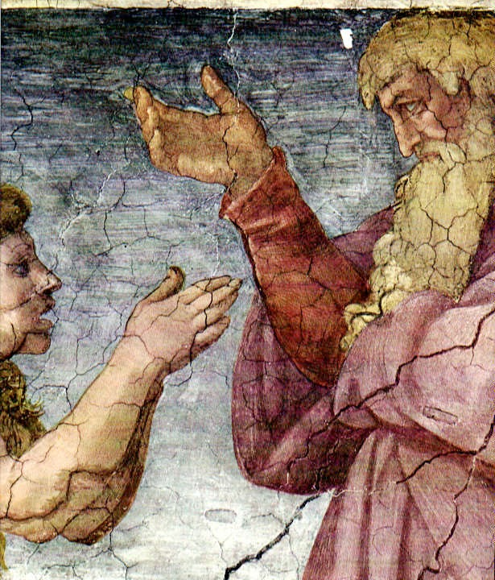
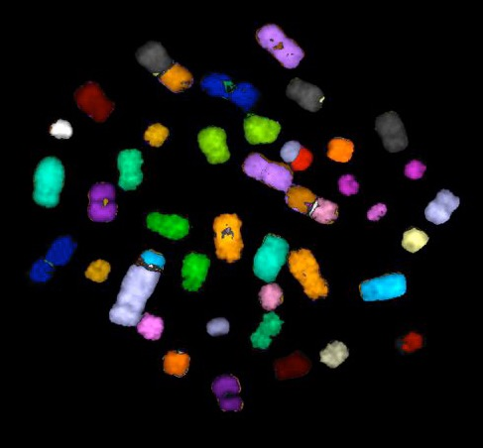
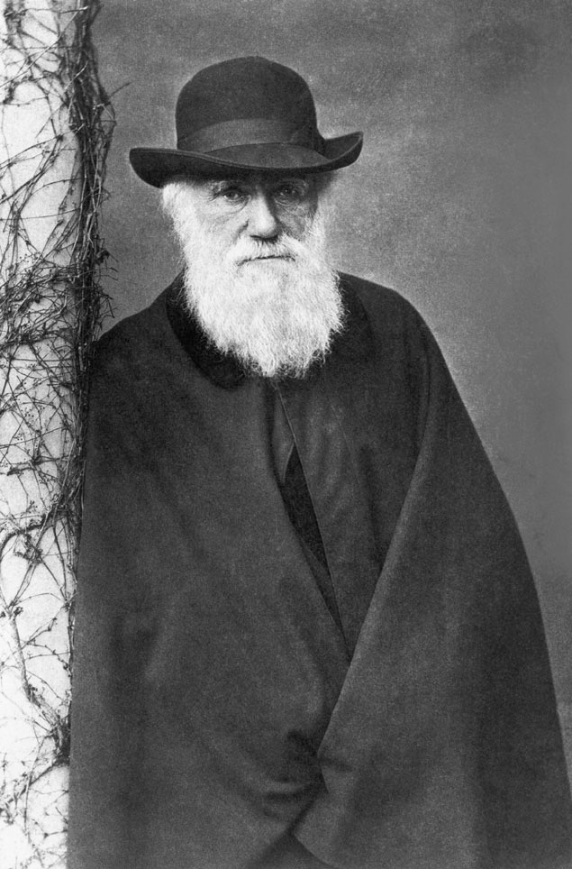
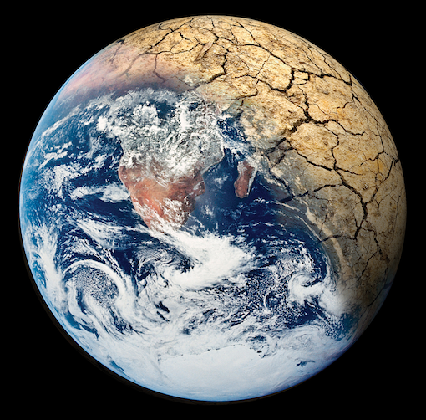
Teaching Evolution & Climate Change in an Age of Denial
Even with NGSS,
the battles continue
Ken Miller
Joe Levine
11/13/15

Slide 2
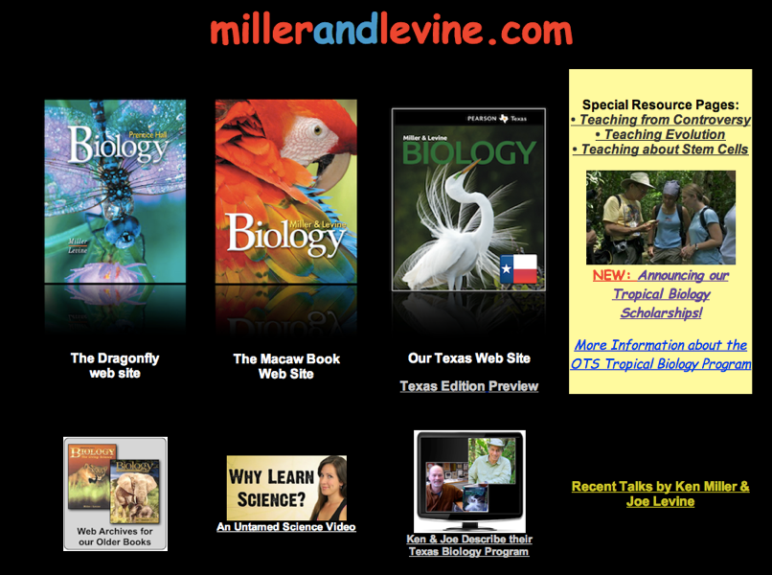

Slide 3
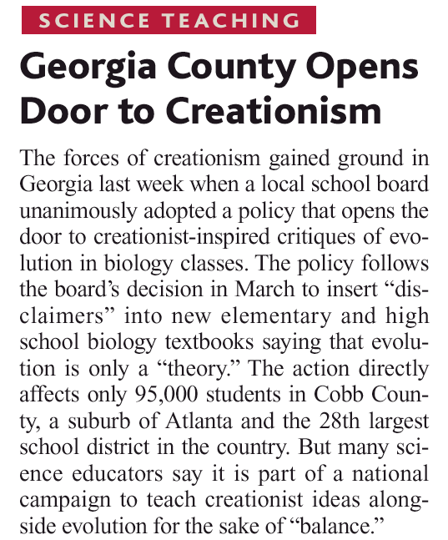
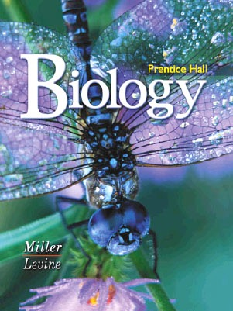
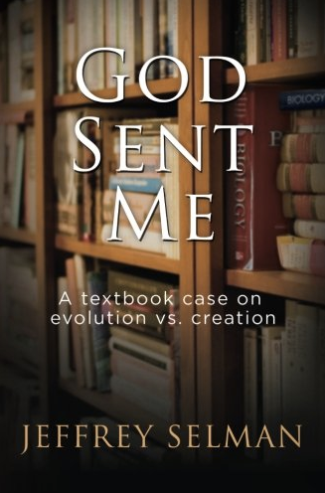
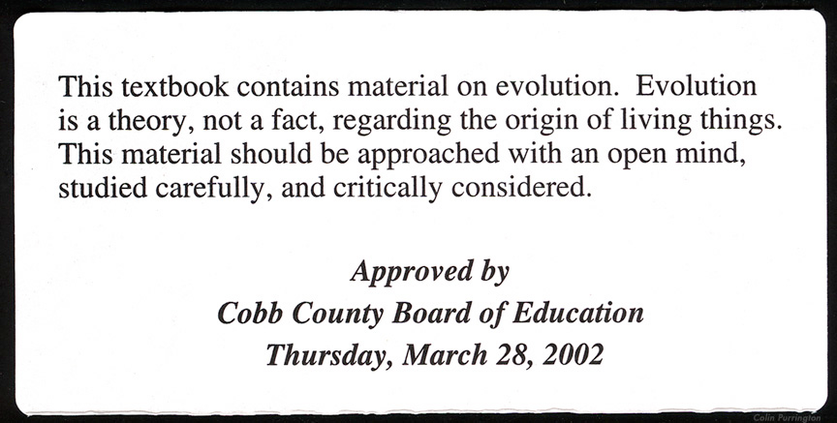
Cobb County, Georgia - 2004
Students must be “warned” about Evolution in textbooks.

Slide 4

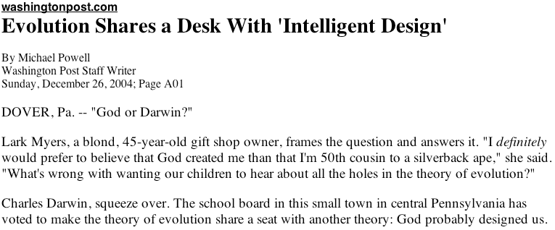
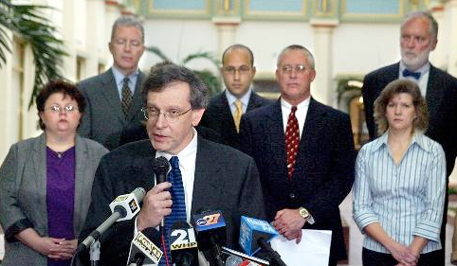
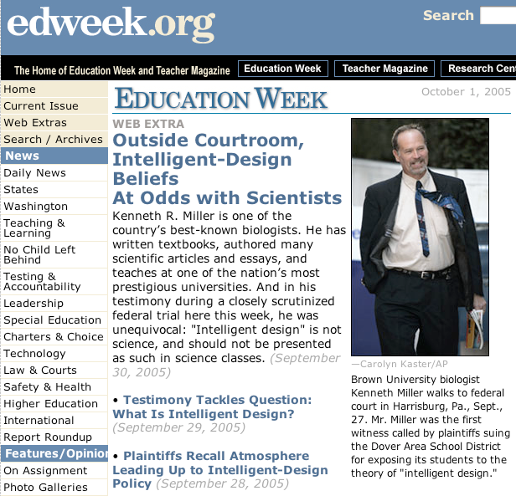

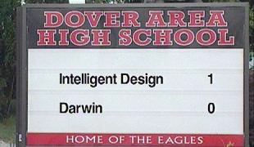
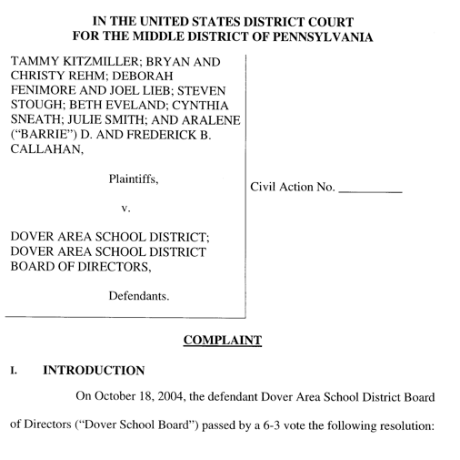

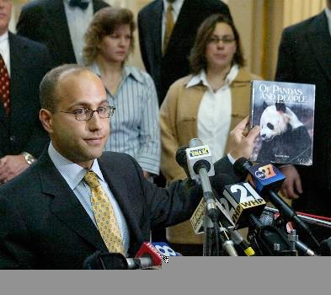
2004: The Dover (PA) school board votes for an “intelligent design” lesson in biology.
Notes:
Current battle — Dover, PA

Slide 5
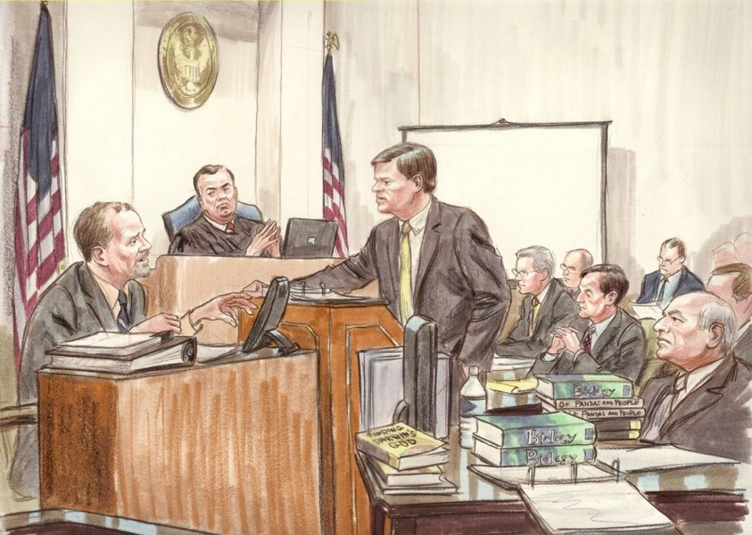
Kitzmiller v. Dover demonstrated the bankruptcy of ID as scientific theory.

Slide 6
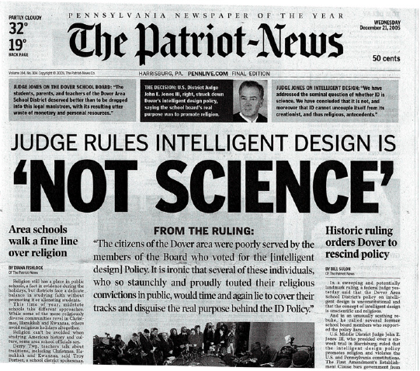

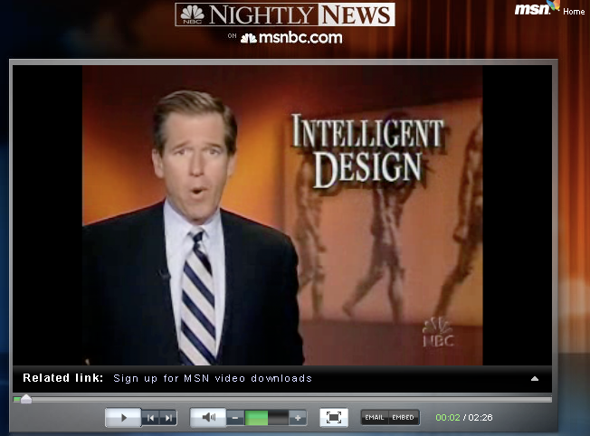
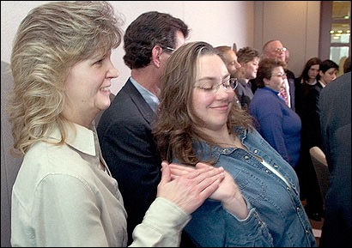
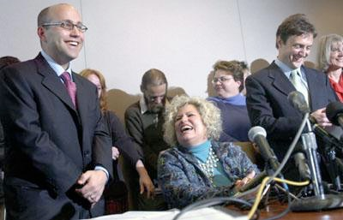
December 20, 2005
Decision Announced

Slide 7

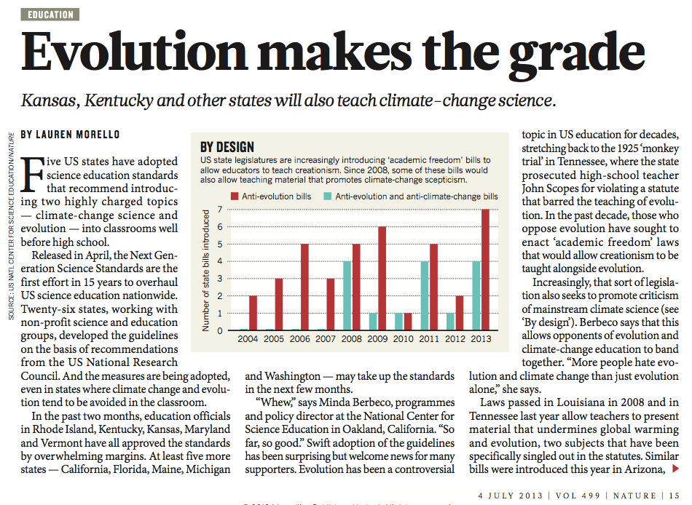
Post-Kitzmiller: the NGSS Biology Standards are strong on evolution

Slide 8
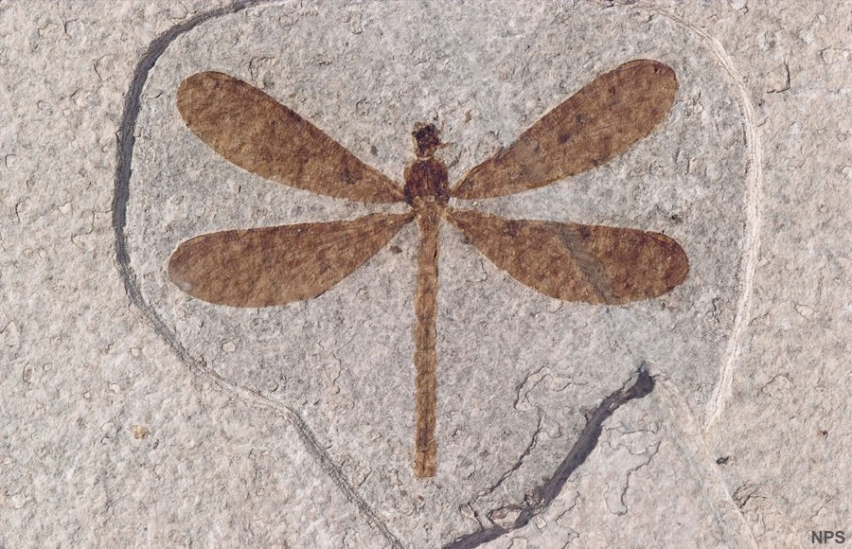
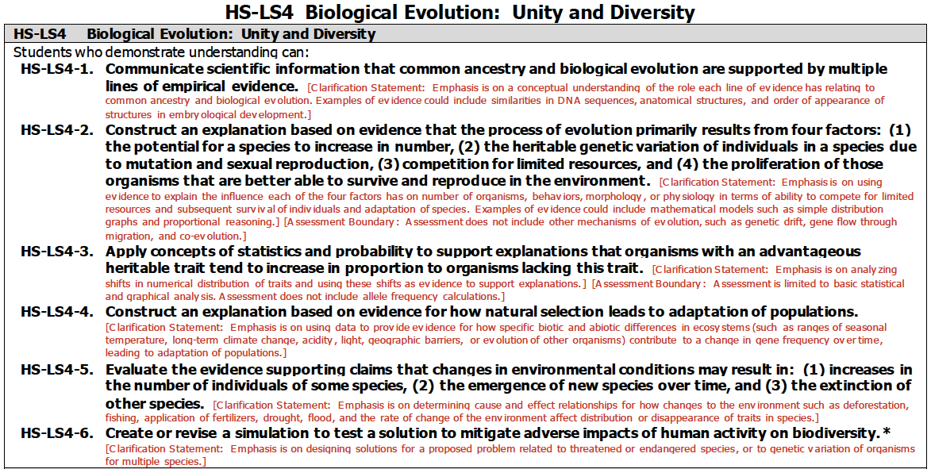

Slide 9
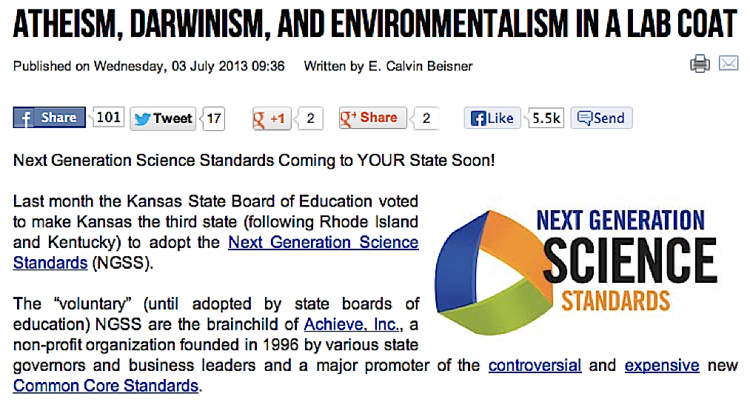
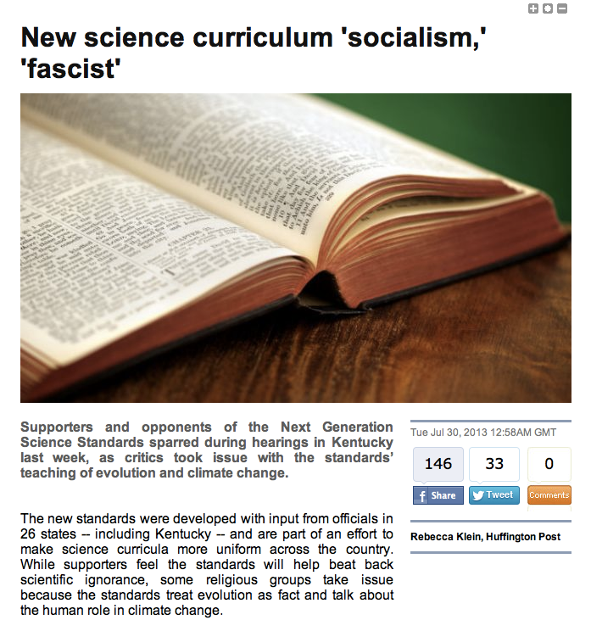
But NGSS is routinely attacked by Evolution deniers

Slide 10
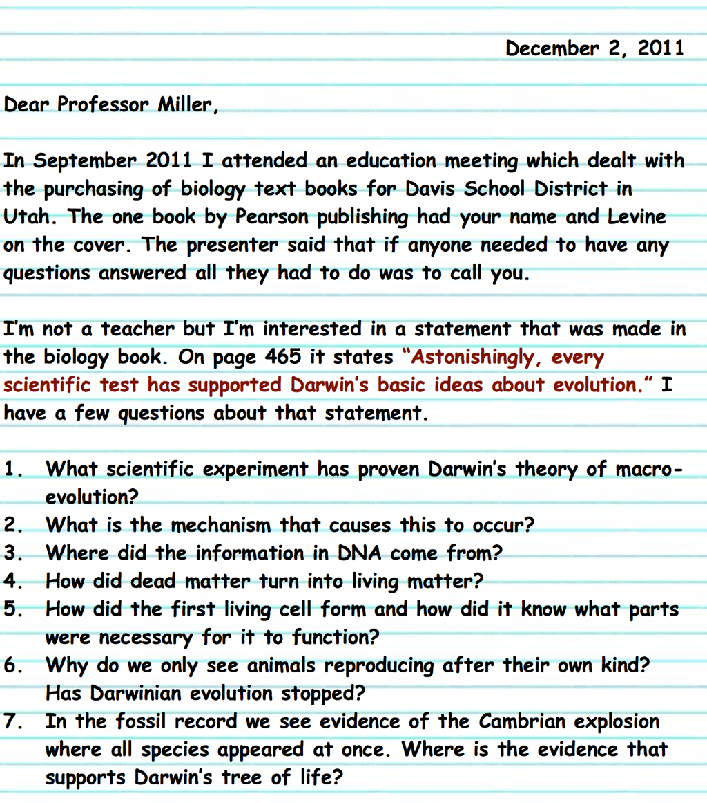
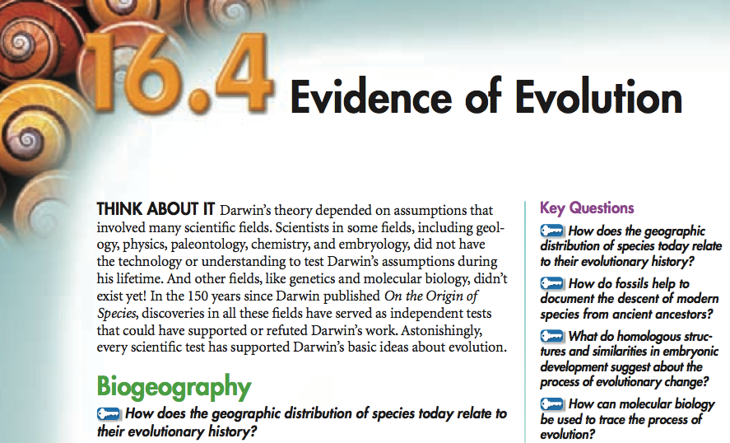
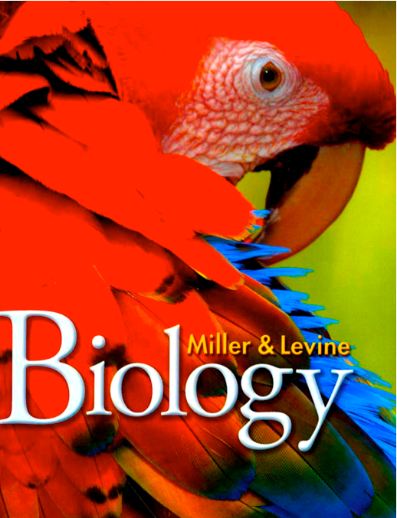
In the 150 years since Darwin published On the Origin of Species, discoveries in all these fields have served as independent tests that could have supported or refuted Darwin’s work. Astonishingly, every scientific test has supported Darwin’s basic ideas about evolution.
So, what’s the right strategy?
First, answer their arguments.

Slide 11

Science Under Siege?
1) Teach the science. Show the factual evidence first, then the theories that unify and explain those facts.
2) Don’t shy away from controversy. If the science points in a clear direction, don’t hesitate to say so.
3) Remember that science is not business or politics or religion. Leave the implications of science to your students.

Slide 12
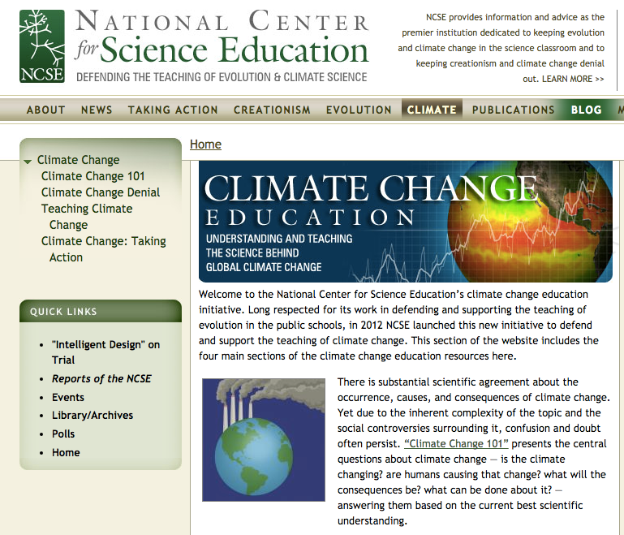
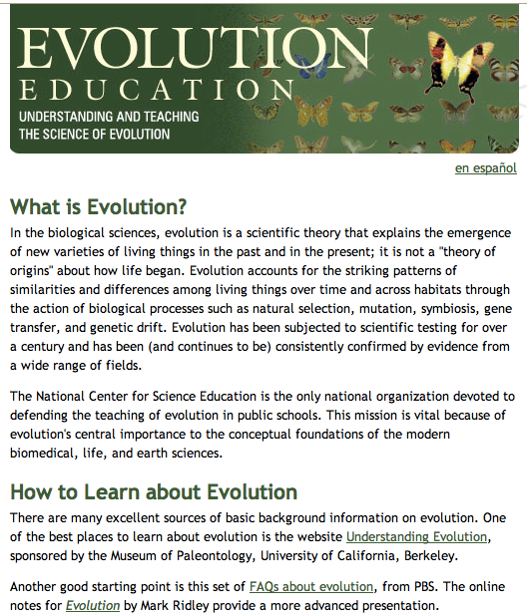
www.ncse.com

Slide 13
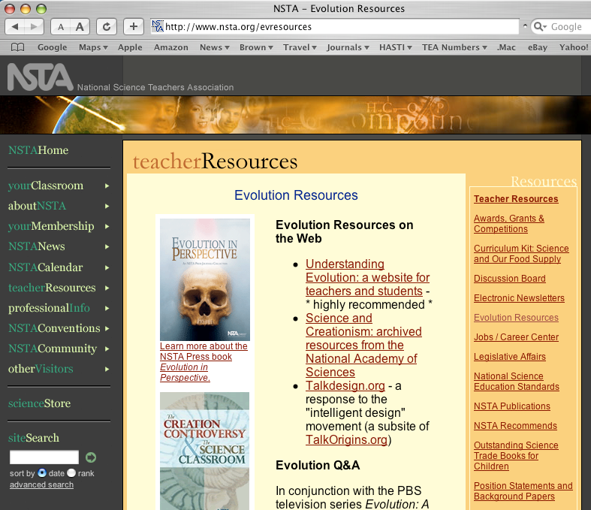
www.nsta.org/evolution

Slide 14
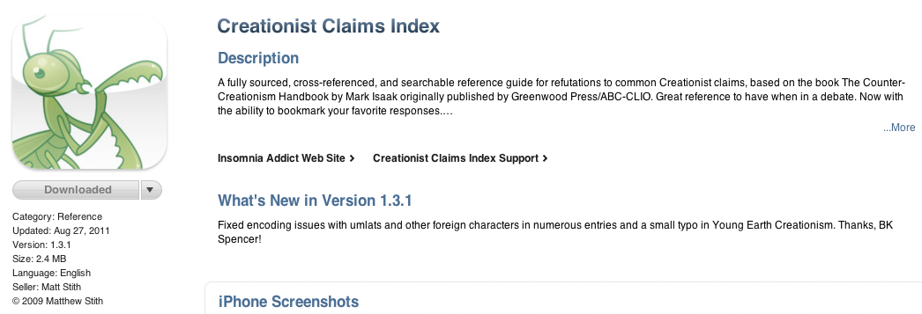
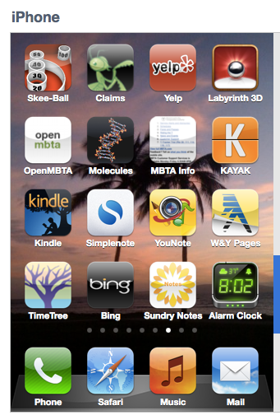
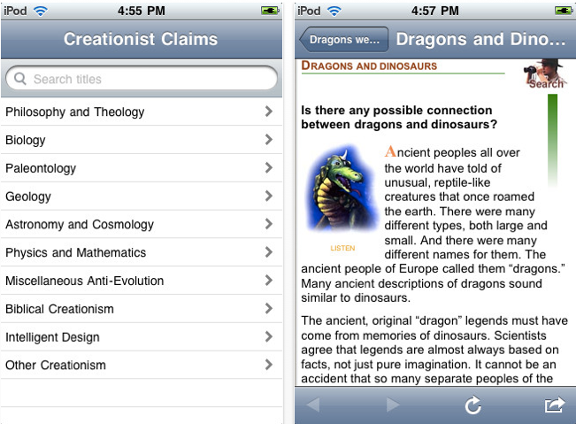
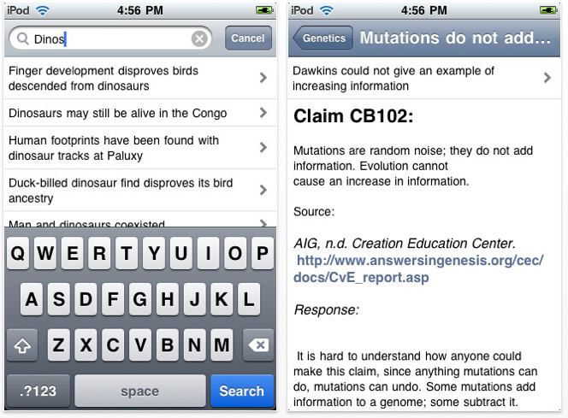

Slide 15
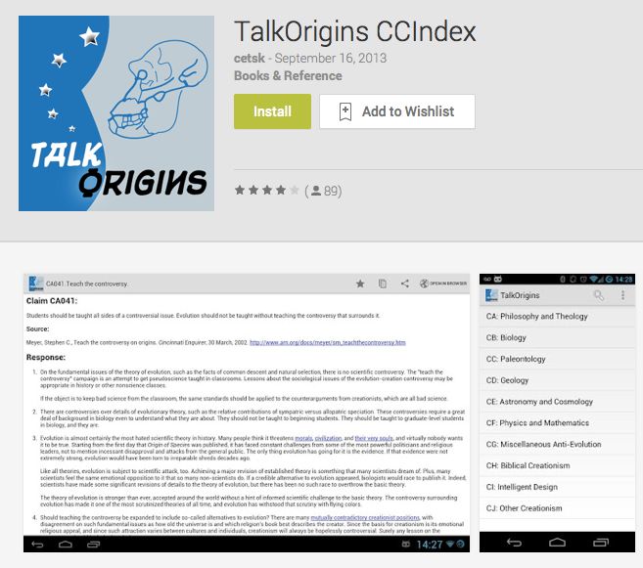
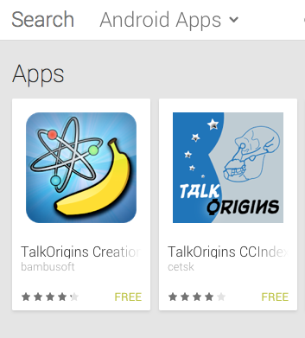
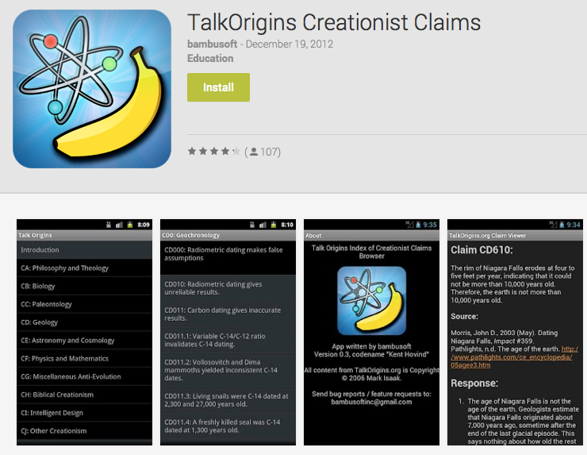

Slide 16
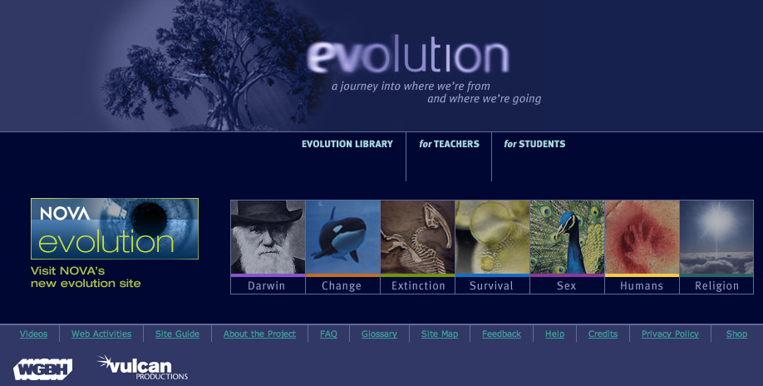
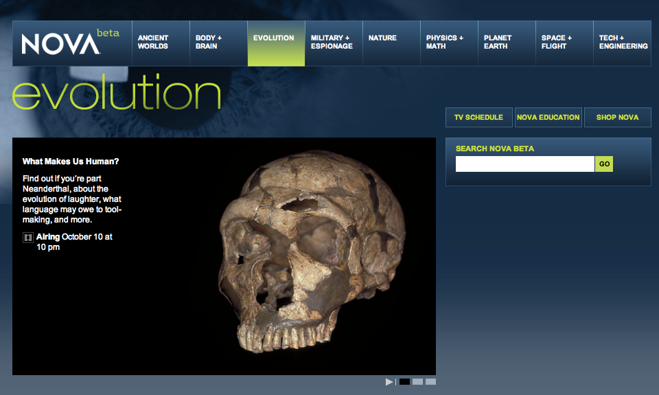
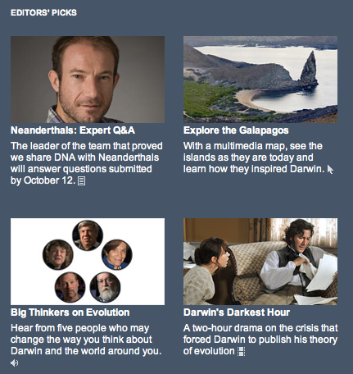
http://www.pbs.org/evolution

Slide 17
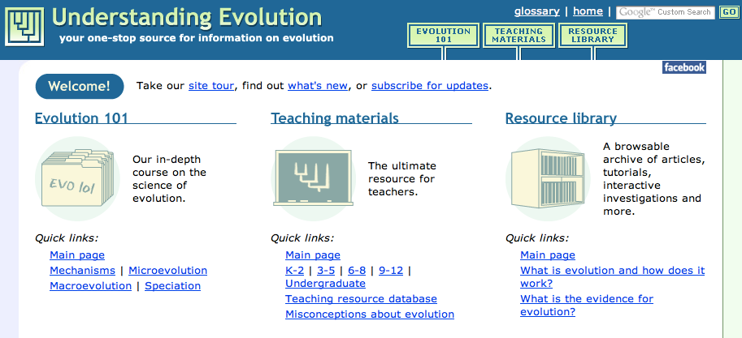
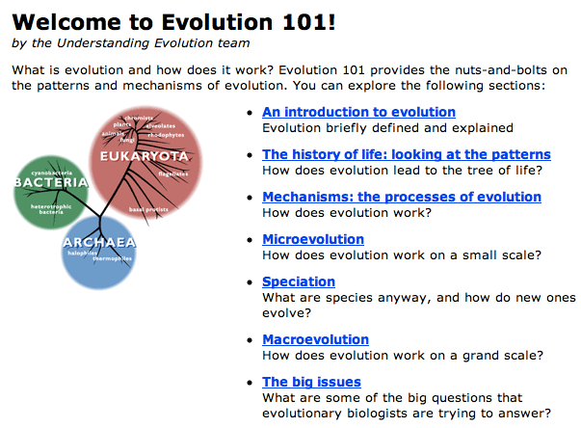
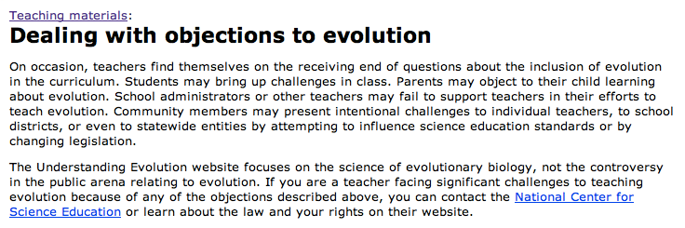
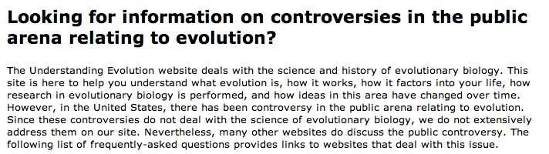
http://evolution.berkeley.edu/

Slide 18
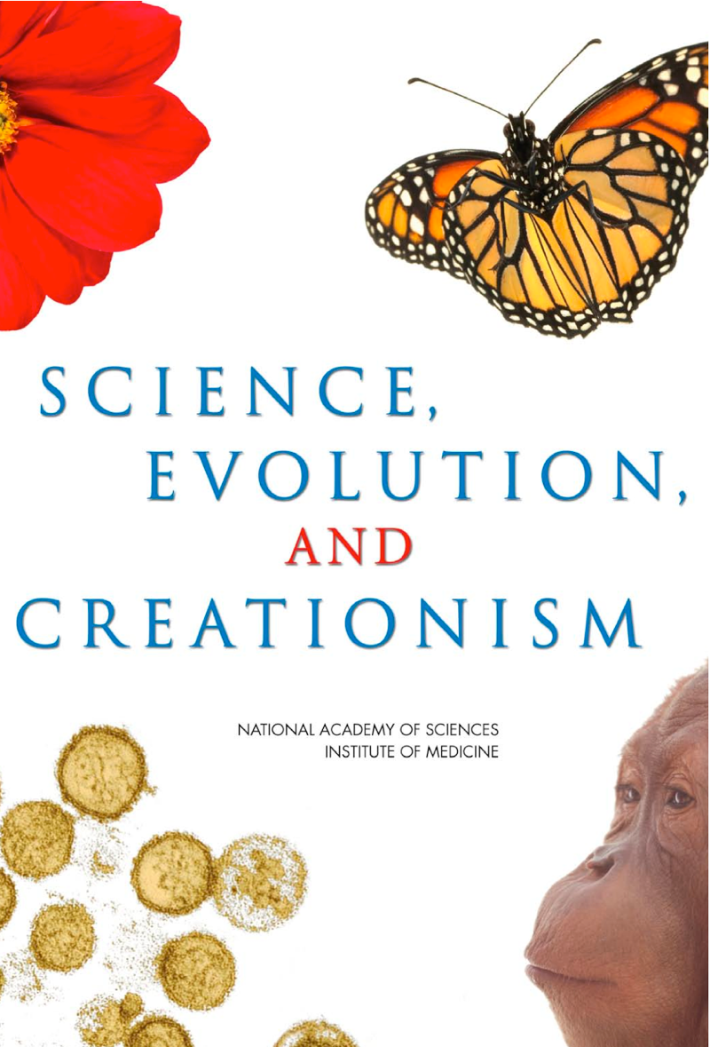
from the National Academy of Sciences:
www.nas.edu

Slide 19
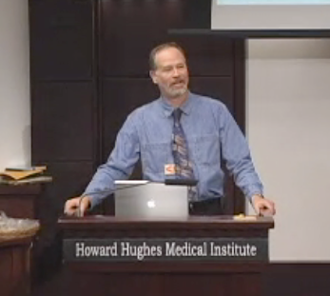
I’d be glad to visit your classroom to talk about evolution
Speciation
Human Genome
Irreducible Complexity
Fossil Record
Bacterial Flagellum
“Intelligent Design”

Slide 20
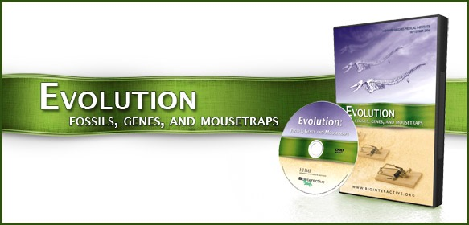

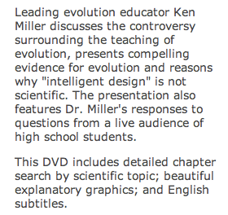
www.hhmi.org/biointeractive
HHMI:
Free DVD — from the Howard Hughes Medical Institute

Slide 21
General Guidelines & Suggestions
Emphasize that the purpose of science education is not to compel belief — it is to promote understanding.
Scientists don’t “believe” in scientific theories — they accept or reject them on the basis of the evidence.

Slide 22
General Guidelines & Suggestions
Make certain that students don’t see evolution as a subject that places their most closely-held beliefs at issue.
... and, emphasize the process by which scientific ideas are developed — not from preexisting beliefs, but from observation and experiment.

Slide 23
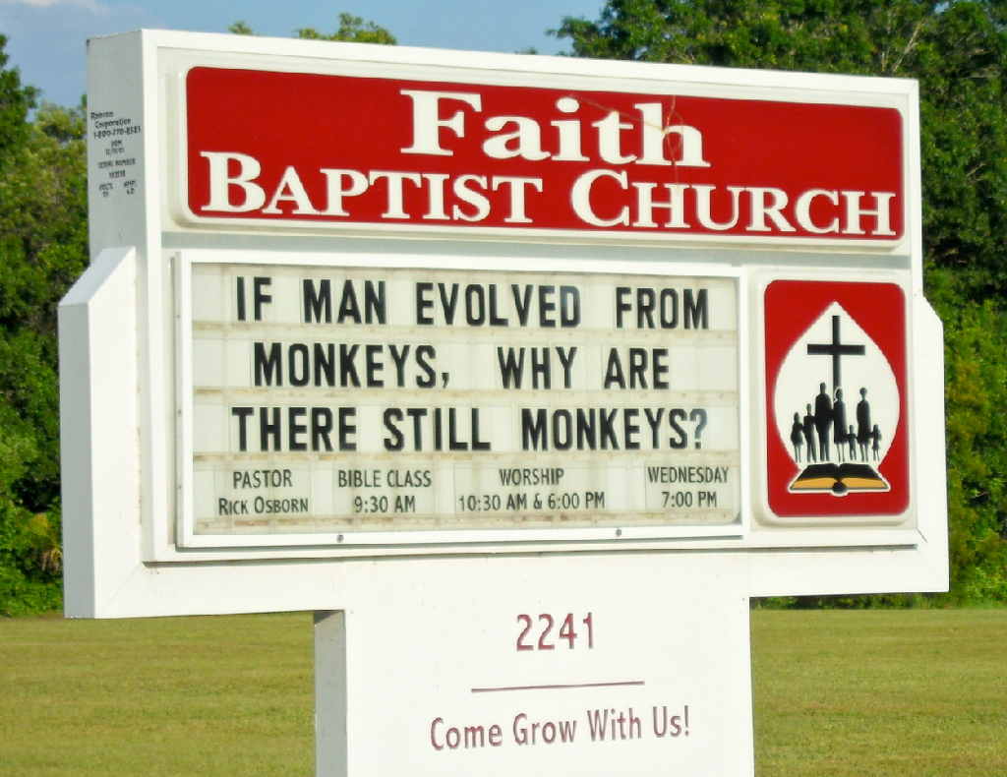

A persistent issue in teaching Evolution: The Science vs. Faith stereotype

Slide 24


But the stereotype is beginning to crack.
An Example:

Slide 25

Significantly, Kitzmiller wasn’t a “God vs. Science” case.
The Judge himself was a Christian (Lutheran).
2 of the 6 expert witnesses were people of faith, and one was a professor of theology at Georgetown Univ.
Most of the 11 plaintiffs were Christians (and 2 were Sunday school teachers).

Slide 26






Slide 27




Assemble the case historically . . .
. . . allowing students to see the scientific development of the theory.

Slide 28


“Succession of types.”
Armadillos are native to the Americas, with most species found in South America.
Glyptodont fossils also unique to South America.
Why should extinct armadillo-like species & armadillos be found on same continent?

Slide 29


Mylodon (left) Giant ground sloth (extinct)
Modern sloth (right)
“This wonderful relationship in the same continent between the dead and the living will, I do not doubt, throw more light on the appearance of organic beings on our earth, and their disappearance from it, than any other class of facts.”
Chapter 8, Voyage of the Beagle.

Slide 30


Author Randy Olson emphasizes the importance of narrative in Science.

Slide 31




We should remember Darwin’s advice: “There is Grandeur in this view of Life.”
Evolution is life’s greatest story. It brings together:
• Development
• Physiology
• Gene Expression
• Natural History
• Proteomics & Genomics

Slide 32





Evolution matters because it is Exhibit A for the anti-Science movement - but it’s not the only issue!

Slide 33





Slide 34
What is “Global Change?”
1. Politically-correct replacement for the discredited tree-hugger fantasy of “global warming.”
2. A global radical-secular-liberal-academic conspiracy to justify creating a one-world government that will prohibit Americans from buying hummers and destroy the livelihoods of coal miners.
3. “... the greatest hoax ever perpetrated on the American people.” (James Inhofe; R-OK)
4. Well-documented changes in local and global environments, largely driven by human activities, that profoundly affect all life on Earth.

Slide 36


Slide 37


Slide 38



Slide 39
Climate denialists’ strategies are all too familiar to any of us also dealing with creationist/ID opposition to evolution
Enlist anyone who has (or appears to have) scientific credentials.
Identify areas in which some genuine scientific questions - however small - exist.
Exaggerate scientific uncertainty to create a “controversy”
Invoke the literalist/inerrant mindset to argue that if one small piece of the argument is flawed, the entire intellectual construct falls apart. Add in a batch of conspiracy theory.
Argue that it is appropriate for students to be exposed to all points of view: “teach the controversy”

Slide 40
An important difference:
There is no equivalent for “separation of church and state” that is applicable to pseudoscience created by industry and anti-environmental “think tanks.”

Slide 41



Slide 42


Slide 43



Slide 44


Slide 45



There is a connection you may or may not have noticed between anti-evolution and anti-global warming groups and strategies.

Slide 46


Slide 47



Slide 48



Slide 49

Challenges in teaching about climate/global change

Slide 50


Slide 51
Another challenge is helping understand the difference between global change over “deep time” and global change today — time scales that differ in several orders of magnitude.

Slide 52

Timescale measured in millions of years.
Timescale measured in decades to centuries.

Slide 53
Climate change offers an excellent opportunity to show students that science deals with both things we know and what we don’t know.
Science rarely “proves” anything “100% beyond a shadow of a doubt”
(Important difference between experimental sciences and math.)
Scientists aim for the best approximation of reality that current methods can reveal. Uncertainty is part of the process.
Despite uncertainty science can make useful predictions and prudent recommendations
Engage students in scientific reasoning and tie individual lessons together in the context of a conceptual framework that guides them in “connecting the dots.”

Slide 54
Science proceeds by:
formulating hypotheses,
testing those hypothesis with data …
  … which support or refute hypothesis.
Do data support or refute the hypothesis that the biosphere is warming?

Slide 55

Some data are in the form of “physical” evidence, such as temperature recordings, along with changes in arctic and mountain glaciers, and arctic and antarctic sea ice.

Slide 56


Slide 57


Slide 58


Slide 59



Slide 60



Slide 61



Slide 62



Slide 64


Slide 65


Slide 66


Slide 67


Slide 68


Slide 69


Slide 70



Slide 71

When God created the first man, God showed him all the trees of the Garden of Eden and said: “Look at My works, how pleasing and perfect they are. All that I have created, I have created for you. Be mindful that you do not abuse and destroy my world; for if you destroy it, there is no one to repair it after you.”
MIDRASH ECCLESIASTES RABBAH 7:13
בשעה שברא הקב"ה את אדם הראשון נטלו והחזירו על כל אילני גן עדן ואמר לו ראה מעשי כמה נאים ומשובחין הן וכל מה שבראתי בשבילך בראתי, תן דעתך שלא תקלקל ותחריב את עולמי, שאם קלקלת אין מי שיתקן אחריך
קהלת רבה פרשה ז:יג

Slide 72

So let your enthusiasm and imagination take wing!
Teach about climate change as if all our lives depend on it … because they do!

Slide 73




ken.miller@brown.edu
401-863-3410
levinejs@me.com
millerandlevine.com

