Slide 1

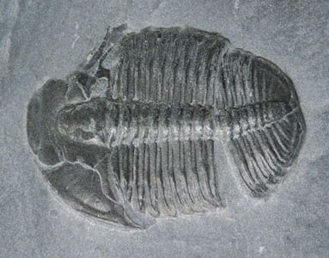
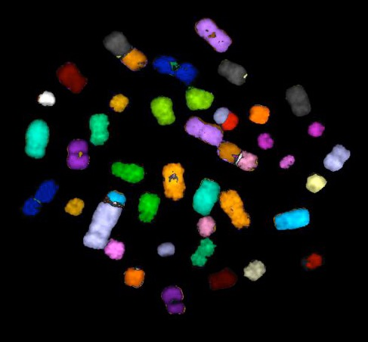
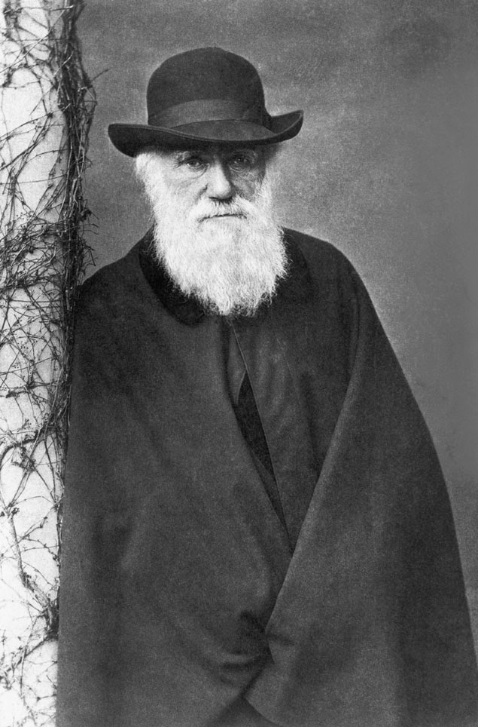
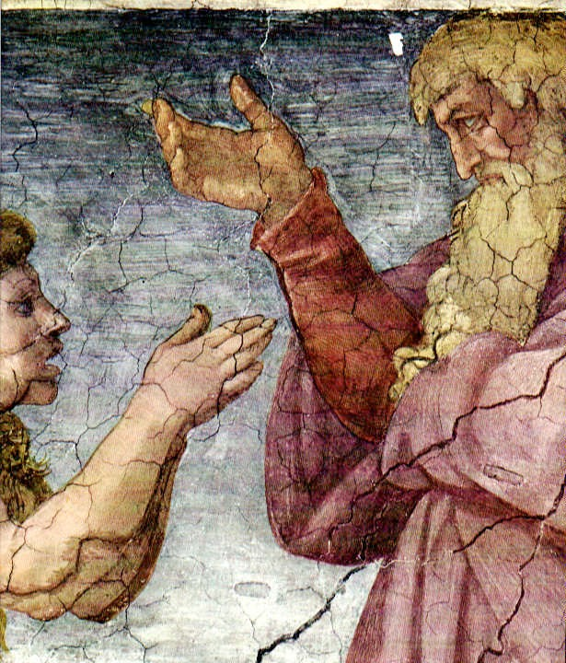
The Human Difference
How Evolution Fashioned the Earth’s most Extraordinary Creature
Kenneth R. Miller
Brown University
11/4/19

Slide 2

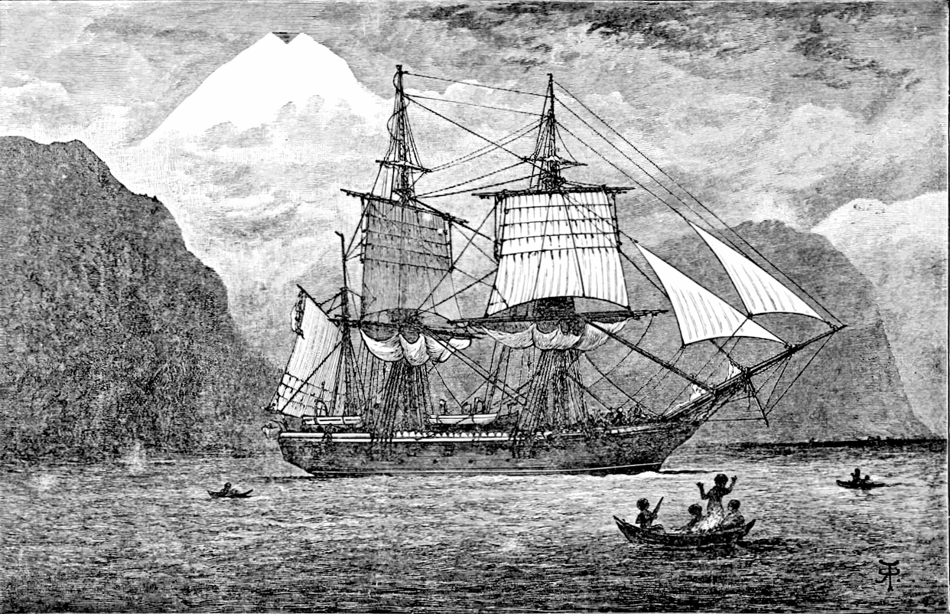
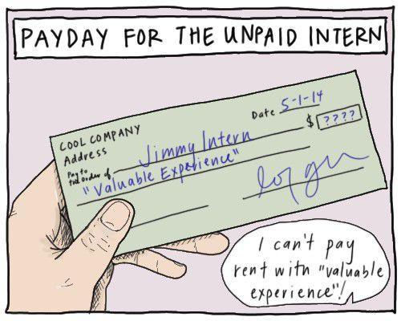

The new semester has officially begun at Villanova and the pressure to solidify internships and academic pursuits for next summer is already intense. College students experiencing the fierce competition for internships and research opportunities are compelled to take any “professional” opportunity they can get – regardless if it pays.
“I can’t pay rent with ‘Valuable Experience.’ ”

Slide 3
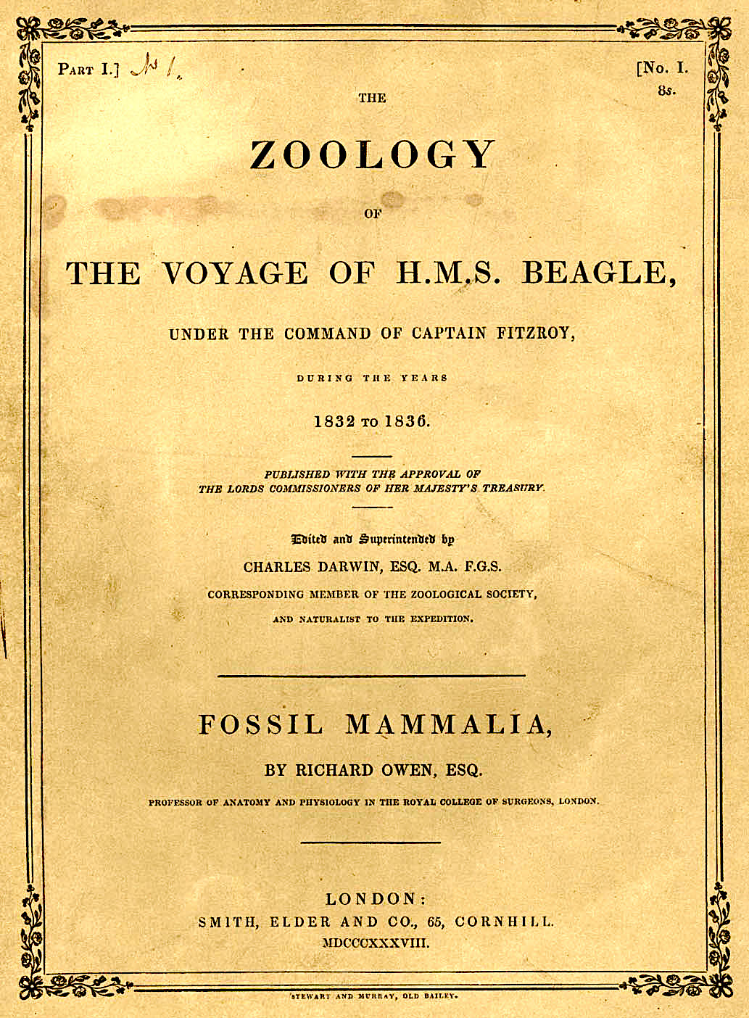
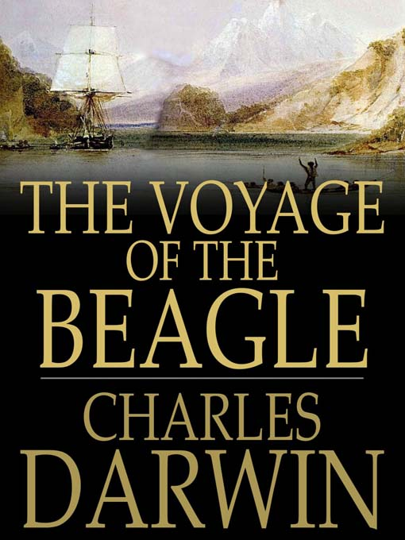
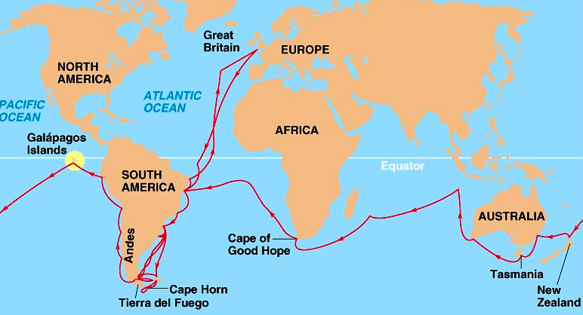
1832-1836
Darwin published
The Voyage at age 29.

Slide 4
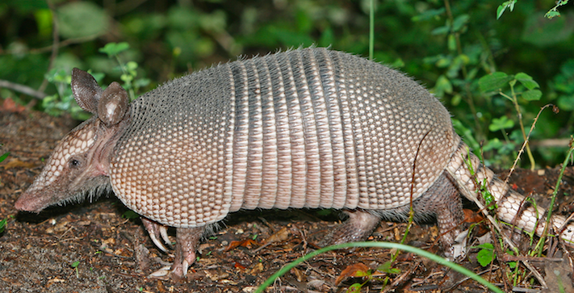
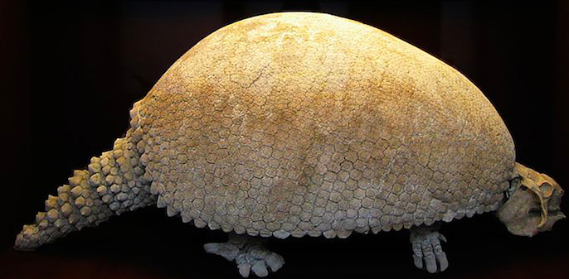
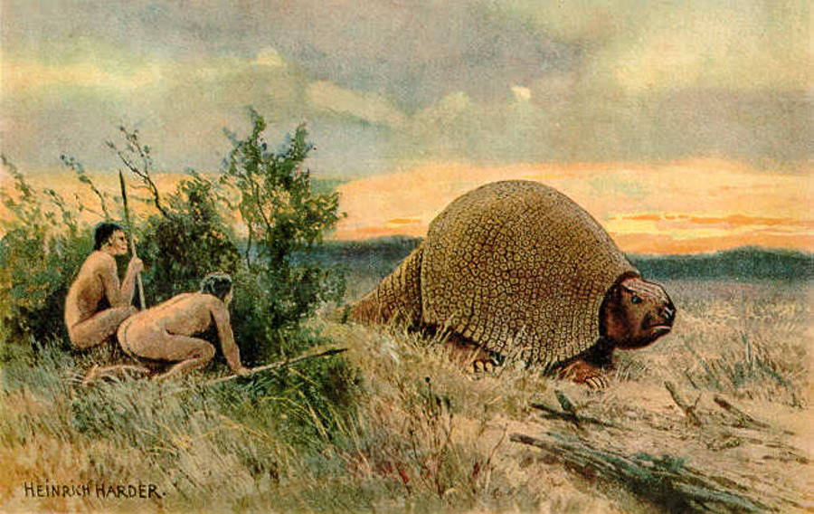
Armadillo
(~45 kg)
Glyptodon
(~2000 kg)

Slide 5
“There are fossil ant-eaters, armadillos, tapirs, peccaries, guanacos, opossums, and numerous South American gnawers and monkeys, and other animals.”
“This wonderful relationship in the same continent between the dead and the living will, I do not doubt, throw more light on the appearance of organic beings on our earth, and their disappearance from it, than any other class of facts.”
Chapter 8, Voyage of the Beagle.

Slide 6
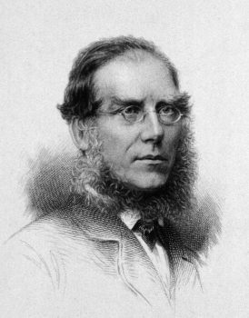
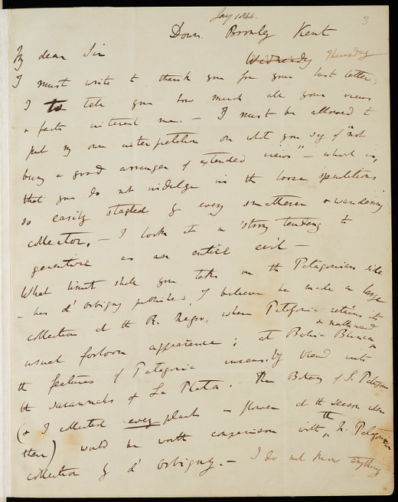
Six years later he extended this idea in a letter to botanist Joseph Hooker:
“At last gleams of light have come, & I am almost convinced (quite contrary to opinion I started with) that species are not (it is like confessing a murder) immutable.”

Slide 7

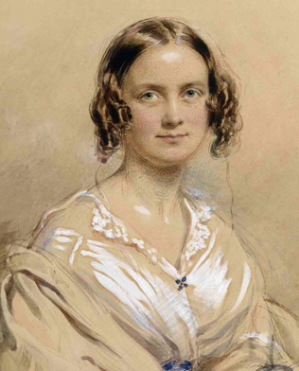
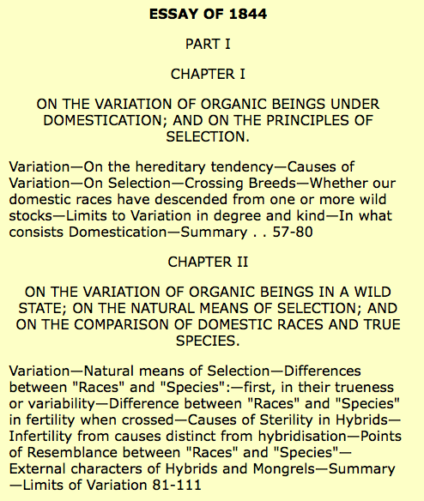
Worried his ideas might be lost, in 1844 he wrote a 250 page “outline” of his theory:
Emma Darwin
Letter to Emma: “If, as I believe, my theory in time be accepted even by one competent judge, it will be a considerable step in science. I therefore write this in case of my sudden death, as my most solemn and last request, which I am sure you will consider the same as if legally entered in my will, that you will devote £400 to its publication.”

Slide 8
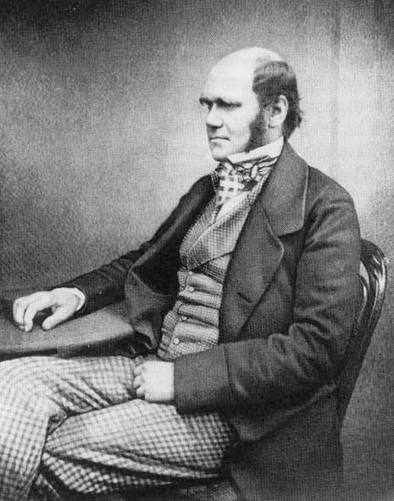
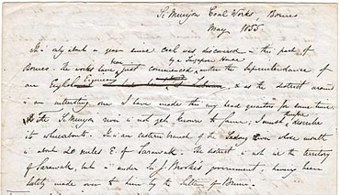

But 11 years later, he received a letter that changed everything…..
Still, he did not publish his theory.
Alfred Russel Wallace, a young naturalist working in the East Indies, was toying with a novel theory. He asked if Darwin could review a draft he was writing and comment upon it.

Slide 9
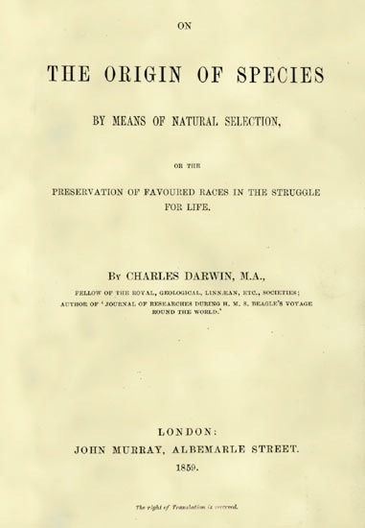
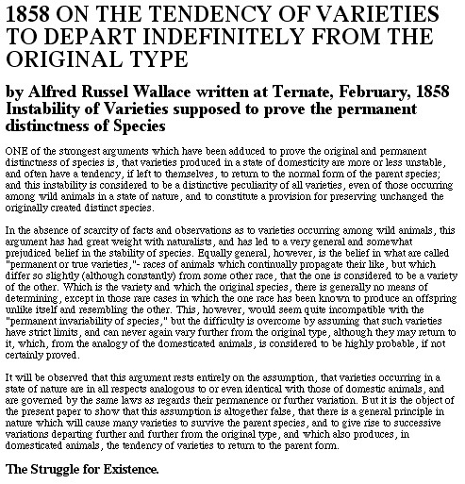
Darwin wrote to Lyell: "Your words have come true with a vengeance ... I never saw a more striking coincidence ... so all my originality, whatever it may amount to, will be smashed."

Slide 10
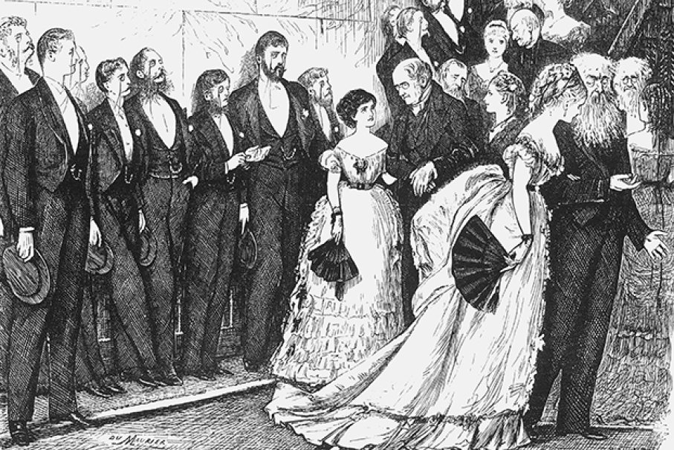
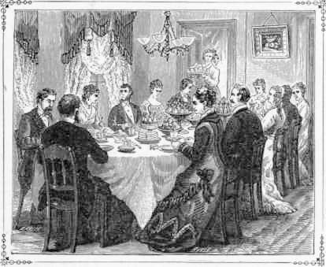
“Let us hope that it is not true.
But if it is true…
… let us hope that it does not become generally known!”

Slide 11
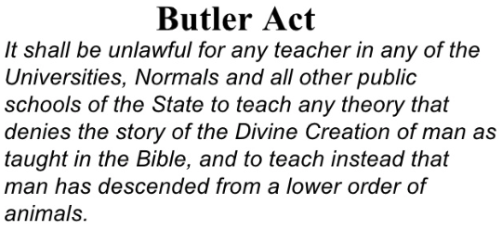
In the US, many states actually did try to keep it from being “generally known.”
Notes:
anti-evolution league photo:
http://lh4.ggpht.com/AuntLefty/R5u5QPDctnI/AAAAAAAABI0/vQd4HLhHDEY/BE053411-Standard.jpg
http://picasaweb.google.com/AuntLefty/ReadersReadilyReadingSlideshow/photo#5159921486653077106
Darrow and Bryan:
http://coe.west.asu.edu/students/tvanburen/trial3.jpg
http://coe.west.asu.edu/students/tvanburen/indexw.htm
Inherit the wind:
http://kilby.sac.on.ca/towerslibrary/pages/users/vidweb.htm

Slide 12
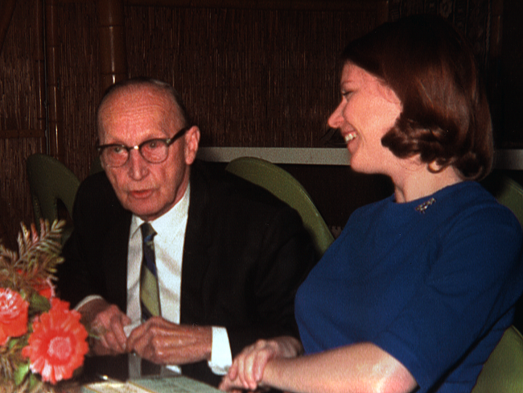
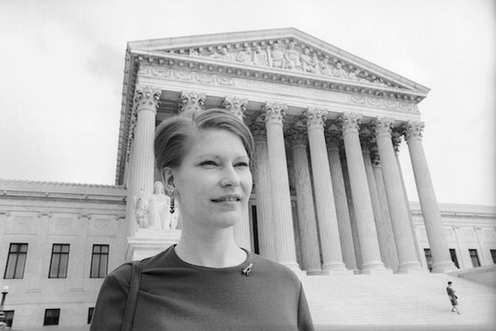
• The Scopes was convicted - and the Butler Act remained on the books.
• Teaching evolution remained banned in 6 states.
Until 1965, when Susan Epperson, a second year Biology teacher in Little Rock, filed a lawsuit against the state of Arkansas.
Notes:
anti-evolution league photo:
http://lh4.ggpht.com/AuntLefty/R5u5QPDctnI/AAAAAAAABI0/vQd4HLhHDEY/BE053411-Standard.jpg
http://picasaweb.google.com/AuntLefty/ReadersReadilyReadingSlideshow/photo#5159921486653077106
Darrow and Bryan:
http://coe.west.asu.edu/students/tvanburen/trial3.jpg
http://coe.west.asu.edu/students/tvanburen/indexw.htm
Inherit the wind:
http://kilby.sac.on.ca/towerslibrary/pages/users/vidweb.htm

Slide 13
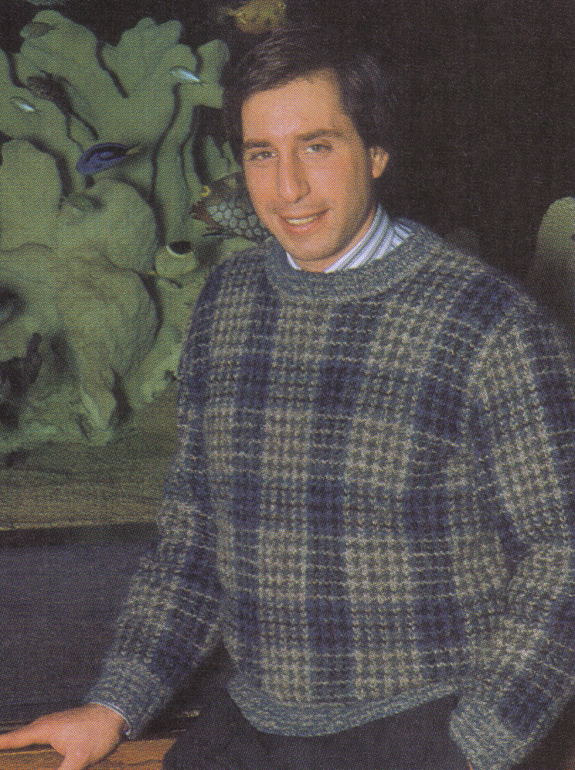
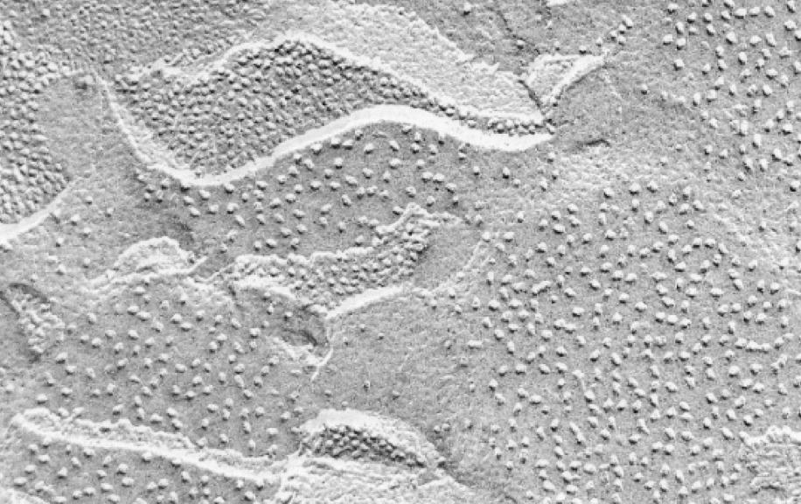
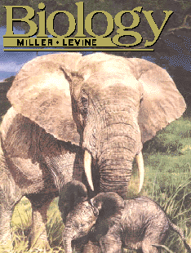
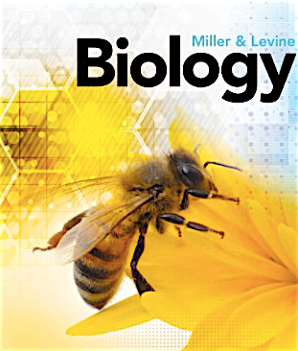
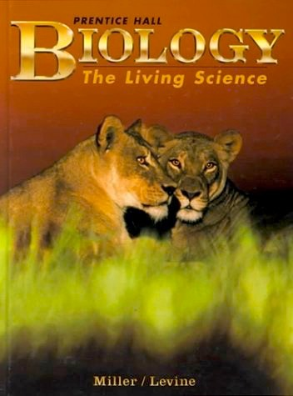
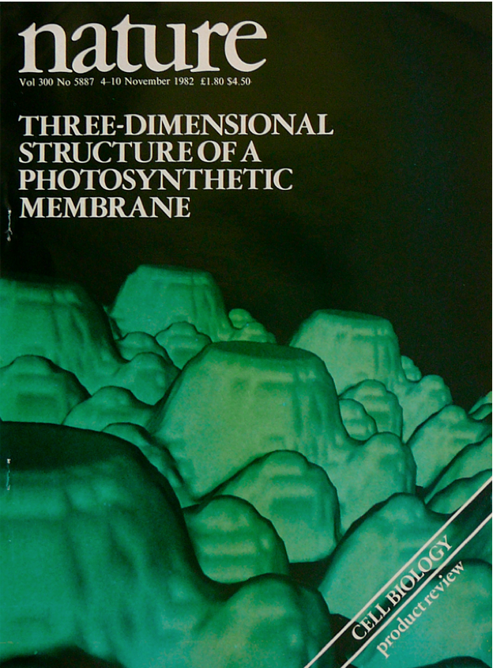
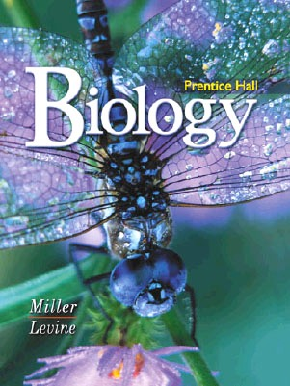
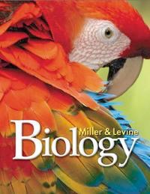
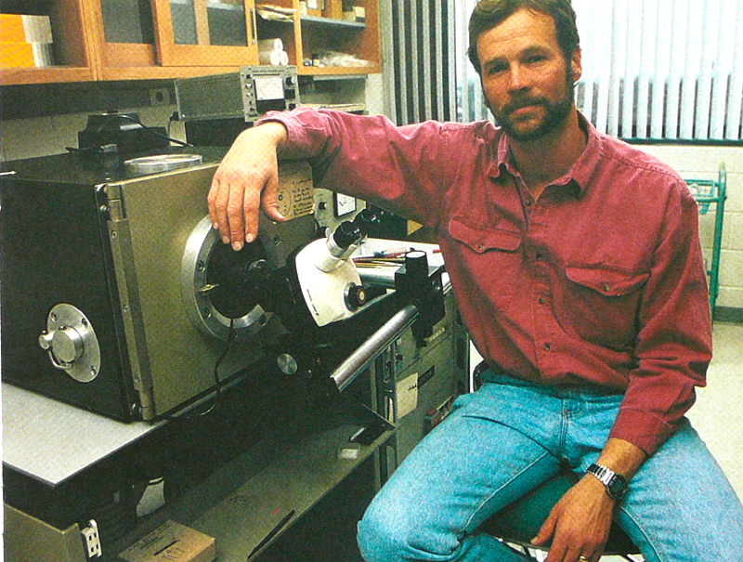
1982: I’m just an innocent Cell Biologist, working in my lab... and the phone rings.
Joe Levine: “Want to write a HS Biology textbook?”
Ken: “Whaddayou, nuts?”
Joe Levine

Slide 14
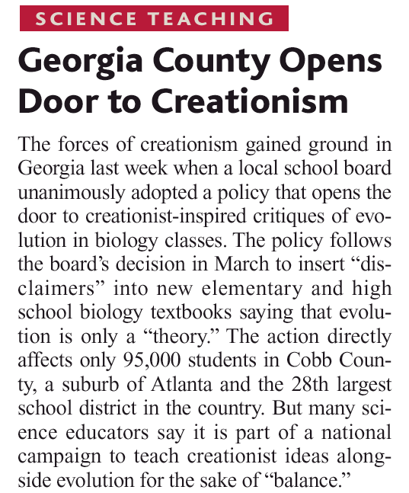
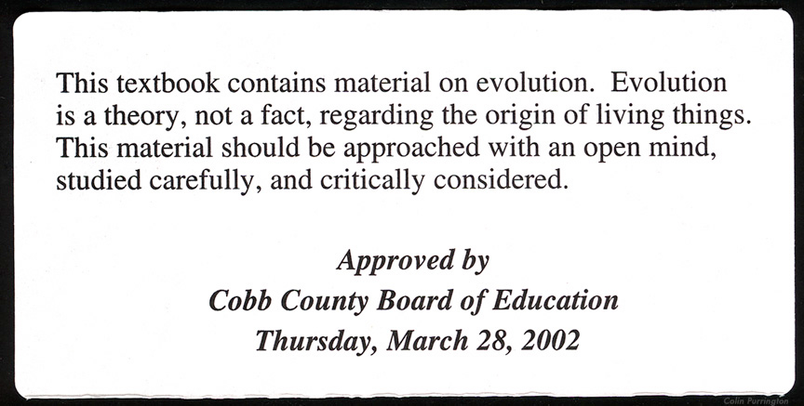
Cobb County, Georgia - 2004
Students must be “warned” about Evolution in textbooks.

Slide 15
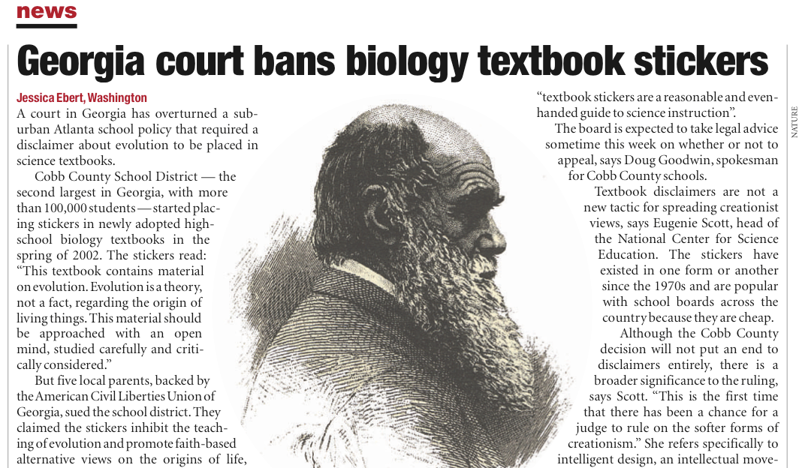
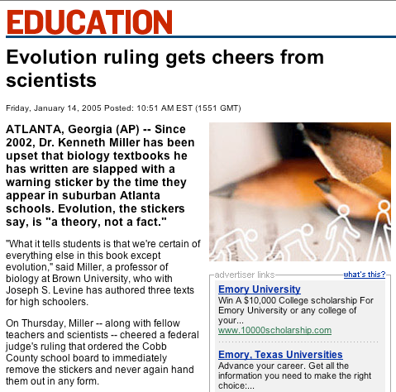
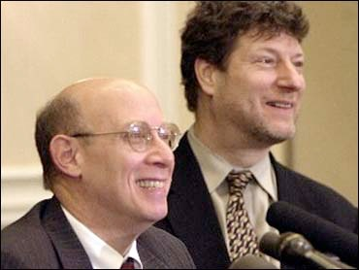

\
Jeff Selman

Slide 16
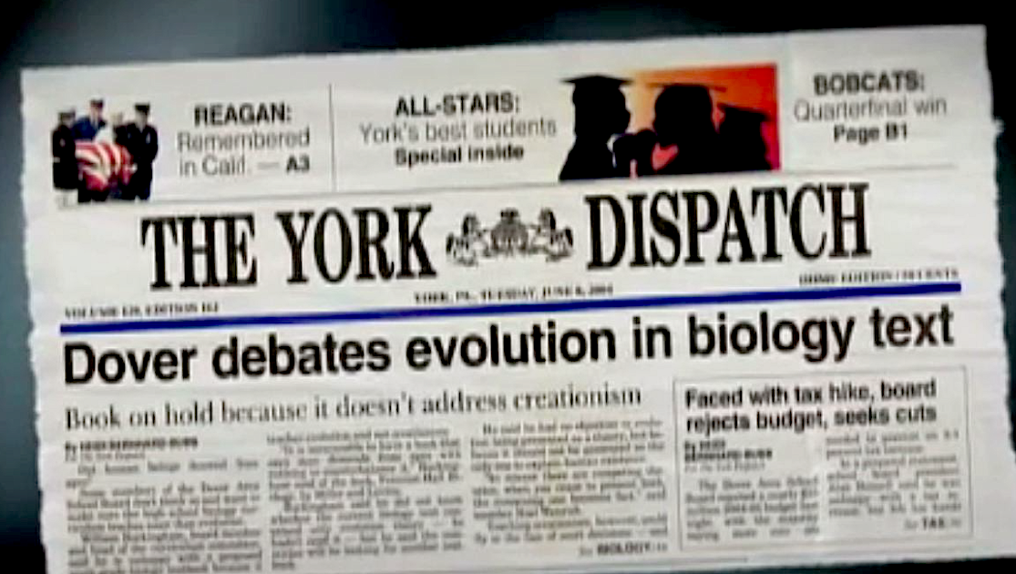
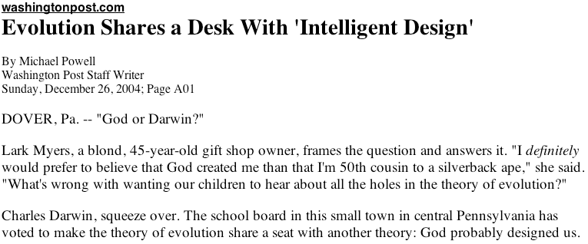
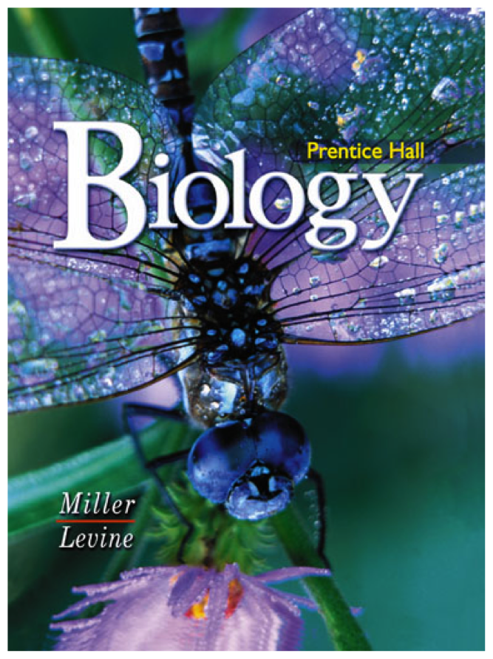


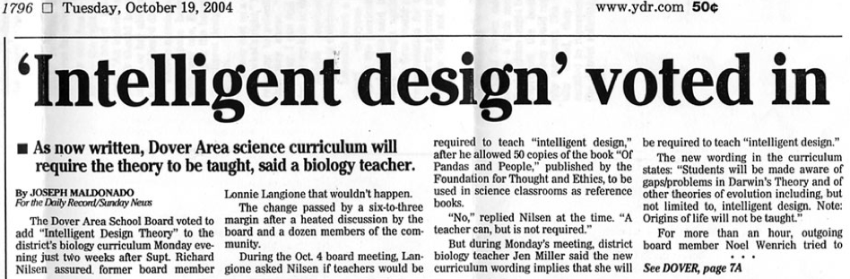
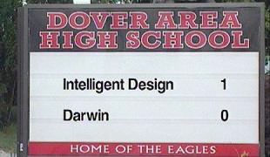
The conflict continues (2004): The Dover (PA) school board votes for “intelligent design” lessons in biology classes.
Notes:
Current battle — Dover, PA

Slide 17
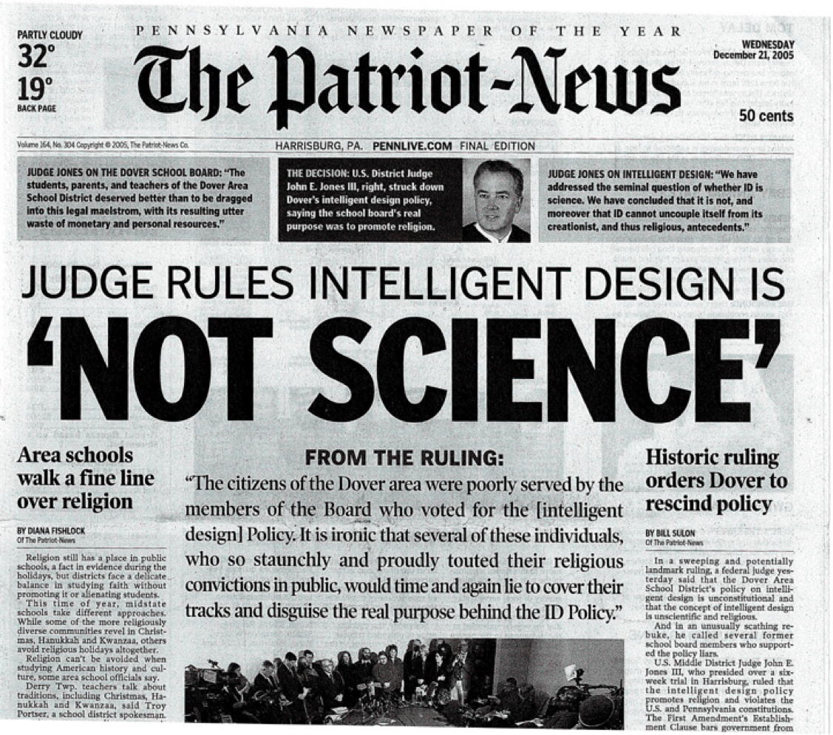

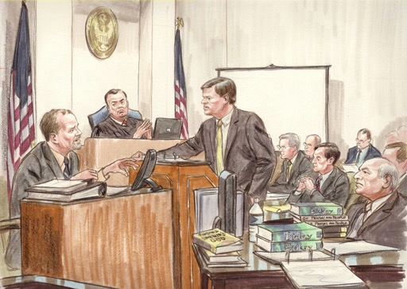

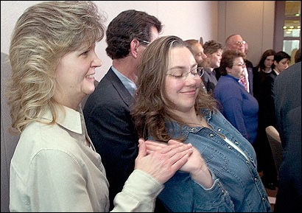
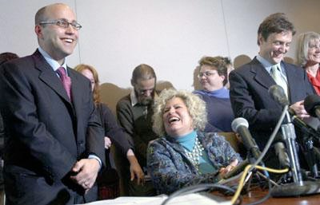
December 20, 2005
Decision Announced

Slide 18

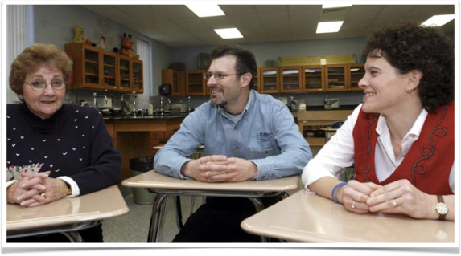
Tammy Kitzmiller
Dover Teachers:
Bertha Spahr, Rob Eschbach, Jennifer Miller

Slide 19

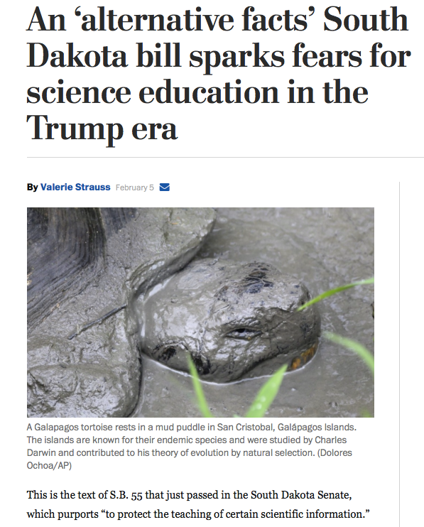


Slide 20

Florida’s new Board of Education Chairman supports vouchers and charter schools, but not teaching evolution
New Florida Board of Education Chair: “I won’t support any evolution being taught as fact at all in any of our schools.”
Tampa Bay Times August 6, 2019

Slide 21





Slide 22






Slide 23


The most powerful evidence for Evolution is found in
the Human Genome.
“More than a century ago Darwin and Huxley posited that humans share recent common ancestors with the African great apes. Modern molecular studies have spectacularly confirmed this prediction and have refined the relationships, showing that the common chimpanzee (Pan troglodytes) and bonobo (Pan paniscus) are our closest living evolutionary relatives.”
Notes:
MSNBC and NATURE

Slide 24



What SJ Gould once called a “senseless sign of history is present in the Human Genome:”
Chromosome Numbers in the great apes
human (Homo) 46
chimpanzee (Pan) 48
gorilla (Gorilla) 48
orangutan (Pongo) 48
Testable prediction: If these organisms share common ancestry, the human genome must contain a fused chromosome.
Notes:
Photos come from uncertain web sources.

Slide 25
Ancestral Chromosomes
Chromosome Numbers in the great apes (Hominidae):
human (Homo) 46
chimpanzee (Pan) 48
gorilla (Gorilla) 48
orangutan (Pongo) 48
Fusion
Homo sapiens
Centromere #1
Telomere sequences
Centromere #2
Centromere
Telomere
Testable prediction: The marks of that fusion must appear in one of the human chromosomes.
Notes:
My drawings.

Slide 26
Human Chromosome #2 shows the exact point at which this fusion took place
Homo sapiens
“Chromosome 2 is unique to the human lineage of evolution, having emerged as a result of head-to-head fusion of two acrocentric chromosomes that remained separate in other primates. The precise fusion site has been located in 2q13–2q14.1 (ref. 2; hg 16:114455823 – 114455838), where our analysis confirmed the presence of multiple subtelomeric duplications to chromosomes 1, 5, 8, 9, 10, 12, 19, 21 and 22 (Fig. 3; Supplementary Fig. 3a, region A). During the formation of human chromosome 2, one of the two centromeres became inactivated (2q21, which corresponds to the centromere from chimp chromosome 13) and the centromeric structure quickly deterioriated (42).”
centromere #13 (inactive)
Telomere sequences
centromere #12 (active)
Hillier et al (2005) “Generation and Annotation of the DNA sequences of human chromosomes 2 and 4,” Nature 434: 724-731.
Notes:
My drawings, and the NATURE article as cited.

Slide 27
If the telomeres of two chromosomes fused to form a single chromosome, what would happen to the characteristic human telomere repeat of TTAGGG?
- - - TTAGGGTTAGGG-CCCTAACCCTAA - - -
- - TTAGGGTTAGGGTTAGGGTTAGGG
- - AATCCCAATCCCAATCCCAATCCC
- - TTAGGGTTAGGGTTAGGGTTAGGG
So we should expect to find this “switchover” from TTAGGG to CCCTAA on either side of the fusion site.
- - AATCCCAATCCCAATCCCAATCCC

Slide 28

Human
chromosome 13 (2A)
chromosome 12 (2B)
IL1RN - PSD4 - PAX8 - CBWD2 - Fusion - RABL2A - SLC35F5 - ACTR3 - DPP10

Slide 29


The Evidence is abundant.
But what does it mean?
Notes:
MSNBC and NATURE

Slide 30



The intellectual burden of denying human evolution in the face of such evidence is far too great for any fair-minded person to sustain.
We are creatures of evolution, with all that implies about our bodies and our minds.
But many are still troubled by a basic question:
What does it mean to be a creature fashioned by the hand of evolution?

Slide 31
Many scientists have said exactly such things.
Suppose someone claimed that you
  • are nothing but an animal….
  …Just one species among millions.
  • have been programmed by natural selection to do nothing more than to survive and mate?
  • are just a collection of mindless matter with the illusion of consciousness and free will?
  • are frankly insignificant in this huge and mindless universe?
How would you feel about Evolution then?

Slide 32






Marilynne Robinson
Such claims have led Marilynne Robinson, one of America’s most celebrated writers, to warn against the dangers of “Darwinism.”

Slide 33

The Death of Adam
Essays on Modern Thought
Marilynne Robinson
“Darwinism is, intrinsically, a chilling doctrine.”
“It has required the grand-scale disparagement of the traits that distinguish us from the animals — and the Darwinists take the darkest possible view of the animals.”

Slide 34
“There is no place left for the soul, or even the self. Moral behavior has no real meaning…”
“For old Adam, that near-angel whose name means Earth, Darwinists have substituted a creature who shares essential attributes with whatever beast
Marilynne Robinson
has recently been observed behaving shabbily in the state of nature. Genesis tries to describe human exceptionalism, and Darwinism tries to discount it.”
“It is a thing that bears reflecting upon, how much was destroyed, when modern thought declared the Death of Adam.”
Notes:
MSNBC and NATURE

Slide 35



The Sea of Faith
Was once, too, at the full, and round earth’s shore
Lay like the fields of a bright girdle furled.
But now I only hear
Its melancholy, long, withdrawing roar,
Retreating, to the breath
Of the night-wind, down the vast edges drear
And naked shingles of the world.
“[Living things], including exalted beings like ourselves, arose from physical laws, from war of nature, famine, and death. This is the ‘grandeur” of which Darwin wrote.”

Slide 36


A 19th Century view of Evolution put Humans at the pinnacle of the tree of life.
Today, we view Evolution differently.

Slide 37


Brian Switek
“There never was an ‘ascent of man,’ no matter how desperately we might wish there to be. We are merely a shivering twig that is the last vestige of a richer family tree. Foolishly, we have taken our isolation to mean that we are the true victors in life’s relentless race.”

Slide 38



We humans “aren’t any more special to the universe than a sea slug.”
PZ Myers

Slide 39


Frans de Waal
“If we look at our species without letting ourselves be blinded by the technological advances of the last few millennia, we see a creature of flesh and blood with a brain that, albeit three times larger than that of a chimpanzee, does not contain any new parts. Our intellect may be superior, but we have no basic wants or needs that cannot also be observed in our close relatives.”

Slide 40
Crows & Chimpanzees - Tool Use.
Trout - Social Cooperation.
Squirrels - Geospatial Navigation.
Sheep - Facial Recognition.
Scrub Jays - Food Storage.
De Waal and others make the argument that none of the qualities we consider characteristic of human beings is actually unique to us.

Slide 41



“Giraffe scientists would no doubt write of evolutionary progress in terms of lengthening necks, rather than larger brains or toolmaking skill. So much for human superiority. If that’s not ignominy enough, bacterial scientists would no doubt ignore humans completely except as convenient habitats, the passive scenery against which the bacterial drama is cast.”
Henry Gee
“Now, ask yourself—which of these stories is any more valid than any other, at least as a narrative?”

Slide 42
However, in their eagerness to demote the human species, Gee, de Waal, and others have overlooked something important.
In reality, there are no “giraffe scientists,” no “bacterial scientists,” and no books written by them about us….. even though we write books about Them.
“Giraffe scientists would no doubt write of evolutionary progress in terms of ……”

Slide 43

We are the species that invented science (and discovered Evolution!)
In reality, there are no “giraffe scientists,” no “bacterial scientists,” and no books written by them about us….. even though we write books about Them.

Slide 44


Claim: Evolution explains all human behavior
David Sloan Wilson
Evolution will include all Human Knowledge:
“Nothing about X makes sense except in the light of evolution, where X can equal Anthropology, Art, Culture, Economics, History, Politics, Psychology, Religion, & Sociology.”

Slide 45


Edward O. Wilson
Wilson argues that the adaptive value of human customs, behaviors, superstitions, and social institutions permits Evolution to explain all of them.

Slide 46



Marilynne Robinson
“A central tenet of the modern world view is that we do not know our own minds, our own motives, our own desires. And — an important corollary — certain well-qualified others do know them."
As Robinson points out, this amounts to a claim by scientists that they alone know the real reasons for your actions.

Slide 47


“If history and science have taught us anything, it is that passion and desire are not the same as truth. The human mind evolved to believe in the gods.
”It did not evolve to believe in biology.”

Slide 48








The human mind did not evolve to believe in biology?
The Human Mind Invented Biology!

Slide 49



Supposedly, human psychology was shaped by evolutionary pressures in the Pleistocene

Slide 50
What about the actual Pleistocene?
“We know so little about the environment of our Pleistocene ancestors, what they were like, and how they lived, that almost any hypothesis about which strategies might have helped them to reproduce, and thus let their characteristics ripple through the gene pool, is bound to be highly speculative.” [Anthony Gottlieb, NYTimes 1/29/09]

Slide 51





The most extreme conclusions of Evolutionary Psychology stem from false confidence about the nature of the human past.
Especially since we live today in societies that reinforce a host of cultural stereotypes.

Slide 52


“Man is a singular creature. He has a set of gifts which make him unique among the animals: so that, unlike them, he is not a figure in the landscape—he is a shaper of the landscape. In body and in mind he is the explorer of nature, the ubiquitous animal, who did not find but has made his home in every continent.”

Slide 53


Scientists like BF Skinner and Konrad Lorenz have extrapolated their studies of rats and ducks to explain human behavior.
Bronowski: “They tell us something about man. But they cannot tell us everything.”
“There must be something unique about man because otherwise the ducks would be lecturing about Konrad Lorenz, and the rats would be writing papers about B. F. Skinner.”

Slide 54
Evolutionary Psychology’s obsession to reach deep into the past to find the hidden chains that bind us must be paired with the realization that we have evolved into the only creatures able to perceive those chains, to rise above them, and to achieve an independence of thought, action, and creativity that makes possible the great and lasting achievements of our species.
We are, then, creatures like no other.

Slide 55

My answer to Marilynne Robinson:
Far from diminishing us, knowing the details of Adam’s journey ennobles each of us as a carrier of something truly precious—the genetic, biological, and cultural heritage of life itself.
Evolution describes not the Death of Adam, but his Triumph. That is the great Truth of our story.
Piero della Francesca, 1466

Slide 56

The Perseids - 2017
Of all the creatures, of all the forms of life that grace the surface of this small planet, only one that looks this way into the nighttime sky. Only one knows the Perseid spectacular is coming. Only one contemplates the age of the universe, only one is aware of the mysteries to be solved in starlight.
I’m hoping for a clear sky tonight. It’s expected be the peak of the annual Perseid meteor shower, a chance to glory in streaks of sudden fire as fragments of a comet come crashing through the Earth’s atmosphere. In between those moments of spectacle, there will be a chance to lie still in the darkness and absorb the quiet beauty of the nighttime sky.
That is the Human Difference. And that is why our presence on this planet amounts to nothing less than the Universe becoming conscious of itself.
The Cosmos itself is waking up, and we are the instruments of that self-awareness.
While all of life is one, linked by ancestry, structure, and design, only the human creature seeks answers to questions in the stars.

Slide 57


Slide 58

“There is grandeur in this view of life; with its several powers having been originally breathed into a few forms or into one; and that, whilst this planet has gone cycling on according to the fixed law of gravity, from so simple a beginning endless forms most wonderful and most beautiful have been, and are being evolved.”

Slide 59



kenneth_miller@brown.edu
Twitter: @KennethRMiller

