Slide 1

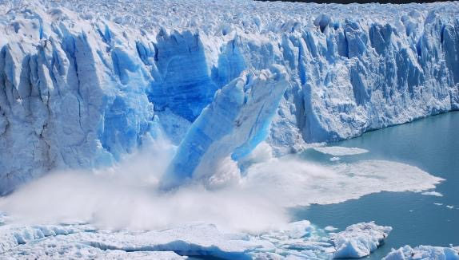
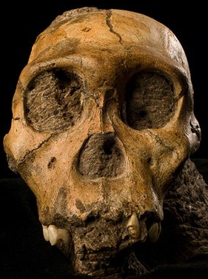


Science Denial
Why it Continues, and What Science Educators Can Do About it
Ken Miller &
Joe Levine
3/16/18

Slide 2
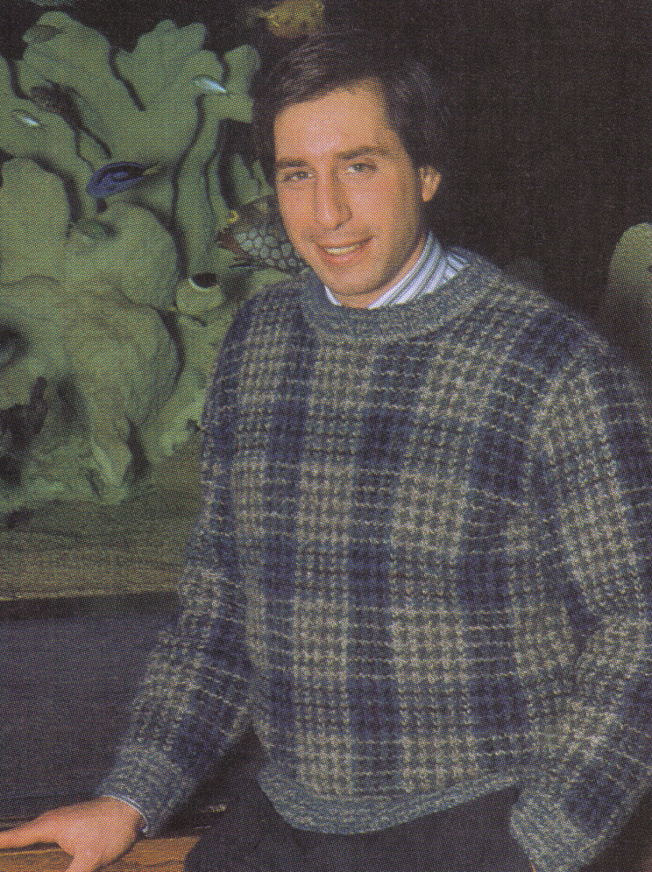
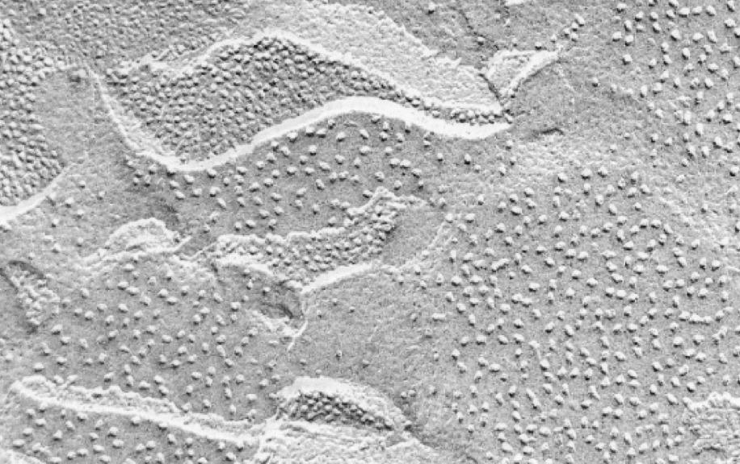


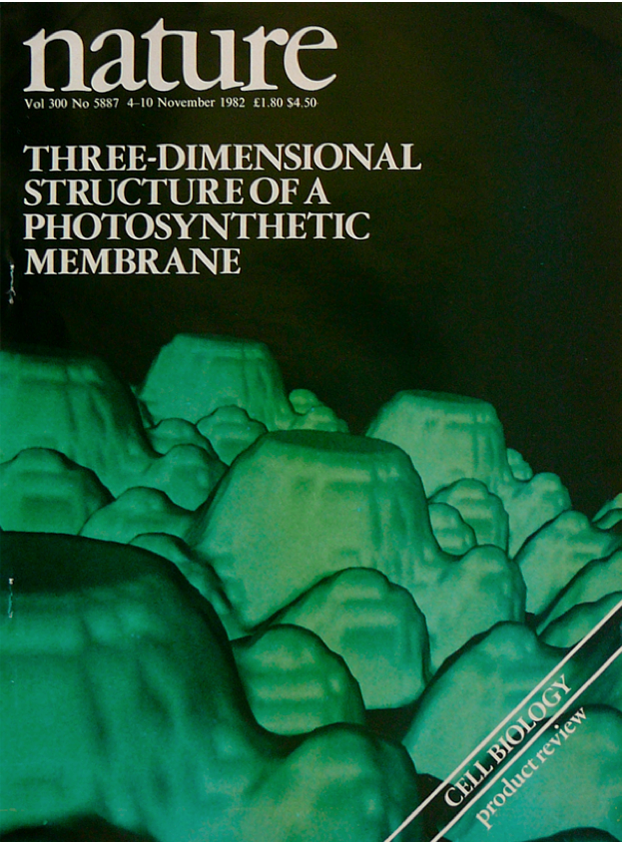

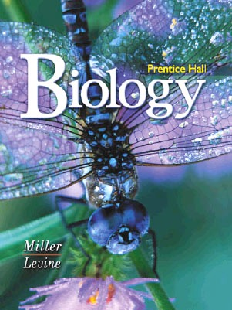
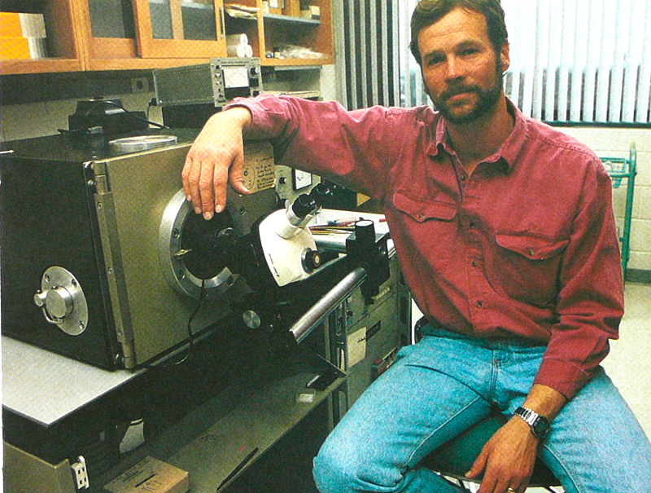
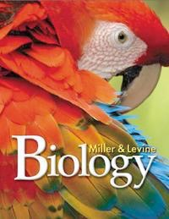
Joe Levine: “Want to write a HS Biology textbook?”
1982: I’m just an innocent Cell Biologist, working in my lab... and the phone rings.
Ken: “Whaddayou, nuts?”
Joe Levine
a mere 8 years later

Slide 3
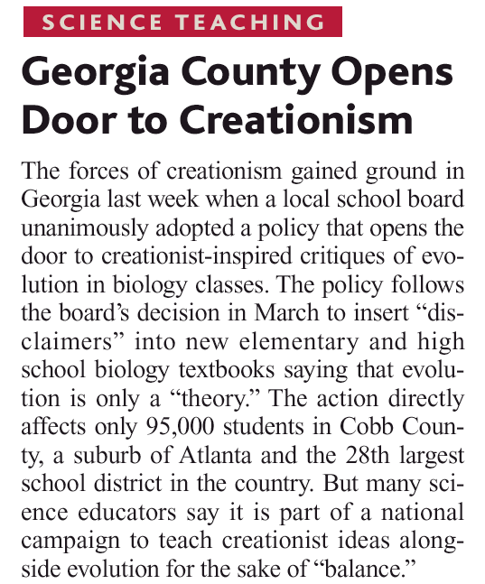

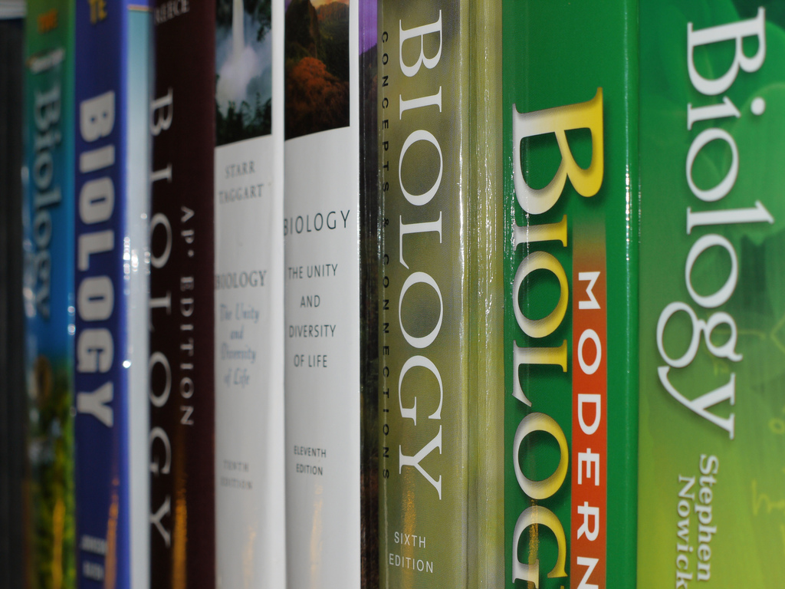
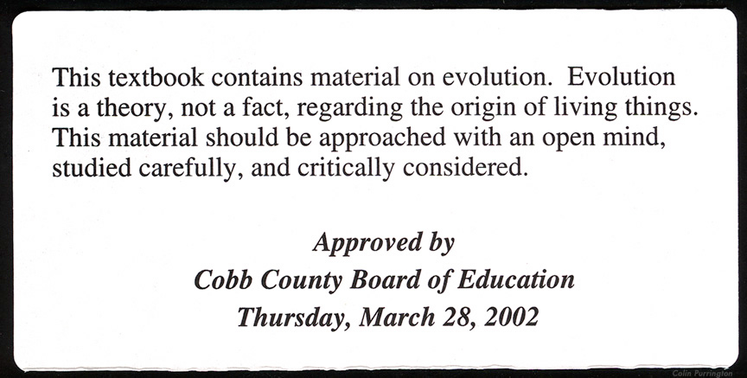
Cobb County, Georgia - 2004
Students must be “warned” about Evolution in textbooks.
This book contains material on Science. Science is built around theories, which must be strongly supported by factual evidence. Everything in science should be approached with an open mind, studied carefully, and critically considered!

Slide 4
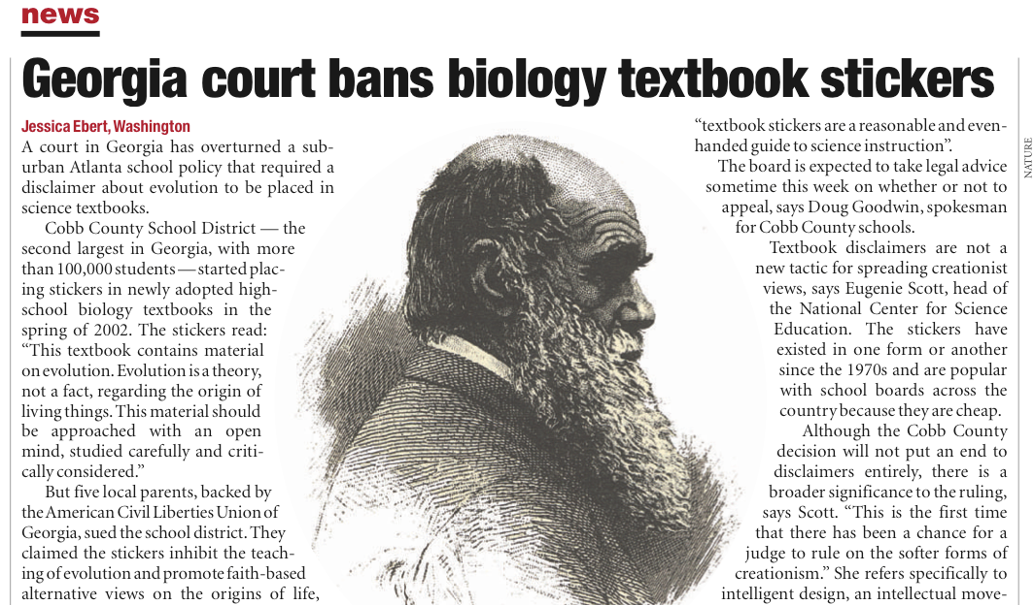
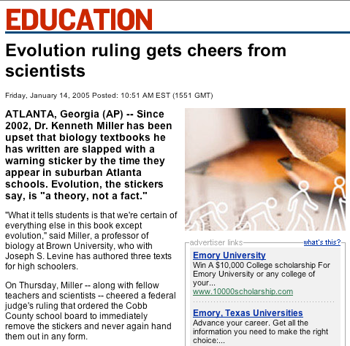
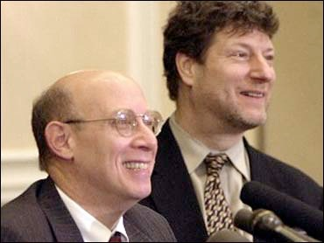

\
Jeff Selman

Slide 5
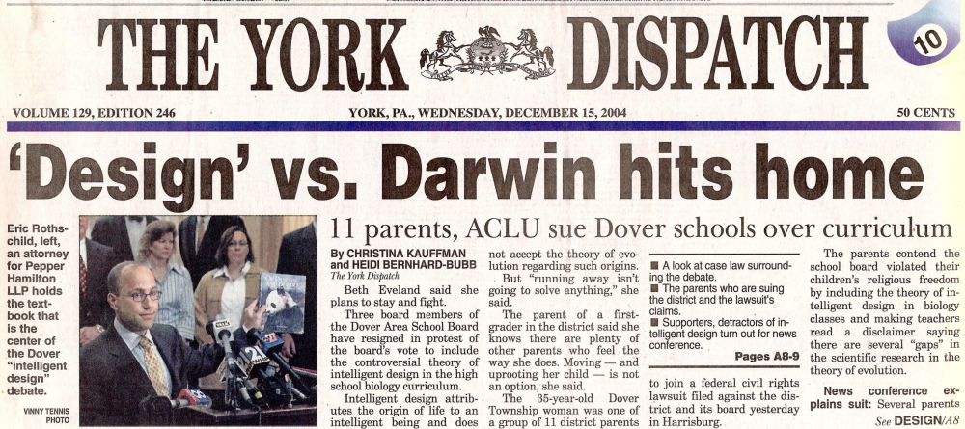
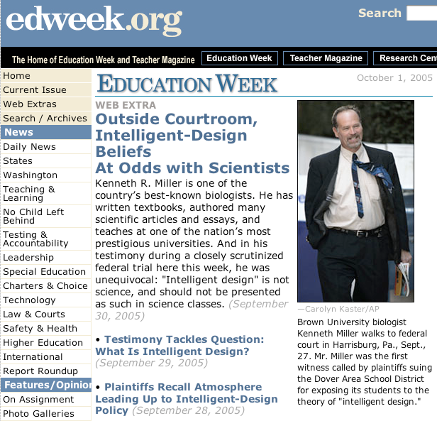
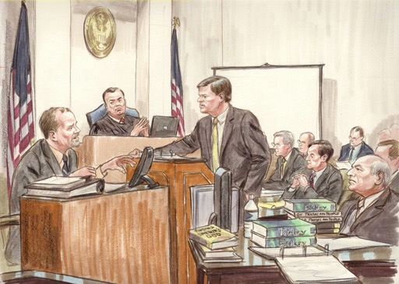
Dover, PA
2004
“Intelligent Design”

Slide 6
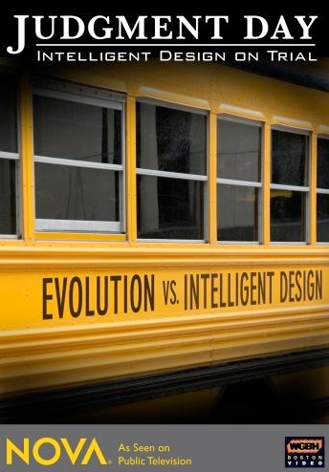
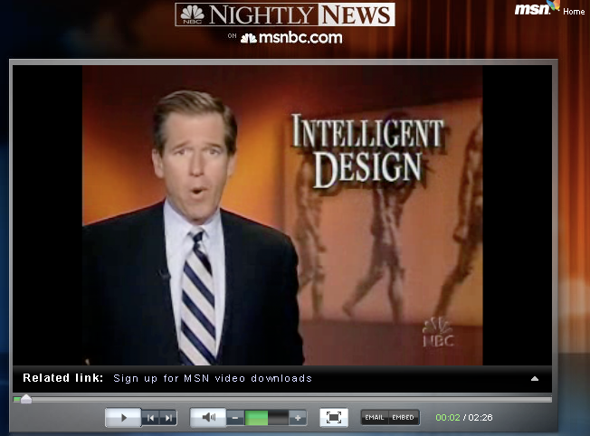
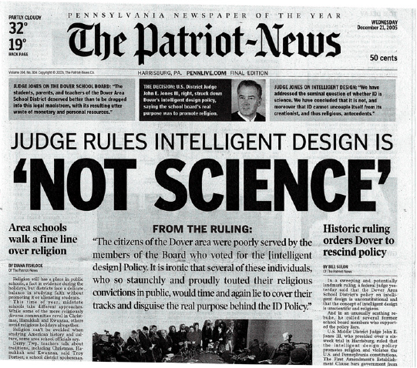
Judgment Day
PBS - November 13, 2007

Slide 7
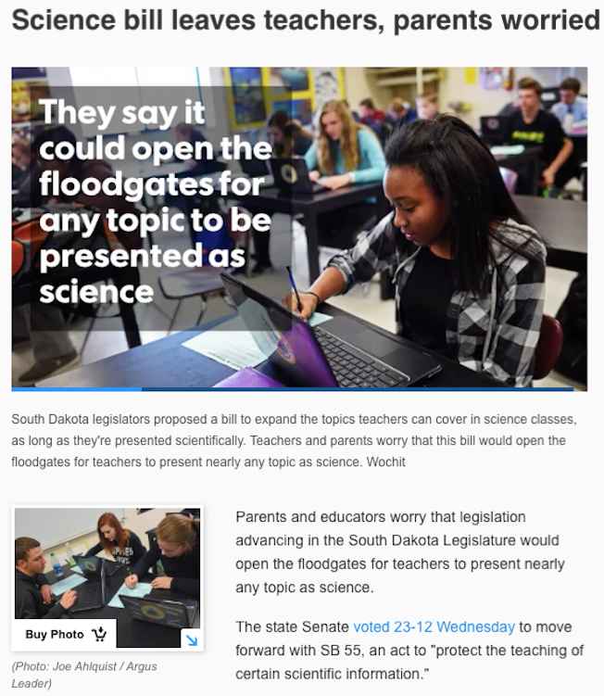
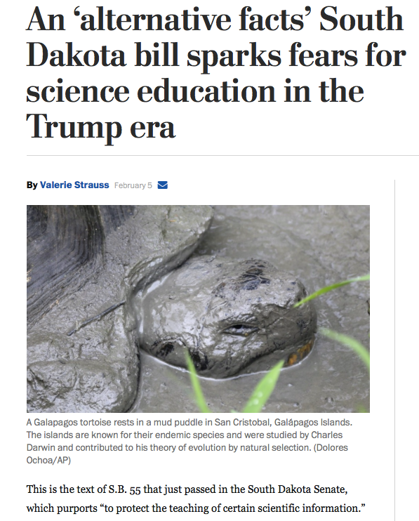
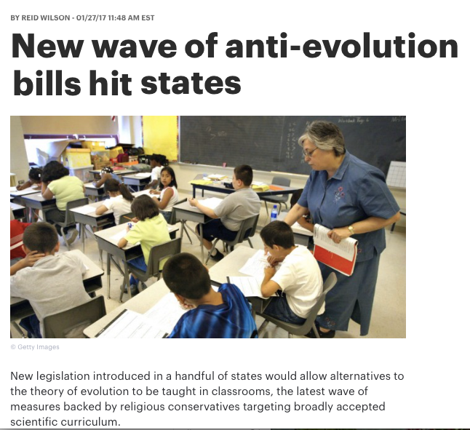

Slide 8
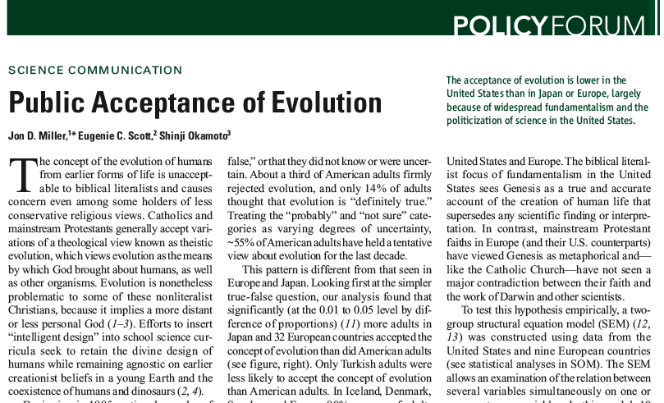
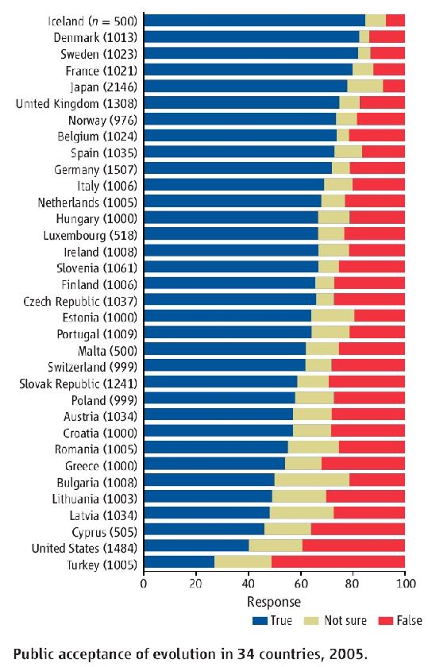
The US ranks next to last in public acceptance of evolution
Jon D. Miller, Eugenie C. Scott, Shinji Okamoto (2006)
Science 313: 765-767

Slide 9
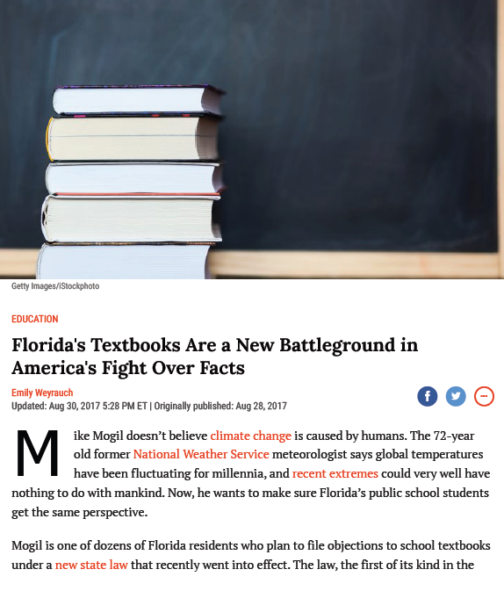
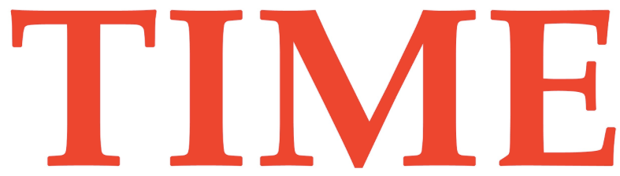

Florida has reopened the debate on textbooks
“Maybe we should just not teach it as strongly, maybe briefly cover it and move on.”

Slide 10


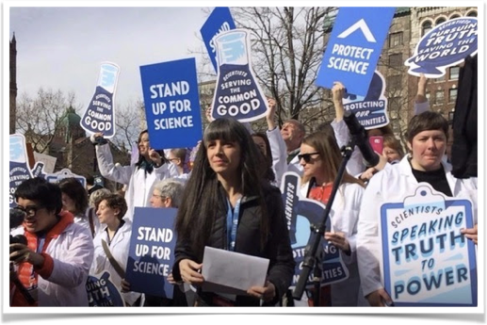
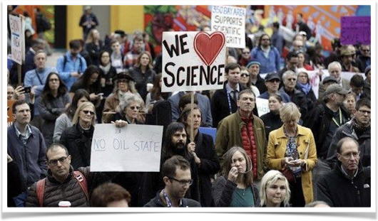

Slide 11
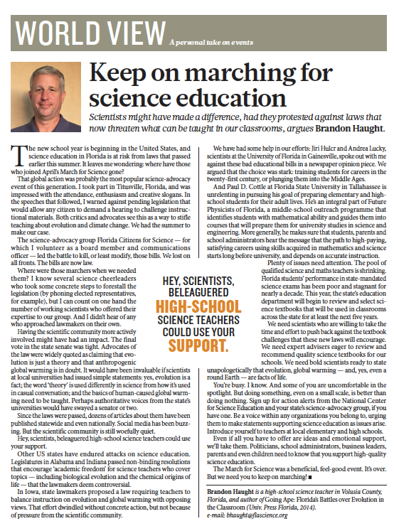

August 2017:
Florida teacher Brandon Haught called out the scientific community for its conspicuous lack of help when science education was under attack in his state.

Slide 12
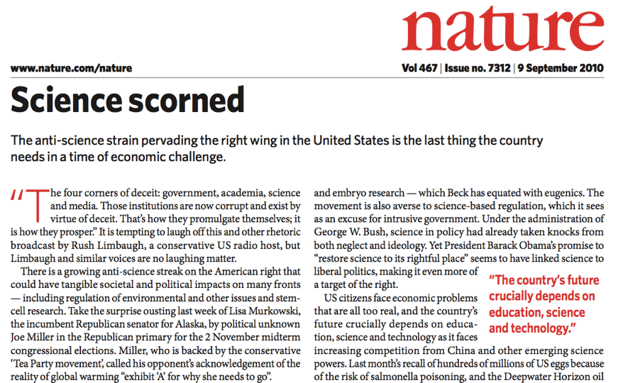
Evolution matters because it is Exhibit A for the anti-Science movement - but it’s not the only issue!

Slide 13
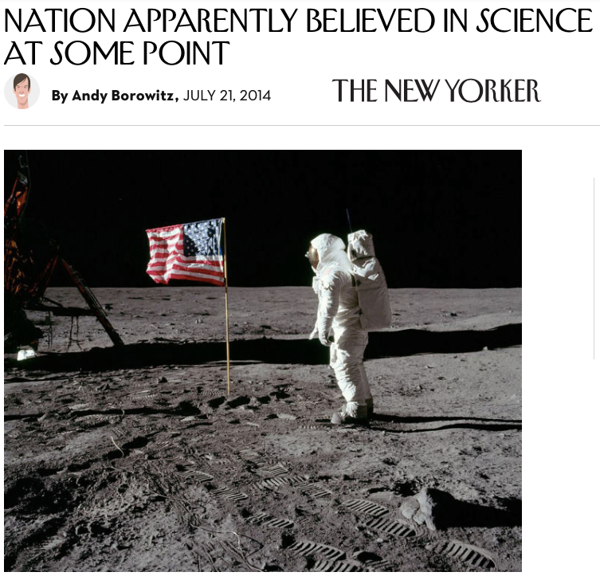
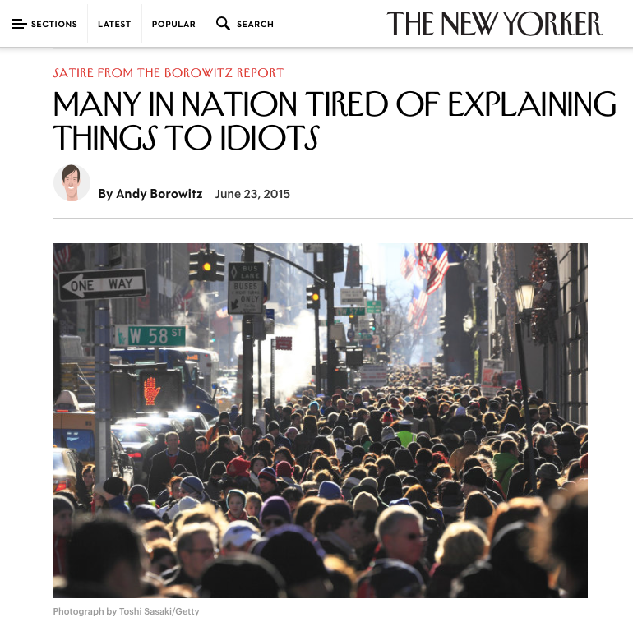

Slide 14
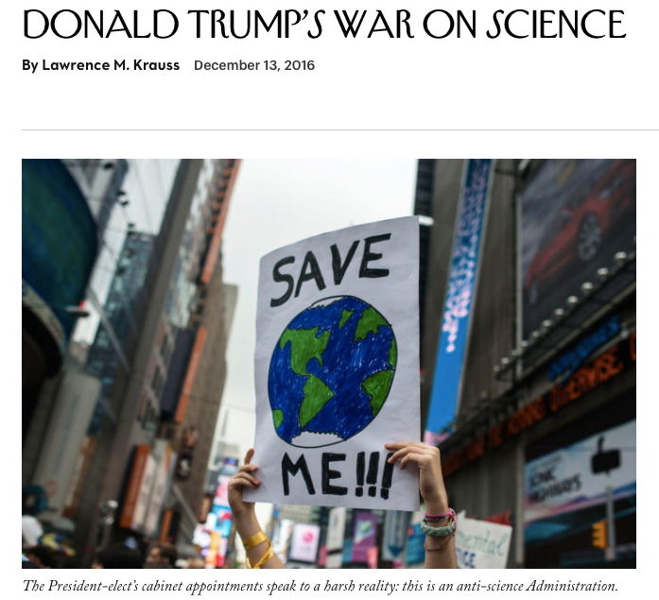
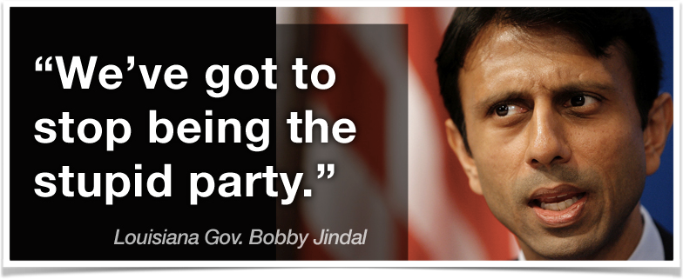
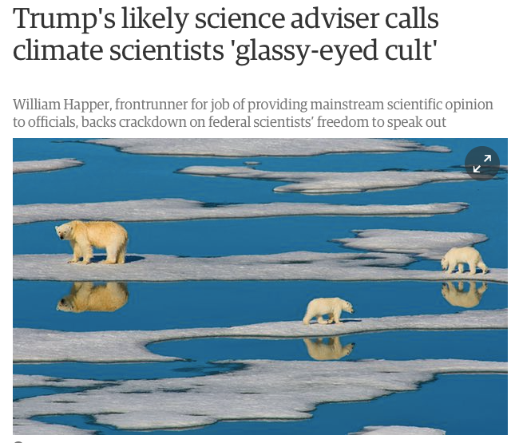
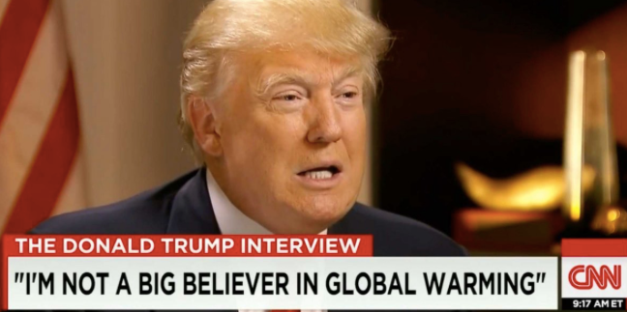
But the real question isn’t who’s being “stupid.”
It’s why depicting yourself as anti-science has become a viable political strategy.

Slide 15
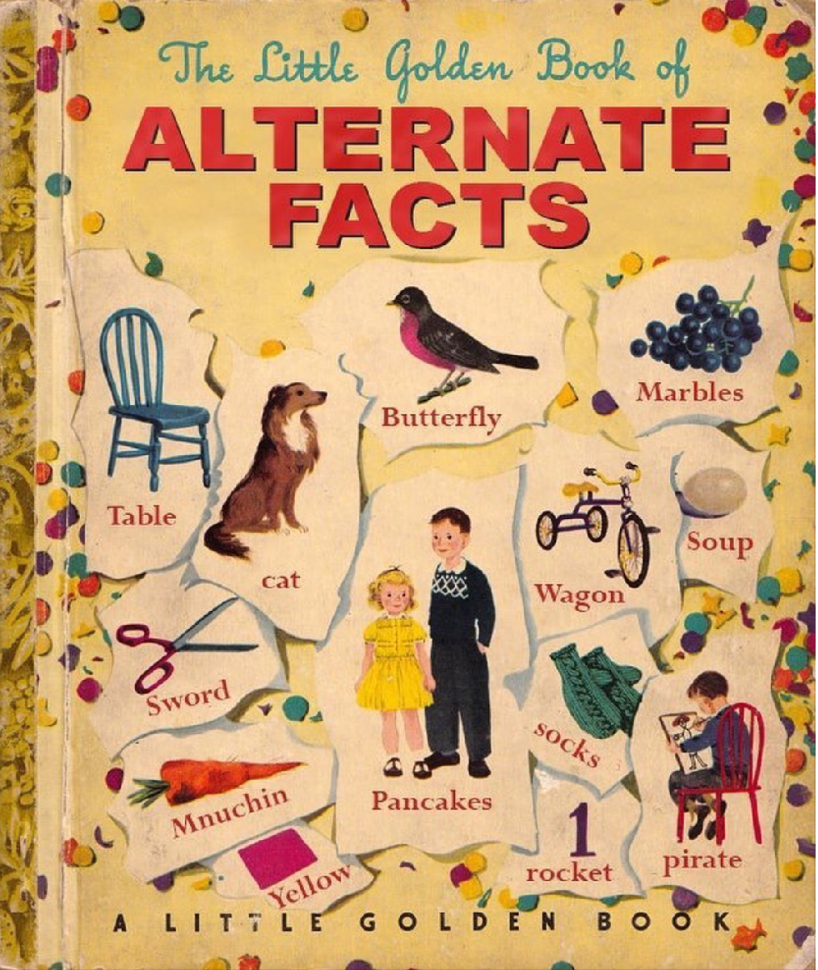
What’s happening?
(awareness of social context)
What are the roots of science denial?
(some similar, some different)
What tactics do denialists use?
(know your opponents)
What can we, as science educators, do?
(teach carefully & defensively)
What resources are available for teachers?
LOTS!

Slide 16
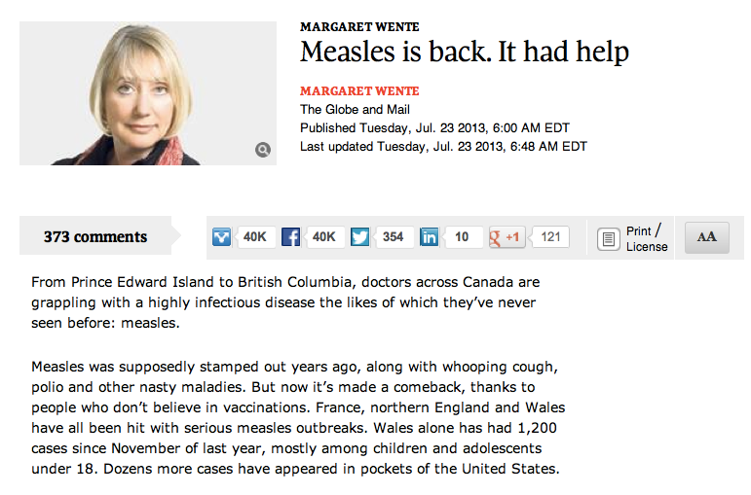
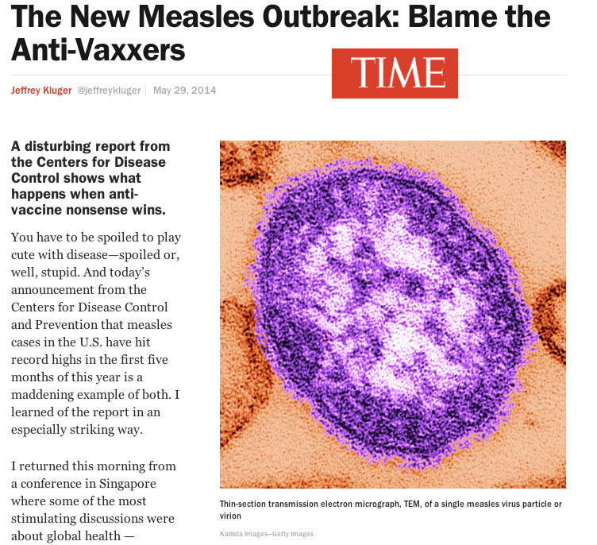
An Example:
The anti-Vaccine Movement

Slide 17
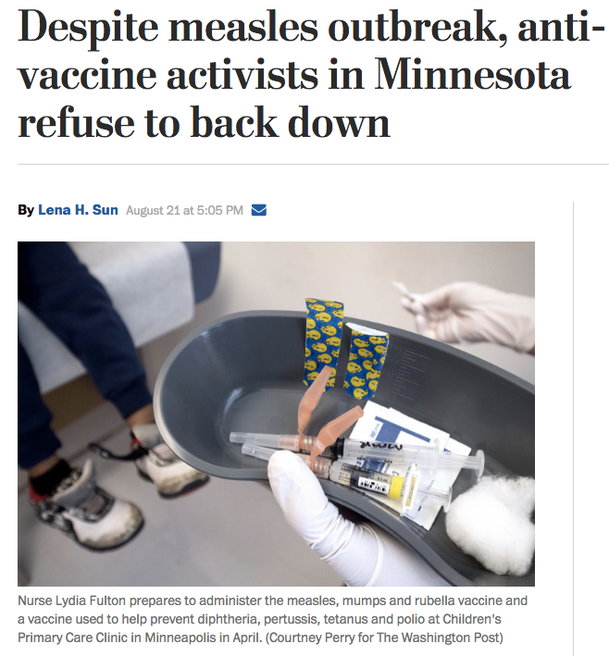

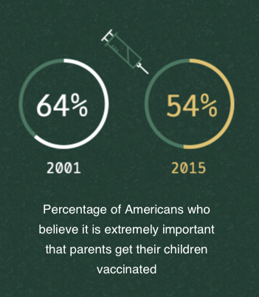
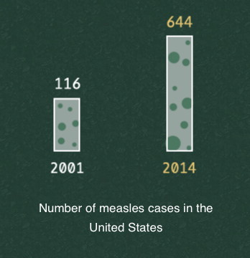

Slide 18
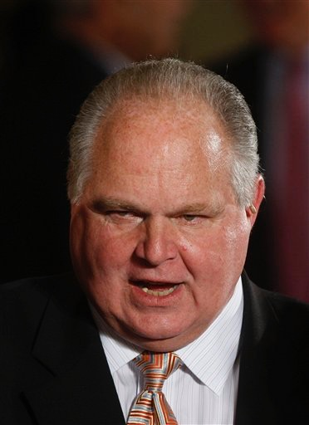
Conservatives associate vaccination programs with the Government.
Limbaugh on the H1N1 vaccine:
“Screw you, Ms. Sebelius! I am not going to take it, precisely because you're now telling me I must. It's not your role, it's not your responsibility, and you do not have that power. I don't want to take your vaccine. I don't get flu shots.”

Slide 19
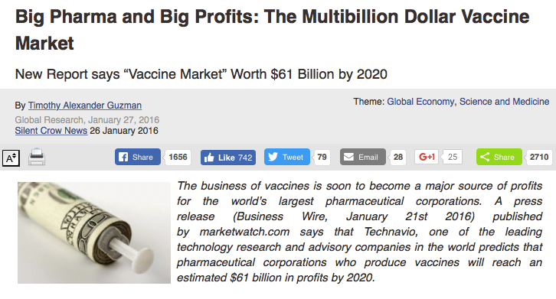


Progressives associate them with Big-Business Pharmaceutical Companies.

Slide 20
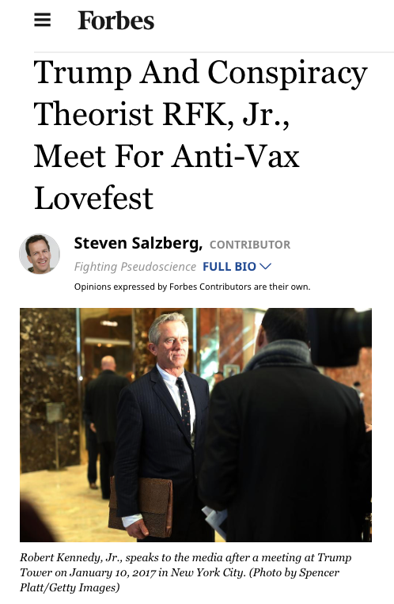
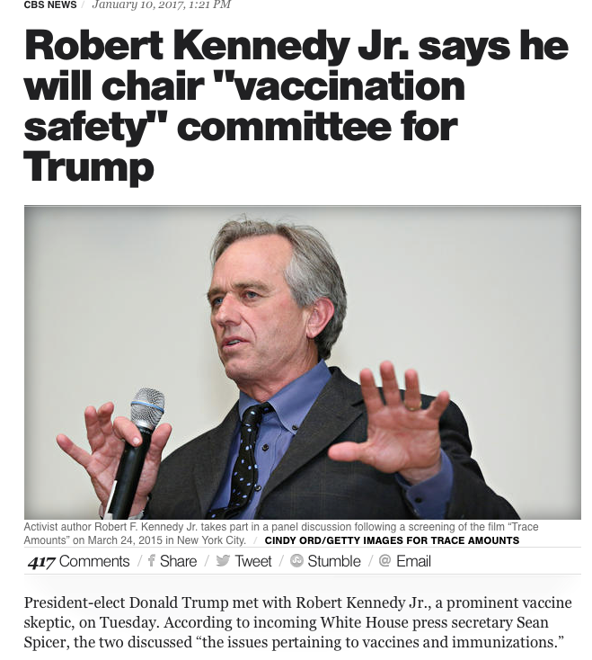
One such “Progressive” is RFK Jr.

Slide 21
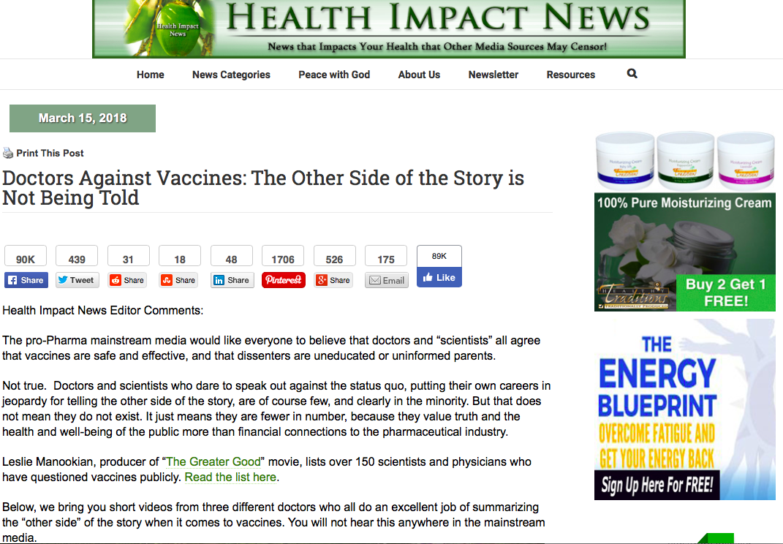


Slide 22
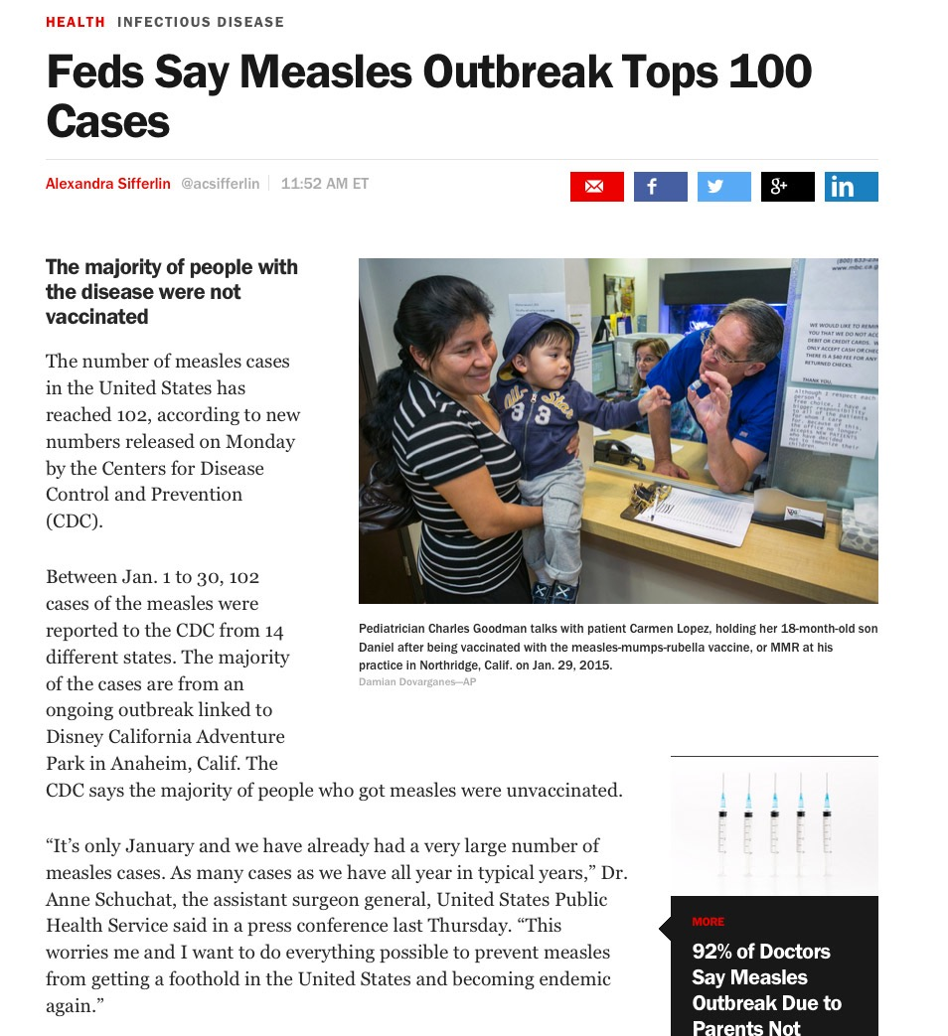
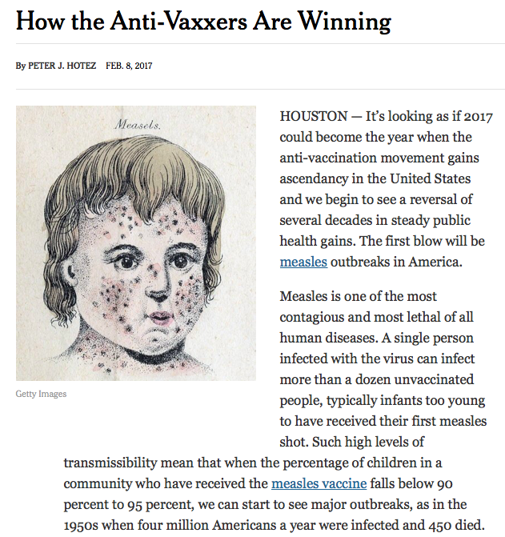

Slide 23



Slide 24





Slide 25



Slide 26






The facts?
• Vaccinations save lives
• The supposed “link” between vaccines and autism was a fraud.
But neither Limbaugh nor Kennedy would be swayed by the actual science of vaccine safety and effectiveness.
Because both are looking beyond the science itself.

Slide 27





American voters have consistently supported Science Deniers
WHY?

Slide 28





The attack comes from both the political right and the left.
Scientific American - November 2012

Slide 29



Slide 30



What are the roots of science denial?
A deep history of anti-intellectualism in the United States

Slide 31



Slide 32


Slide 33


<—Real Gnus

Slide 34


Why do you only teach the globe theory?
Why don’t you present both sides and let people decide?

Slide 35



Slide 36


Slide 37


Slide 38




Slide 39


Slide 40


Slide 41



Slide 42



Slide 43


Science denial is not about the facts

Slide 44
What tactics do denialists use?
A universal strategy:
Enlist any willing shill who has, or appears to have, scientific credentials.
Identify areas in which some scientific uncertainty - however small - exists.
Exaggerate uncertainty to create a “controversy”
Invoke an literalist/inerrant mindset to argue that if one small piece of the argument is flawed, the entire intellectual construct falls apart.
Argue that students should be exposed to all points of view: “teach the controversy”

Slide 45







Slide 46



Slide 47
Motivation for climate denial?
The simple and obvious answer: $$$$$$
The fossil fuel industry, like the tobacco industry before it, doesn’t want to give up a profitable product.
This create motivation to reject facts in conflict with that goal.
BUT: $$ alone doesn’t explain why some credentialed scientists would sign on to the deception
And it doesn’t explain why “ordinary people” — folks who don’t own oil wells or fossil fuel stocks — would be persuaded by denialist arguments.
Adapted from Naomi Oreskes’ AAAS Keynote lecture, 2017

Slide 48
A complex answer
A combination of partisan tribalism and:
Deep-seated belief in that the best and most efficient approach is to allow “The Market” to handle problems
Disbelief in the ability of government to deal with problems efficiently … if at all.
Worry that projected harm caused by climate change would justify expansion of government into the market … and personal lives.
Adapted from Naomi Oreskes’ AAAS Keynote lecture, 2017

Slide 49

Naomi Oreskes’ AAAS Keynote lecture, 2017

Slide 50

In all science courses, begin with the nature of science
What can we, as science educators, do?

Slide 51


Slide 52


Slide 53
Focus on the highest goal of science education:
FUNCTIONAL SCIENTIFIC LITERACY
Functional scientific literacy includes “knowledge and understanding of scientific concepts and processes required for personal decision making, participation in civic and cultural affairs, and economic productivity.”
(National Science Education Standards, National Academy of Sciences)
PBL, argument from evidence, crosscutting concepts, communication, understanding & constructing models, etc

Slide 54
Functional scientific literacy requires three related skill sets and understandings:
1. Familiarity with the body of scientific information, theories, and hypotheses that have been gathered by scientists over time.
2. Understanding the practices and approaches that comprise scientific inquiry and generate scientific information.
3. Ability to integrate and synthesize intra-disciplinary core ideas and inter-disciplinary cross-cutting concepts in ways that lead to new understanding and perspectives.

Slide 55


Slide 56
Emphasize that science ALWAYS deals with a mix of knowns and unknowns.
Distinguish between scientific reports, news reports, and sensationalistic reporting.
Emphasize that that science rarely “proves” anything; scientists aim for the best approximation of reality that our methods can reveal.
Uncertainty is always part of the nature & process of science.
Despite uncertainty, science can make useful predictions and prudent recommendations

Slide 57
How should functional scientific literacy work in informing public policy?
1. Observations show that the environment is changing in a way we think is dangerous.
2. More observations and research suggest that human activity is causing that environmental change.
3. Additional research strongly supports the hypothesis that a particular human activity causing the environmental change.
4. Scientific information is used, with input from economists, stakeholders, and government, to decrease or eliminate negative effects.

Slide 58

The situation with chlorofluorocarbons and the ozone layer is a great example of the progression from observation to scientifically-informed action.

Slide 59

Naomi Oreskes’ AAAS Keynote lecture, 2017

Slide 60
Be clear and precise in communicating!
Be especially careful/aware of differences between the way scientists use certain terms and the way the public interprets them.
Veterans of the “evolution-creationism wars” know about the importance of fully explaining what scientists mean by the word “theory.”
But there are LOTS more words we use in communicating science to our students that have very different meanings in common speech.
Lowest-hanging fruit: Belief vs understanding

Slide 61


Slide 62


Slide 63



Slide 64





Slide 65


Slide 66

What trusted resources are available for teachers?
www.ncse.com

Slide 67


The Antidote?
ncse.com

Slide 68



NCSE.com

Slide 69

http://evolution.berkeley.edu/

Slide 70


Slide 71



Slide 72

http://www.pbs.org/evolution

Slide 73

nationalacademies.org/evolution

Slide 74



Slide 75

cleanet.org

Slide 76

skepticalscience.com

Slide 77


